Slide 1
SINE 2020 Project and Detectors WP Overview
Nigel Rhodes
SINE 2020 Meeting PSI
13 June 2017

Slide 2
Introduction
Introduction
Why are neutron scattering and MuSR important
Diverse detector requirements
SINE 2020
SINE 2020 WP 9
Interaction with industry

Slide 3
Neutrons and muons
Neutrons have some unique properties
  Wavelength is commensurate with atomic spacing
  Energies are similar to energies of atomic vibrations and molecular rotations
  Zero charge
  Magnetic moment
Ideal probes for looking at the structure and dynamics of material on an atomic and molecular scale. Complimentary information to x-ray scattering
Muons are ideal probes for studying the internal magnetic fields of materials on an atomic scale

Slide 4
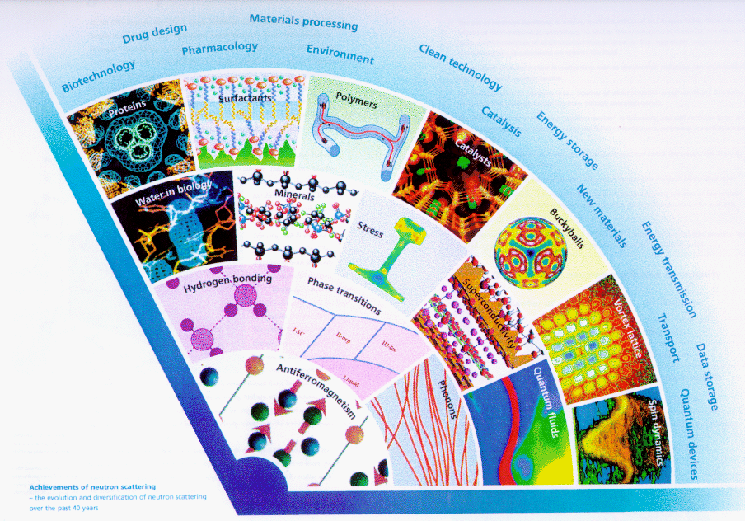
Applications of neutron scattering
2000
1990
1980
1970
1960
Between 5000 – 10,000 scientists in Europe making use of neutron and muon techniques

Slide 5
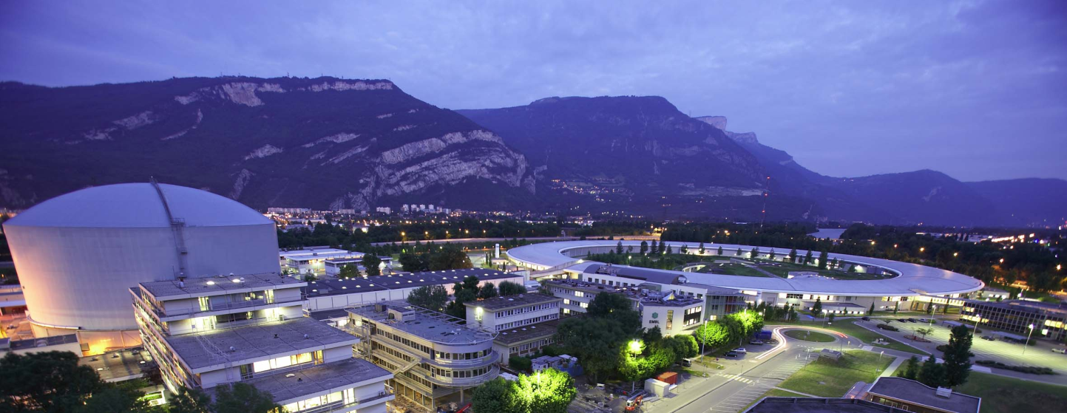
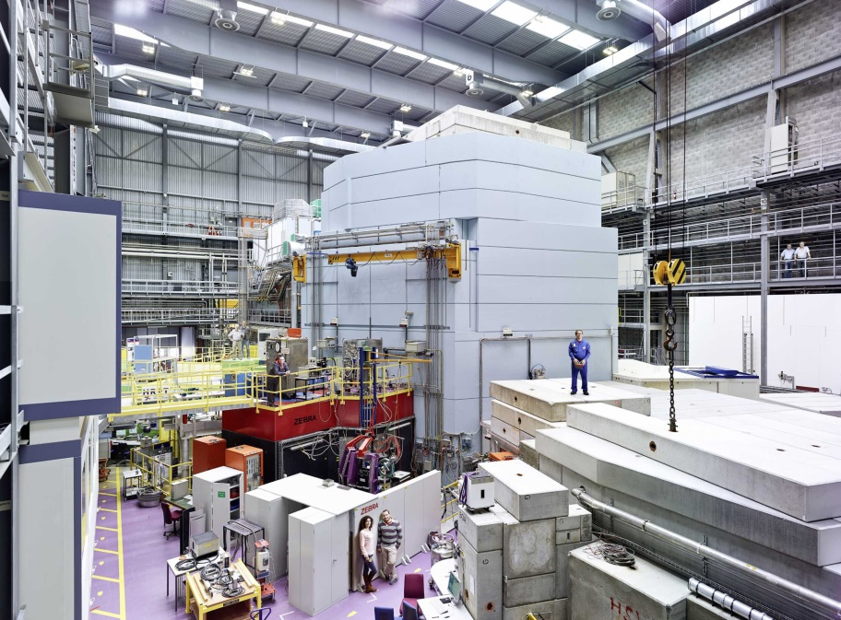
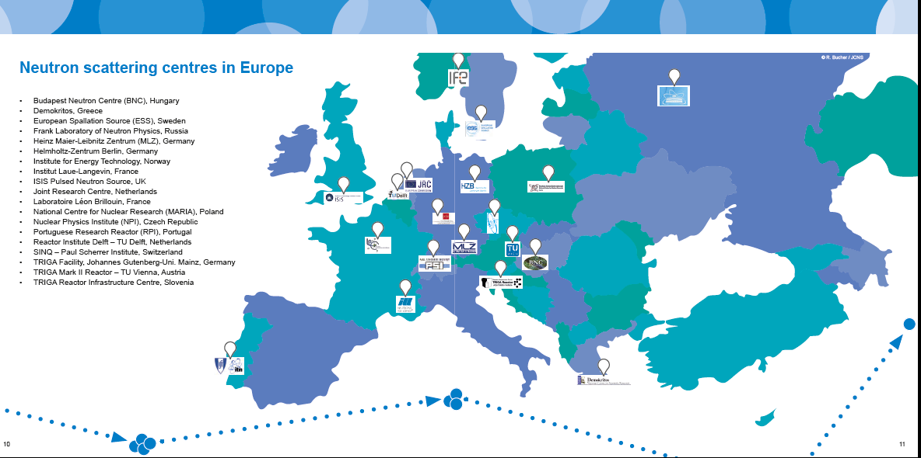
Neutron and Muon Production
Large Scale facilities are required for neutron and Muon Production
PSI and ISIS are the two European muon sources

Slide 6
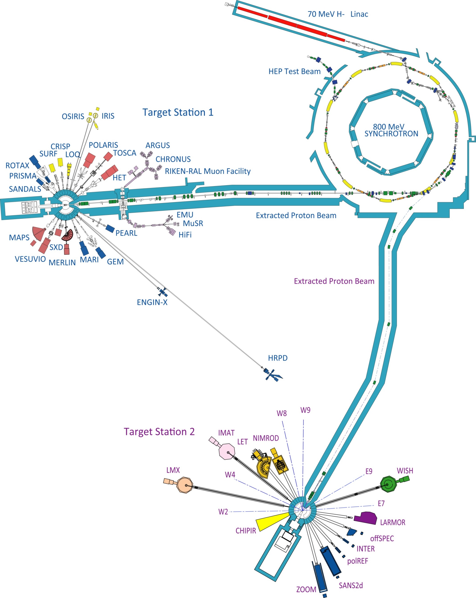
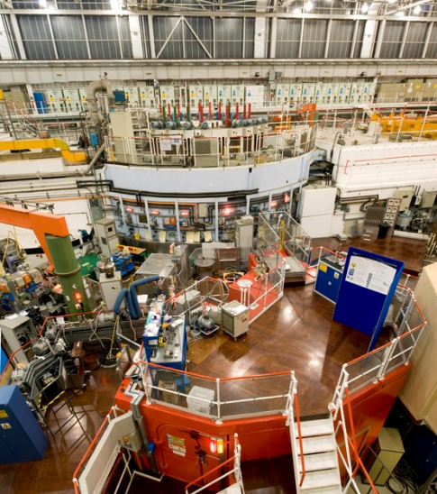

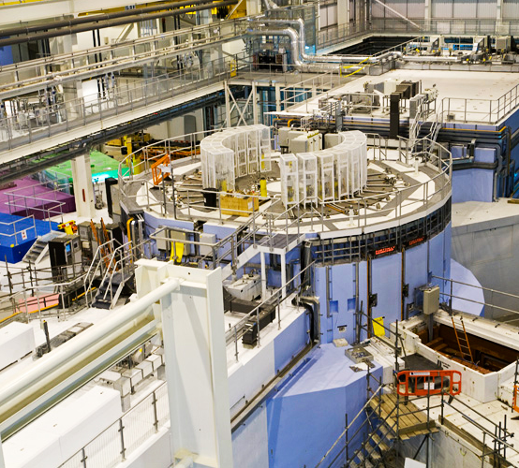
Instrument Diversity
Set up for discussion
30 Neutron instruments
7 Muon instruments

Slide 7
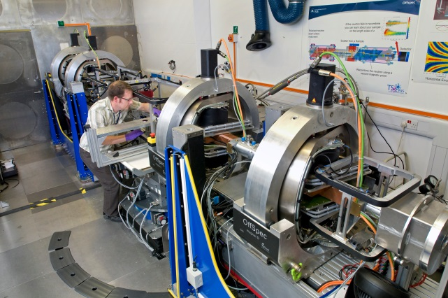
INSTRUMENT DIVERSITY
The ISIS Instrument Suite
Thirty neutron scattering nstruments at ISIS
Seven instruments for muon
The neutron instruments are designed for many different applications
7 Diffractometers
6 Reflectometers
4 Chopper spectrometers
3 SANS instruments
2 Quasielastic spectrometers
2 SANS instruments for liquid and amorphous samples
1 Single crystal diffractometer
1 Molecular spectoscopy spectrometer
1 Deep inelastic scattering spectrometer
1 Chip Irradiation facility
1 Neutron detector test facility
7 Muons spectrometers

Slide 8
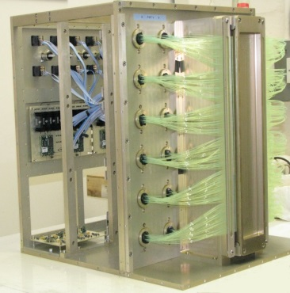
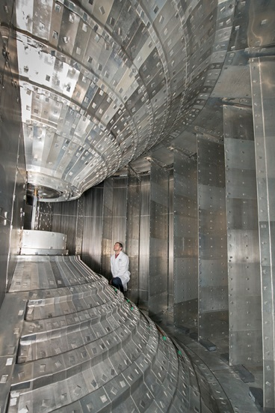
Detector Diversity
Many have more than one dual requirements
~50 % of the detectors are based on gas technology
~50 % are based on scintillator technology
Detector requirements for different classes of instruments require:
    Coverage
    Position resolution
    Detector efficiency
    Insensitivity to gamma radiation
    Rate capability
    Environment
    Etc
No one size fit all
Rarely are two instruments in the same class built with the same detector design

Slide 9
Detector development requirements
Access to beam time for detector development
Detector development needs access to neutrons
Historically a lot of detector development has been caried out at the LSFs.
Use of radioactive sources is highly beneficial since beam time is expensive
Use of some beam time is essential for detector development
Access to funding
Once a facility is established money for building a new beam line comes via a grant application of through capital infra structure.
This is often time bound 3 – 5 years
Detector development can take longer and needs to be near completion before the money is available to build an instrument.

Slide 10
Detector development requirements
Detector development for Neutron and muon applications is critically dependent on a few key components
Scintillation detectors
Appropriate scintillator
WLS fibre
Multi Anode PMTs
Appropriate SiPMs
Adequate electronics
Gas detectors
3He at an affordable price
Availability of micopattern detector technology
Adequate electronics

Slide 11
SINE 2020: AIMS
SINE2020 is an EC funded Horizon 2020 Research and Innovation programme to develop world-class Science and Innovation with Neutrons in Europe in 2020.
The principle aims of the programme are:
preparing Europe for the unique opportunities at the European Spallation Source in 2020
developing the innovation potential of neutron Large Scale Facilities (LSFs).
Muon spectroscopy is a closely related, highly complementary technique (PSI and ISIS)
Much of the neutron-oriented work will benefit muon spectroscopy
Several muon specific developments will be undertaken within SINE2020
SINE2020 started on 01 October 2015
Will run for four years
Received 12MEuro
Grant agreement No 654000

Slide 12
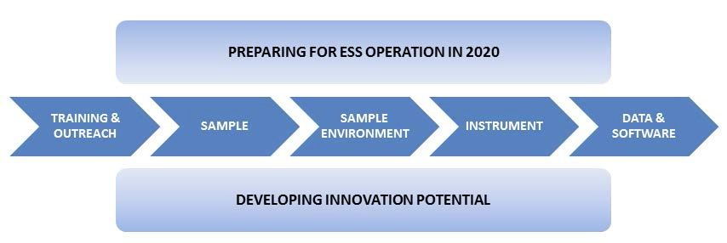
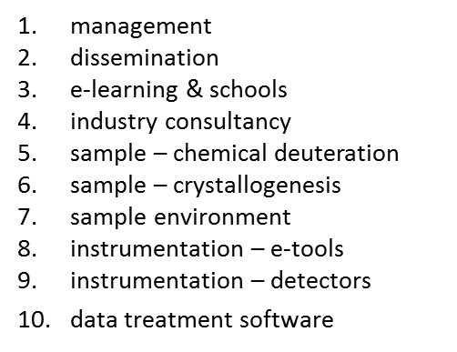
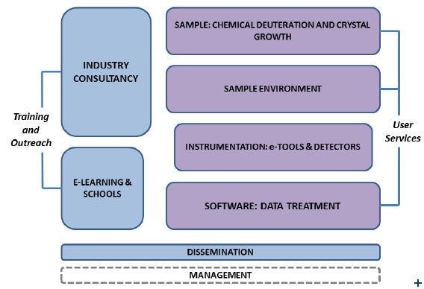
SINE 2020 WPs
Programme divided into 10 Work Packages
Details of the SINE 2020 project can be found at http://www.sine2020.eu

Slide 13




SINE2020 Partners
SINE2020 comprises 18 partner institutions from 12 European countries (12 RIs + 6 APs)
Czech Republic
Nuclear Physics Institute
Denmark
Niels Bohr Institute, UCPH
Technical University of Denmark, DTU
France
Institut Laue-Langevin (ILL)
DSM/IRAMIS/LLB, CEA
Germany
Forschungs-Neutronenquelle Heinz Maier-Leibnitz (FRM II), TUM
Helmholtz-Zentrum Berlin (HZB)
Helmholtz-Zentrum Geesthacht (HZG)
Jülich Centre for Neutron Science (JCNS)
Hungary
Centre for Energy Research, Hungarian Academy of Sciences
Italy
Universita' degli Studi di Parma
Portugal
Laboratório de Instrumentação e Física Experimental de Partículas (LIP)
Spain
ESS Bilbao
Instituto de Ciencia de Materiales de Aragon (ICMA), Uni. Zaragoza
Sweden
European Spallation Source (ESS)
Switzerland
SINQ, Paul Scherrer Institute (PSI)
The Netherlands
Reactor Institute Delft, TUD
UK
ISIS Neutron and Muon Source, STFC

Slide 14
WP 9: Detectors - Focus
ESS has a requirement for detectors with many different characteristics.
Decided to focus work package towards neutron reflectometry applications at the ESS
Particularly challenging in terms of high resolution and high rate
Output of the detector development programme to be beneficial for the other RIs.
General ESS detector requirements:
Spatial resolution for 1 – 3 mm
Perspective improvement into the sub mm range
Time resolution better than 100 μs
Local instantaneous rate capability of several kHz per mm²
(to be revised upwards)

Slide 15
WP 9: Task 9.1
WP 9 is divided into 4 tasks
TASK 9.1:
Involvement of industry and the wider European neutron and muon detector communities in detector development
Invite manufacturers of critical detector components to selected RTD meetings
Common requirement and united approach
Eg Scintillator manufacturers – improve quality of products
Feedthrough manufactures – improve quality of products
Would be manufacturers of detectors could be invited to selected RTD meetings
Stimulate transfer of detector requirements to industry
Invite detector personnel from groups outside RTD to participate in RTD meetings
Promotes exchange and dissemination of information

Slide 16
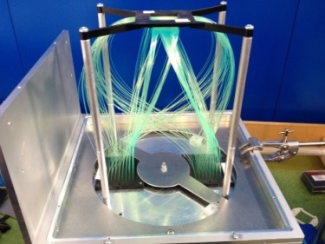
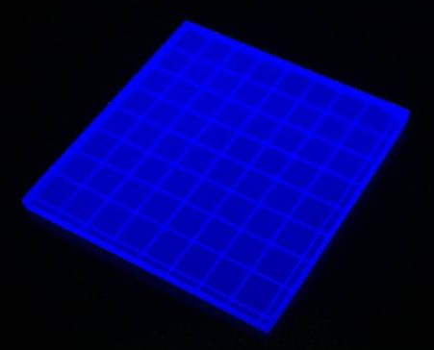
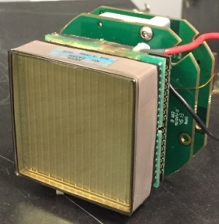
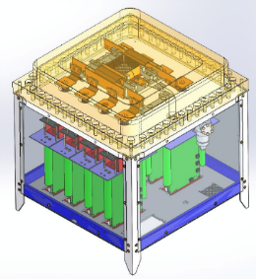
WP 9: Tasks 9.2 and 9.3
TASK 9.2:
Development of scintillation detectors with high rate capability for reflectometry
9.2.1 ZnS scintillation detector with WLS fibre readout
9.2.2 Scintillation detector with direct PMT readout
TASK 9.3:
Development of a 3He based microstrip gas with a novel 2D readout
T9.2.1
T9.2.2
T9.3

Slide 17
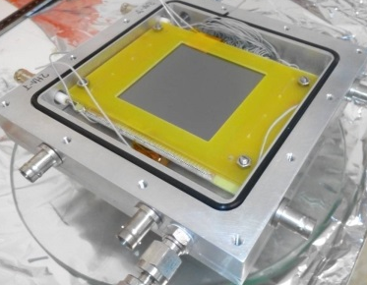
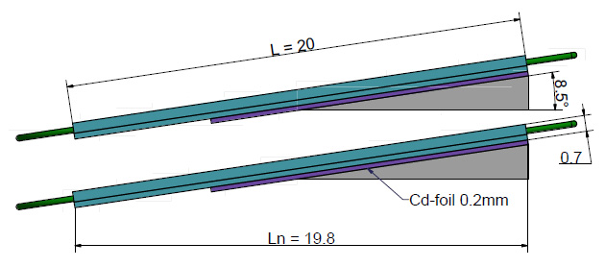
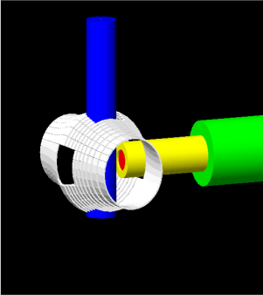
WP 9: Task 9.4
TASK 9.4:
Emergent Detector Technologies for neutron scattering and muon spectroscopy
9.4.1 ¹⁰B₄C coated Resistive Plate Chambers for Position Sensitive Neutron Detectors
9.4.2 Silicon Photomultipliers for Neutron scattering
9.4.3 Silicon Photomultipliers for Muon Spectroscopy
9.4.4 Micromegas detectors
T9.4.1
T9.4.2
T9.4.3
T9.4.4

Slide 18
Interaction with Industry
Within SINE 2020 we have a number of detector developments that we are pursing
By the end of the project the potential of these developments will be clearer
However, without significant further development outside of SINE 2020 these project will not be technologically ready to deploy on beam lines other than as one off prototype detectors.
While development is going on we are very vulnerable with key components only available from a single source
Can we make more effective use of our interactions with industry than we are currently doing?
Either in component development or detector construction
Not limited to these developments in SINE 2020, but applies all the detector development and construction programmes at the neutron and muon LSFs.

