Slide 1
Detectors for MuSR
Erik Schooneveld, Steve Cottrell, Daniel Pooley, Lakshan Ram, Nigel Rhodes
STFC, ISIS facility, UK
Industry day, SINE2020
13th June 2017

Slide 2
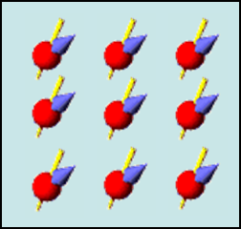
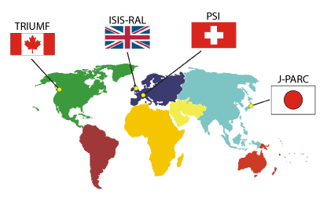
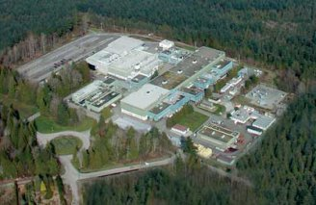
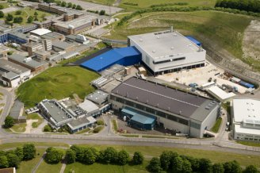
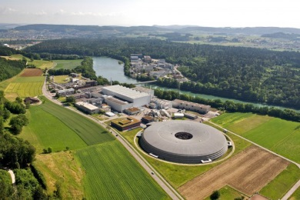
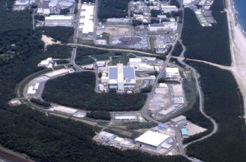
Introduction
MuSR: Muon spin spectroscopy
Study of magnetic fields inside materials
4 facilities: Triumf, Canada
ISIS, United Kingdom
PSI, Switzerland
J-PARC, Japan

Slide 3
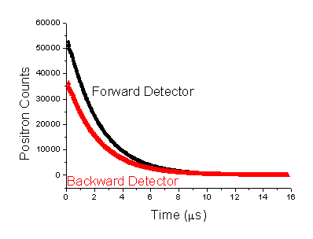
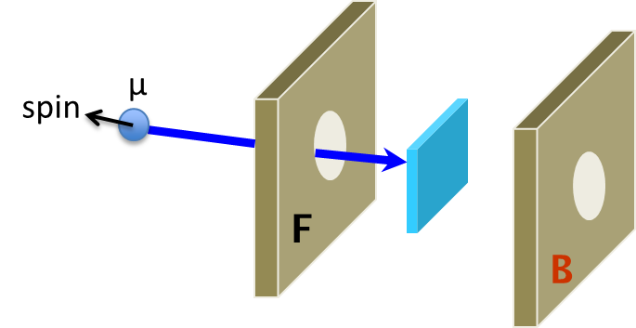
Introduction
Principle
Basically “simple” detector
e+

Slide 4
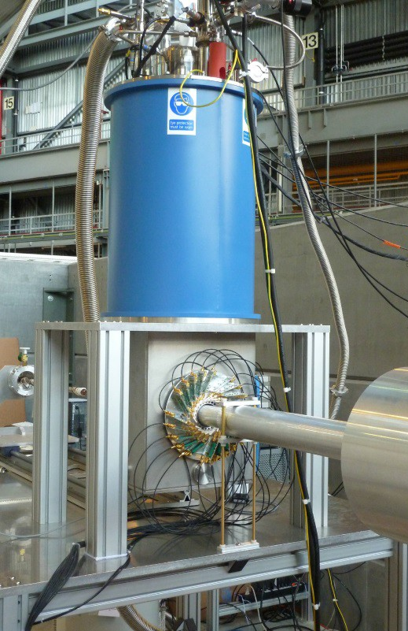
Detectors
HAL-9500 (PSI), 32 detectors
Detector module

Slide 5
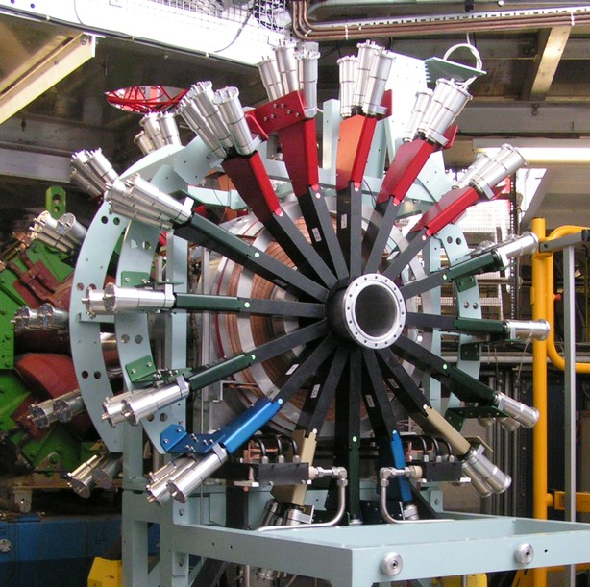
Detectors
EMU (ISIS), 96 detectors

Slide 6
Detectors
Specifications:
Position sensitivity: 1 cm² (used to be 10-100 cm²)
Number of detectors: ~100
Work in high magnetic fields (2000 times kitchen magnet)
Count rate capability (ISIS): > 10 MHz (10 ns pulse width)
Timing accuracy: σ < 100ps (PSI), 1ns (ISIS)
Notes:
200.000 earth magnetic field

Slide 7
Detectors
Modern detectors:
Could fulfil al requirements.
Plastic scintillator
Light guide
Light sensor + electronics
Detector element of ALC (PSI)

Slide 8
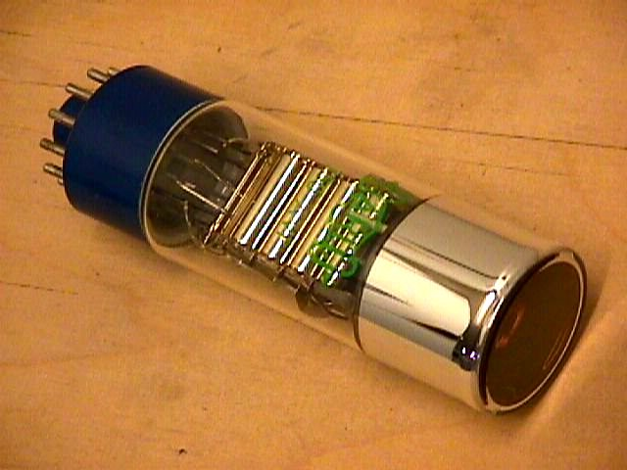
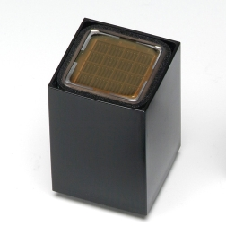
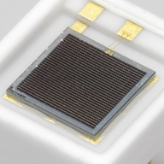
Detectors
Light sensor
Photomultiplier tube (PMT). SiPM / MPPC

Slide 9
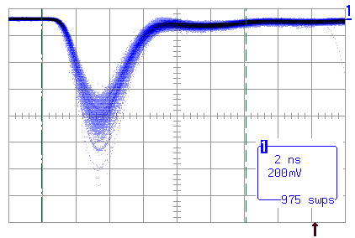
Detectors
Light sensor properties
SiPM is most promising
Properties | PMT | SiPM
Light sensitivity | 25% | 50%
Gain | 10⁷ | 10⁶
Signal duration | 2ns | 50ns
Timing accuracy | 150ps | <100ps
Noise counts (kHz/mm²) | 0.01-0.1 | >100
Magnetic sensitivity | high | none
Temperature sensitivity | Low | Medium
Area | ~10-1000mm² | 10mm²
Life time | Very long | Medium

Slide 10
Requirements
Plastic scintillator
Produce as much light as possible
Produce short flash of light
Commercially available
Not vary with temperature variations
Long life time

Slide 11
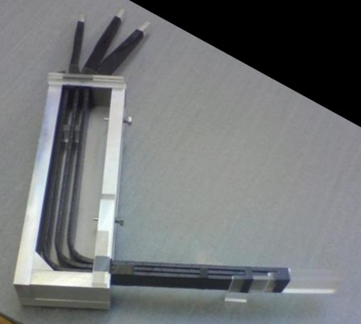
Requirements
Efficient light transport
Shortest light pulses
Commercially available
Robust
Fibre

Slide 12
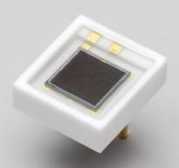
Requirements
Light sensor (SiPM)
High sensitivity + gain (large signals)
Very good timing accuracy
Short signal duration
Commercially available
Low temperature sensitivity
Low noise
Long life time

Slide 13
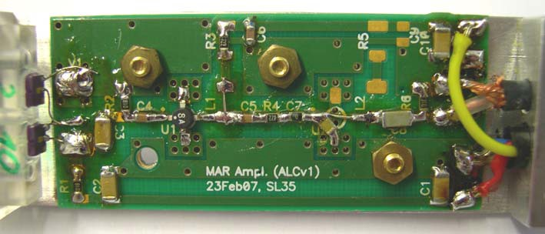
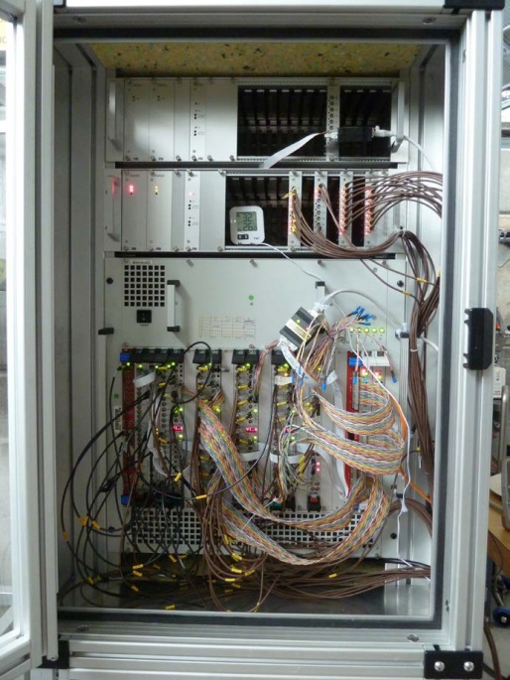
Requirements
Electronics:
Very fast + process small analogue signals
Compact + size tailored to detector
Acceptable power dissipation
Usually designed in-house

Slide 14
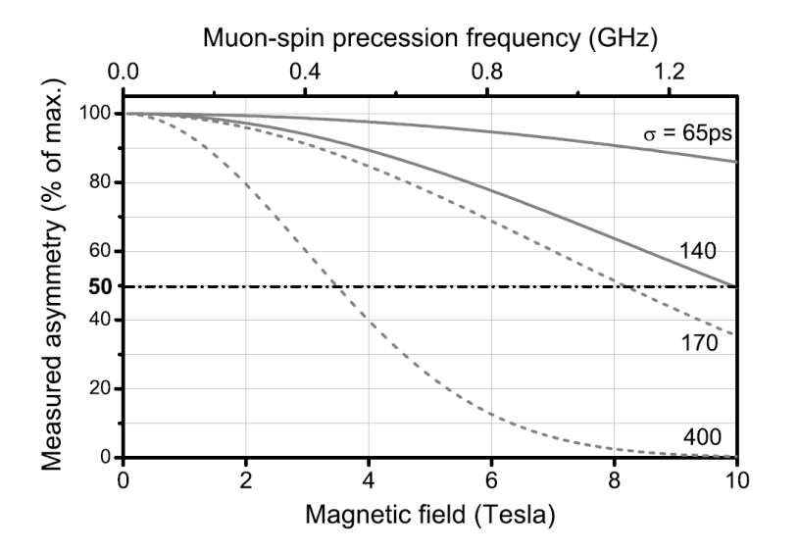
Challenges
Higher magnetic fields ⇒ faster detector
Faster SiPM
Faster scintillator + fibres
Faster electronics
Timing accuracy (ps)

Slide 15
Challenges
Increase count-rate capability: 10 times more muons
Faster detector will help a bit

Slide 16
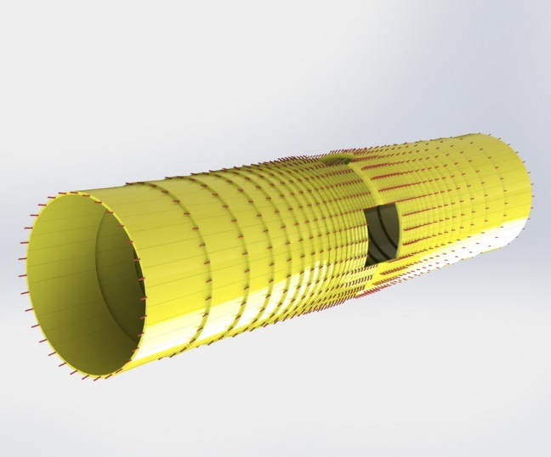
Challenges
Solution: More detectors
Assembly of detectors: specialized work
Electronics?
96 detectors
1216 detectors

Slide 17
Conclusion
Know how to build MuSR detectors
Future: 1) Faster detector components
2) Large increase in number of detectors

Slide 18
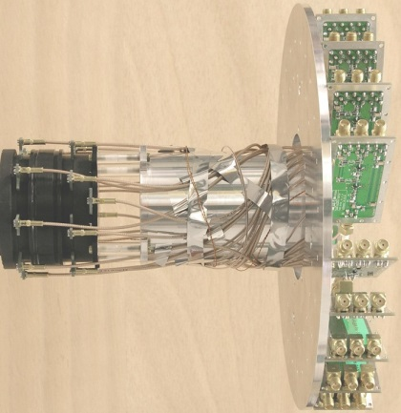
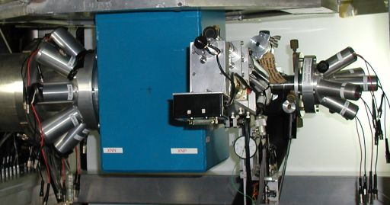
The end
Thank you very much for your attention

