Slide 1
SINE2020 WP9 Meeting and Industry day
M. Hildebrandt :: NUM :: Paul Scherrer Institut
A very warm welcome to you at PSI !
SINE2020 WP9 Meeting, PSI, 13./14.06.2017

Slide 2
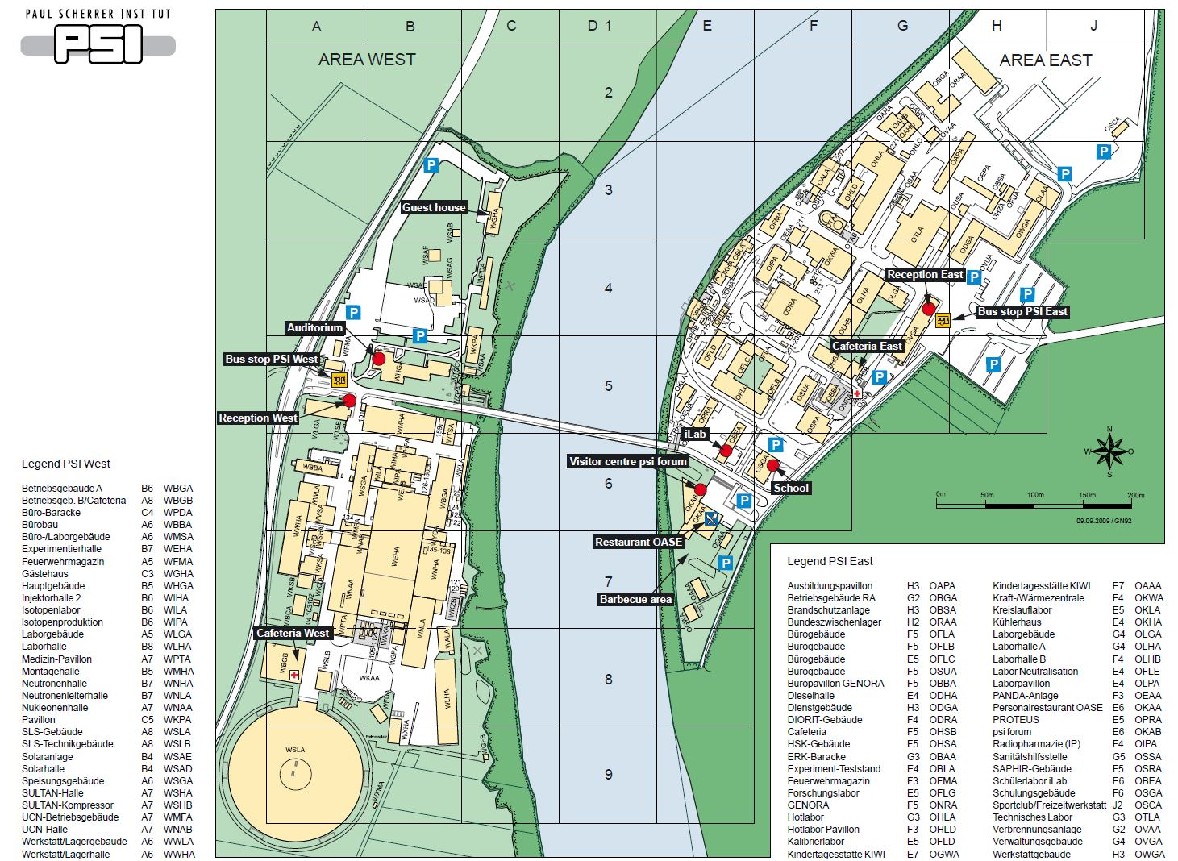
Parking
▪ in case you came by car, please note that parking fees apply
▪ vending machine right at entrance of parking place
▪ violations get ticketed

Slide 3
Bus Connection to Böttstein or Brugg
▪ bus stop PSI West: bus 376 direction Döttingen (via Böttstein)
direction Brugg
to Döttingen: xx:23
xx:53
last bus 20:23
to Brugg: xx:04
xx:34
last bus 21:04
▪ bus tickets are prepared and
available
Böttstein
Villigen/Brugg

Slide 4


WP9 Instrumentation: Detectors RTD Meeting
Tuesday 13th June 2017
Venue: The Auditorium, Paul Scherrer Institute, 5232 Villigen PSI Switzerland
Tuesday 13 June 2017
 | Time | Title | Speaker | Chair
09.00 | 09.10 | Welcome | Malte Hildebrandt Nigel Rhodes
09.10 | 09.35 | SINE2020 project and Detectors WP overview | Nigel Rhodes
09.35 | 10.00 | Scintacor: Company overview and neutron/muon interest | Carlo De Stefanis
10.00 | 10.25 | GERS: Company overview and neutron/muon interest | Jon Voss
10.25 | 10.50 | Coffee
10.50 | 11.15 | Waterjet: Company overview and neutron/muon interest | Stefano Volpe
11.25 | 11.40 | CDT: Company overview and neutron muon interest | Christian Schmidt
11.40 | 11.50 | Arktis: Company overview and neutron muon interest | Giovana Davatz
11.50 | 12.15 | Technology and Innovation Park Innovaare | Nils Gebhardt
12.15 | 12.30 | IMT: Company overview and neutron/muon interest | Immo Knopfel
12.30 | 12.45 | Scintillator detectors with WLS fibre + PMTs: ISIS | Nigel Rhodes
12.45 | 13.40 | Lunch
13.40 | 13.55 | Scintillator detectors with direct readout and PMTs: FZJ | Ralf Engels
13.55 | 14.10 | 3He Microstrip gas chamber with novel 2D readout: ILL | Bruno Guerard
14.10 | 14.25 | Resistive Plate Chambers: LIP | Luis Margato
14.25 | 14.40 | Scintillator detectors with WLS fibre + SiPMs: PSI | Malte Hildebrandt
14.40 | 14.55 | Detectors for MuSR | Erik Schooneveld
14.55 | 15.10 | 10B Micromegas detectors: LLB | Georgios Tsiledakis
15.10 | 15.35 | Photo and Coffee
15.35 | 16.25 | Discussion
16.25 | 17.25 | Tour of SINQ
19.00 |  | Dinner

Slide 5
WiFi
▪ SSID: eduroam
▪ SSID: conf userID: wlan-conf
password: DuqEHj57
▪ SSID: guest
no password, but only vpn & email protocols (imaps, smtps)

Slide 6
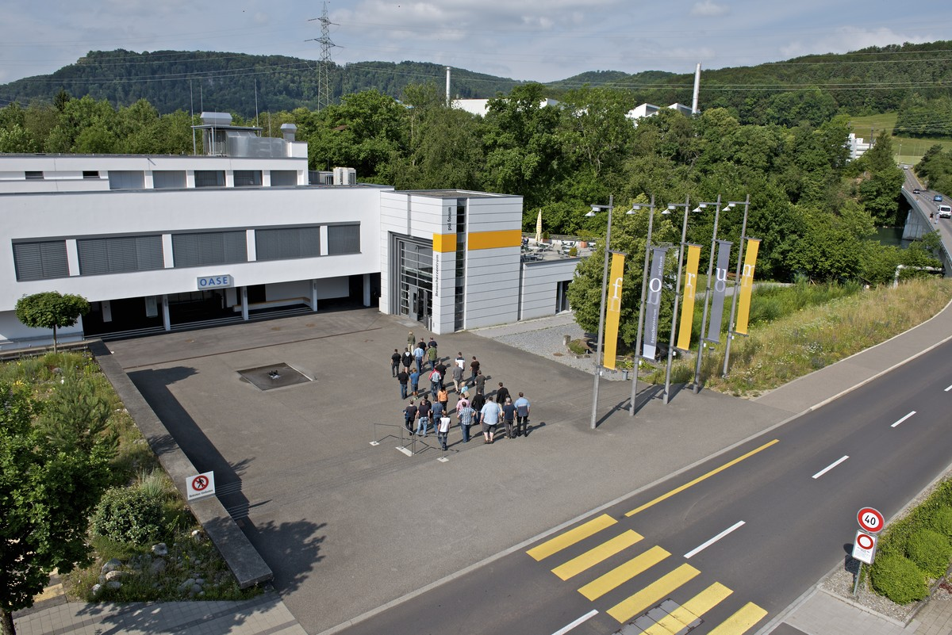
Coffee, Lunch
coffee: outside Auditorium in
foyer of this building
lunch: PSI restaurant OASE
lunch voucher (1 lunch, 1 drink)
remark for Georgios:
OASE is closed on Wed evening

Slide 7
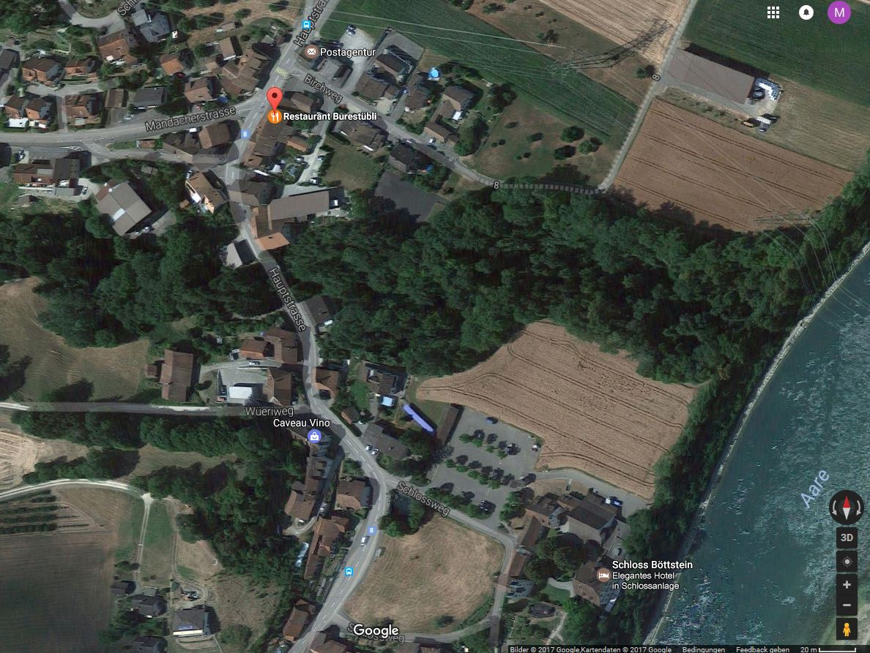
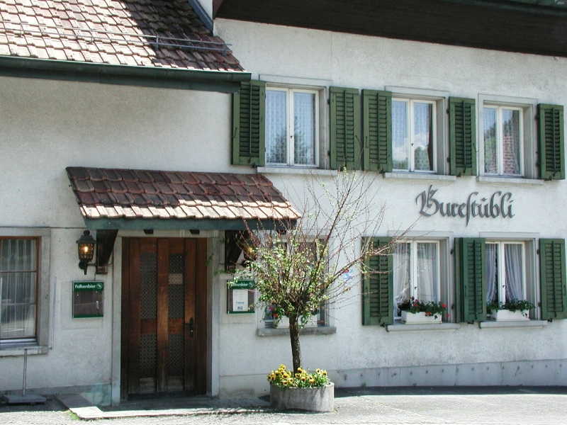
Dinner
dinner: 19:00 Burestübli in Böttstein
bus stop "Böttstein, Birch"
car parking
bus stop "Böttstein, Schloss"

Slide 8
Questions
▪ Any questions?
▪ Any issues which need to be solved right now?

Slide 9
WP9 Instrumentation: Detectors RTD Meeting
Tuesday 13th June 2017
Venue: The Auditorium, Paul Scherrer Institute, 5232 Villigen PSI Switzerland
Tuesday 13 June 2017
 | Time | Title | Speaker | Chair
09.00 | 09.10 | Welcome | Malte Hildebrandt Nigel Rhodes
09.10 | 09.35 | SINE2020 project and Detectors WP overview | Nigel Rhodes
09.35 | 10.00 | Scintacor: Company overview and neutron/muon interest | Carlo De Stefanis
10.00 | 10.25 | GERS: Company overview and neutron/muon interest | Jon Voss
10.25 | 10.50 | Coffee
10.50 | 11.15 | Waterjet: Company overview and neutron/muon interest | Stefano Volpe
11.25 | 11.40 | CDT: Company overview and neutron muon interest | Christian Schmidt
11.40 | 11.50 | Arktis: Company overview and neutron muon interest | Giovana Davatz
11.50 | 12.15 | Technology and Innovation Park Innovaare | Nils Gebhardt
12.15 | 12.30 | IMT: Company overview and neutron/muon interest | Immo Knopfel
12.30 | 12.45 | Scintillator detectors with WLS fibre + PMTs: ISIS | Nigel Rhodes
12.45 | 13.40 | Lunch
13.40 | 13.55 | Scintillator detectors with direct readout and PMTs: FZJ | Ralf Engels
13.55 | 14.10 | 3He Microstrip gas chamber with novel 2D readout: ILL | Bruno Guerard
14.10 | 14.25 | Resistive Plate Chambers: LIP | Luis Margato
14.25 | 14.40 | Scintillator detectors with WLS fibre + SiPMs: PSI | Malte Hildebrandt
14.40 | 14.55 | Detectors for MuSR | Erik Schooneveld
14.55 | 15.10 | 10B Micromegas detectors: LLB | Georgios Tsiledakis
15.10 | 15.35 | Photo and Coffee
15.35 | 16.25 | Discussion
16.25 | 17.25 | Tour of SINQ
19.00 |  | Dinner

