Slide 1
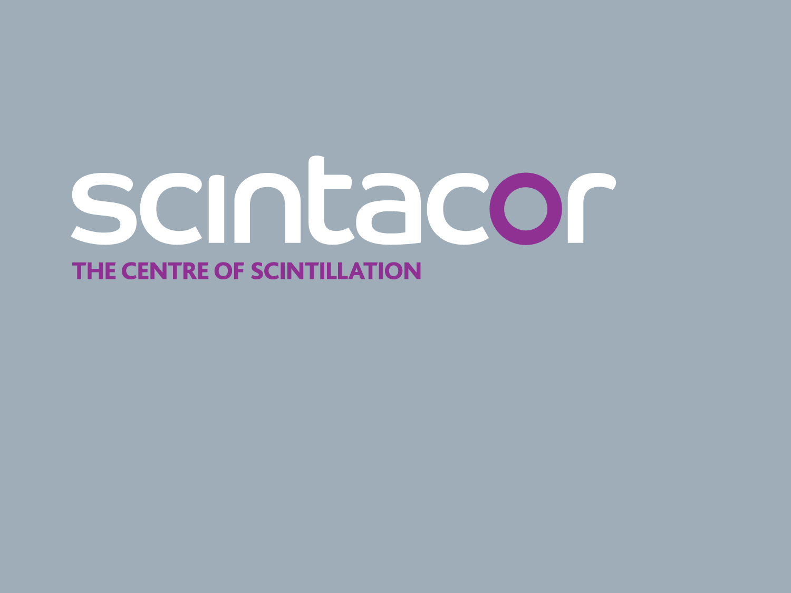
Sine 2020 – 13.06.17
Encouraging industry participation in detector development and construction, a Scintacor perspective.

Slide 2
Contents
Scintacor: overview & capabilities
Faxitron: overview & capabilities
Scintacor road map
Promoting industry participation

Slide 3
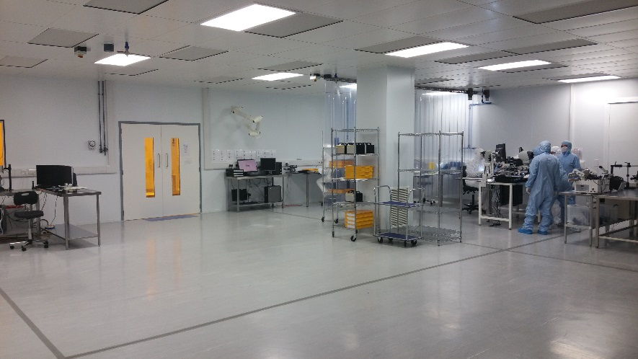
Scintacor: overview
Specialist scintillation company with a strong customer focus
Founded in the 1920’s as Levy West Laboratory, which pioneered the use of phosphor structured scintillators for imaging and detection
Continued investment in manufacturing and R&D
2,700 m² state-of-the-art facility in Cambridge UK
Extensive clean room environment
Steady revenue growth (FY 2015/16 ~$10m)
50 people, 10 in Engineering / R&D
Privately owned, self-funded, long term view
Notes:
Working collaboratively with customers do develop tailor-made products.
Heart of Cambridge technology cluster
Something about our ownership: not a private equity, not seeking quick ins and outs, but track record for growing companies in the long run

Slide 4
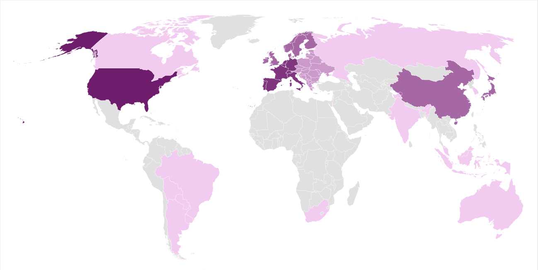
93% export mainly US and Europe
Life Science
Oil&Gas
Dental
Security
Research
Industrial
Medical
Photonics

Slide 5
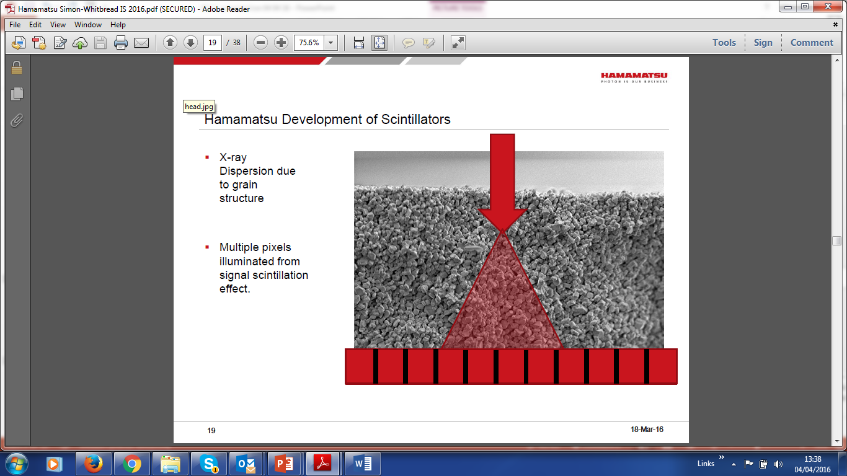
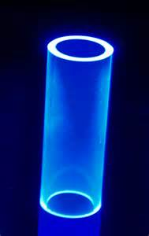
Scintacor: core competencies
Micro-columnar CsI:Tl
Phosphor coatings
6-Li glass formulations
Strong process know-how
  Batch to batch traceability
ISO 9001:2015 approved
Notes:
We are a material supplier with 3 core competencies develop though the years
I am going to review these competencies more in detail in the next slides

Slide 6
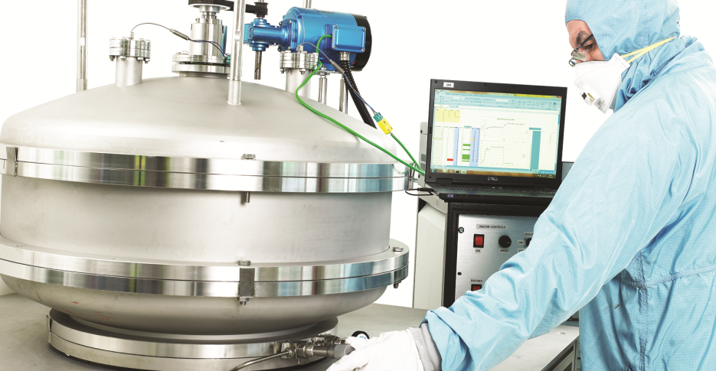
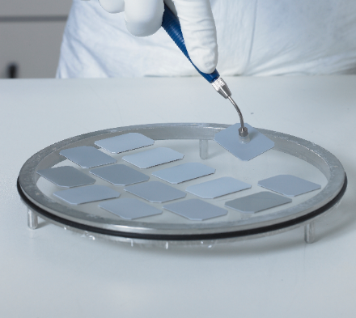
Micro-columnar CsI:Tl
Leading independent manufacturer
Areas up to 150x150 mm coated @ 600 microns thickness
Planned extension to full chest size 430x430 mm
Substrates: fibre optic plate (FOP), aluminium, engineered substrates
Notes:
Thallium doped micro-columnar CsI the scintillator of choice in medical imaging because of
-the high luminosity: LBNL gives a figure of merit 55,000 photons per MeV
-ability to channel light preventing scattering and giving rise high quality images
Traditionally strong position in Dental but now seeking to expand in larger areas and different substrates

Slide 7
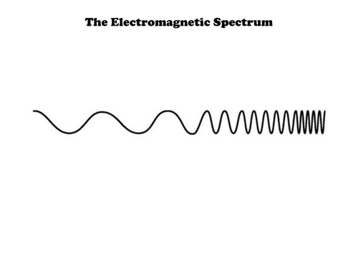
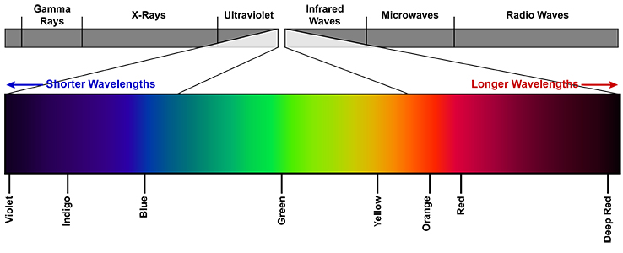
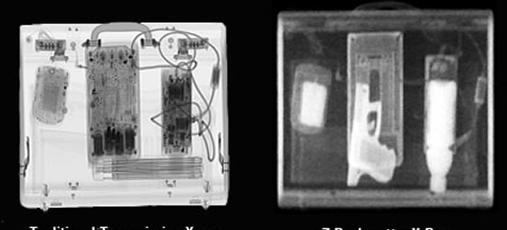
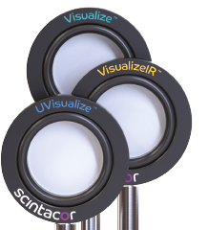
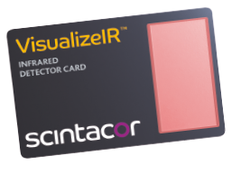
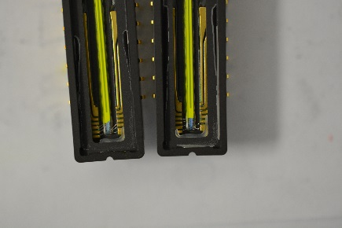
Phosphor coatings: NIR, UV, X-Ray
Proprietary phosphor coating technologies
Thicknesses range approx. 5 – 900um
Areas up to 1,000 x 1,500mm (x-ray and neutron detection screens)
Substrates: quartz, glass, organic, metallic, custom devices (CMOS, CCDs)
NIR Soft X-ray Hard X-ray Gamma
Laser detection cards/discs Custom coatings Gadox phosphor screens
Notes:
We have developed a number of techniques to coat phosphor on different substrates, including CMOs, CCDs and linear diode arrays
Applications range from laser detection cards to coated substrates for detection of charged particles in mass spectrometers / SEM microscopes and coated devices to extend spectral response of CMOS and CCDS

Slide 8
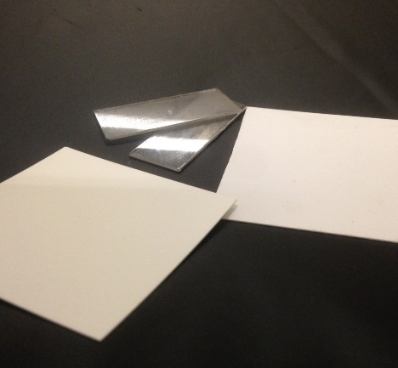
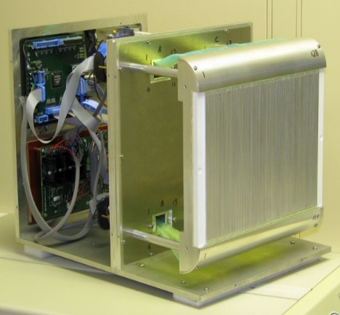
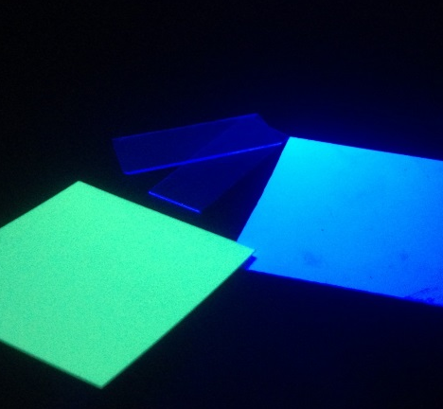
Phosphor coatings: 6LiF-ZnS screens
Screen Type | NDFast | ND | NDg
Formulation | 6LiF ZnO:Zn | 6Li ZnS:Ag | 6LiF ZnS:Cu,Al
Peak Emission | 505um | 450nm | 530nm
Decay to 10% | 3.5us | 80us | 85us
Afterglow | Ultra low | Low level | Low level
Notes:
AST one of the first outfit to manufacture LiF-ZnS in large scale
Benefits of LiF-ZnS: bright, 150,000 photons per neutron, fast primary decay and excellent gamma discrimination but opaque and with long afterglow in ms, which limits count rate capability
LiF-ZnO:Zn: First attempt at fabrication; currently working on the formulation to improve light Yield

Slide 9
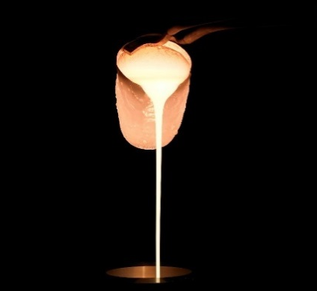
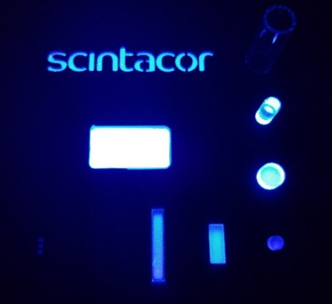
Ce-activated lithium aluminosilicate glasses
GS20®: ~6000 photons per absorbed neutron
Relatively fast decay time constant: approx. 70 ns for good rate capability.
~95% detection efficiency for thermal neutrons (.025 eV) from 2 mm of GS20®
Flat dimensions from 10 - 200mm and thickness 1 - 50mm
Resistant to nearly all organic and inorganic chemicals
Operating range: -200°C to 250°C
Notes:
Scintacor has been involved with glass scintillators including 6-lithium (6Li) enriched ones since 1958 (then Levy West Laboratories) when it started manufacturing these glasses with various compositions based on the work by Anderson et al. Today Scintacor is the owner of the GS20® trademark a trusted partner of leading research organizations and commercial customers.
Glass is available with different levels of LI content and also of enrichment level
The large cross section for 6Li means that 2 mm of GS20 have a 95% efficiency
Li Glass has the same pulse shape when excited with electrons or charged particles. This means that discrimination between gammas and neutrons is done only on a pulse height basis and not with pulse shape discrimination. The thermal neutron peak falls at a gamma equivalent energy a little above 1.6 MeV at room temperature [10], so when the gamma energy reaches the vicinity of 1.6 MeV it cannot be distinguished from the neutron signal

Slide 10
Contents
Scintacor: overview & capabilities
Faxitron: overview & capabilities
Scintacor road map
Promoting industry participation

Slide 11
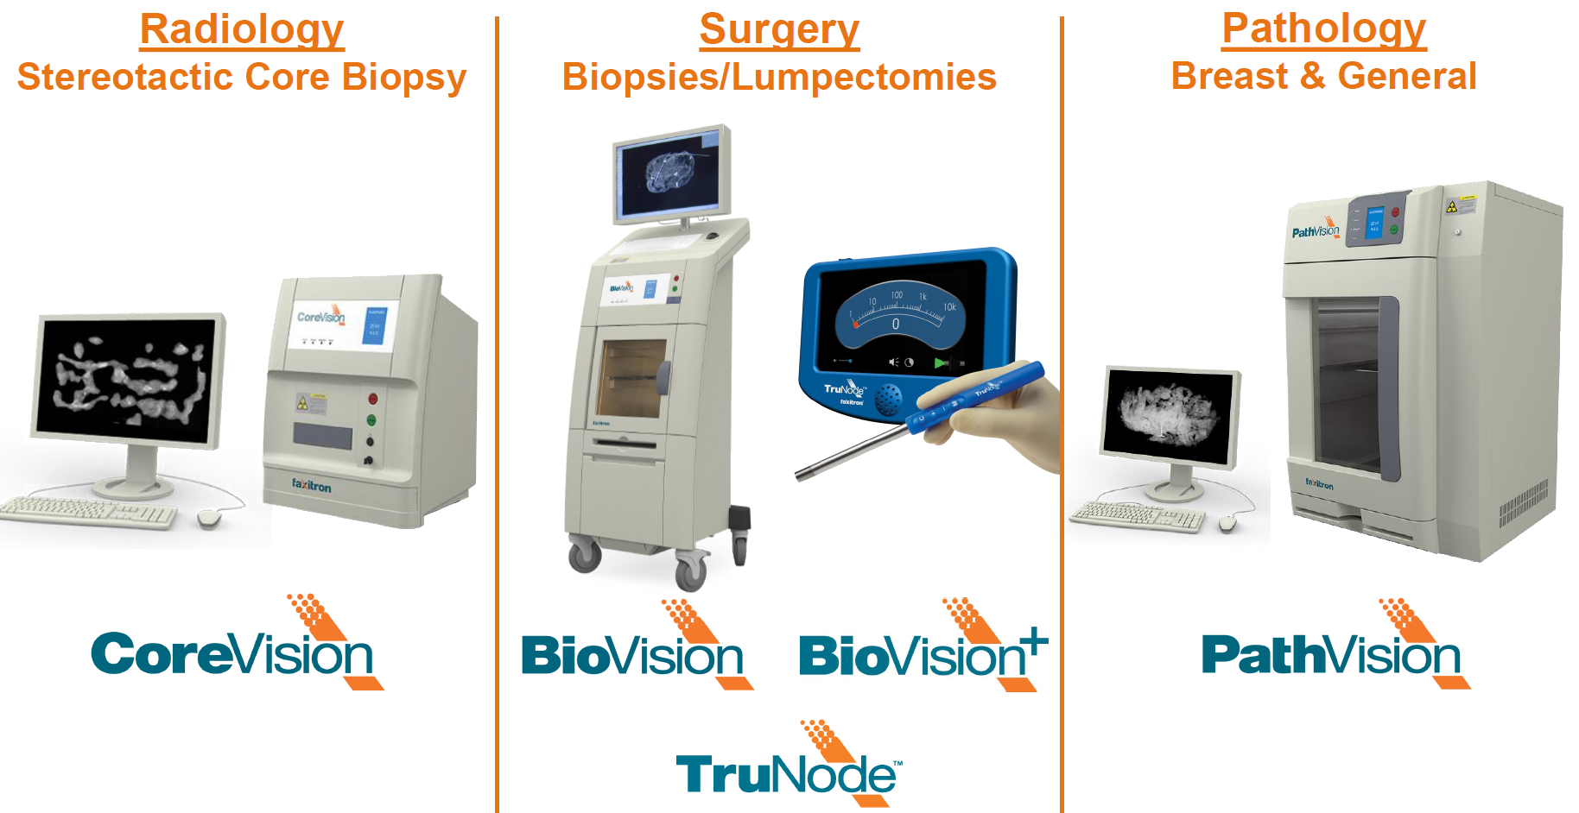
Faxitron Product Range
Notes:
Faxitron sister company base in Tucson Arizona
1967 Joseph Henderson invented cabinet x-ray
Specialists in breast cancer and Specimen Radiography
Why I talk about them? That’s where detector expertise comes into play and they have a strong experience in both detector development and systems integration

Slide 12

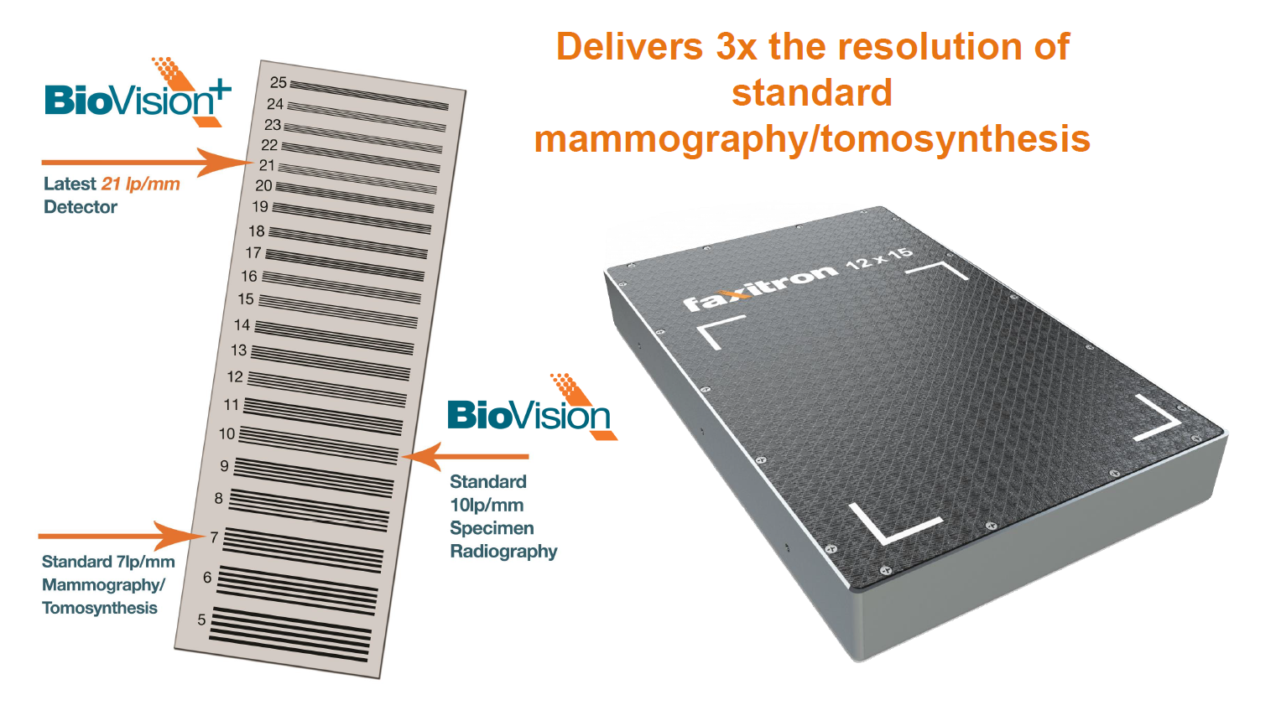
Faxitron .

Slide 13
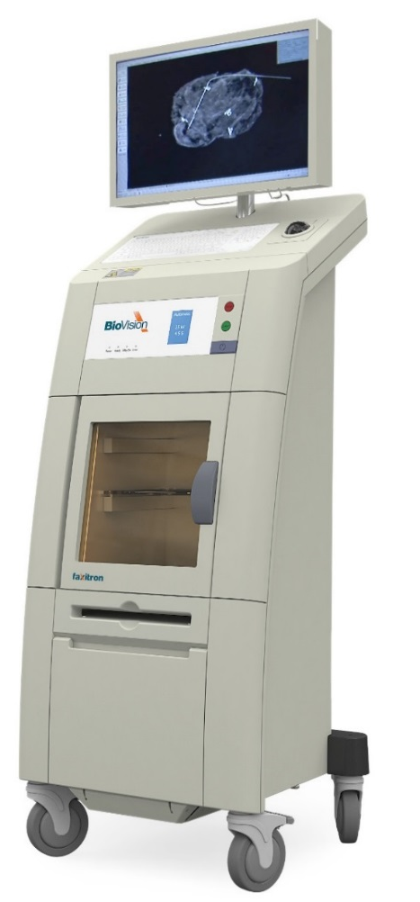
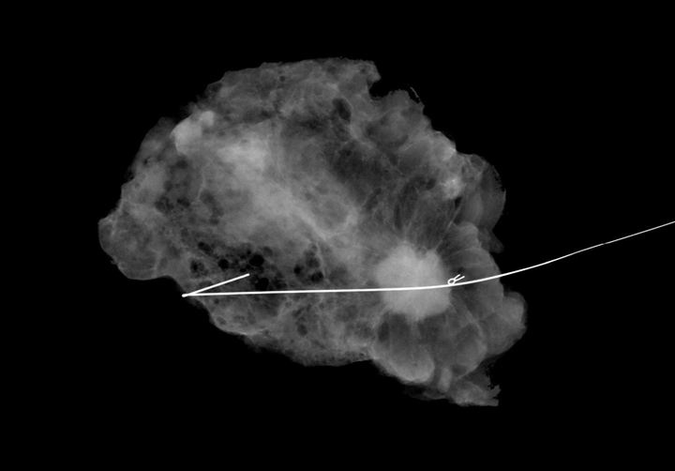
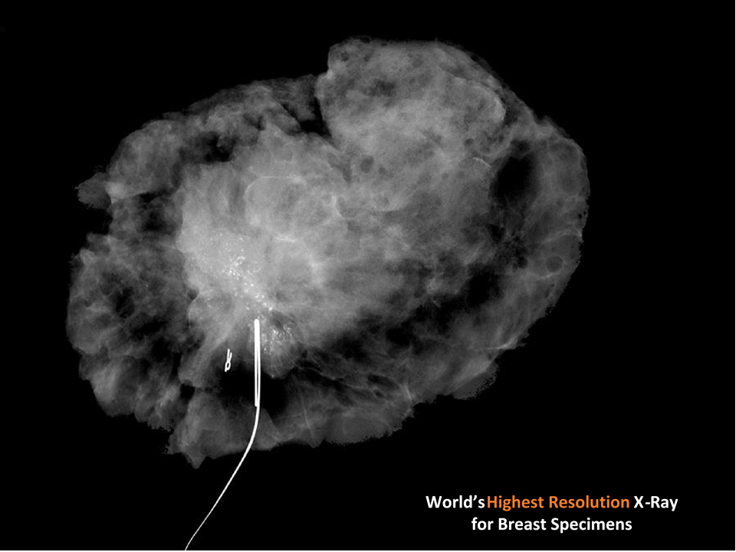
Faxitron .
World’s
Highest Resolution x-ray for breast specimen

Slide 14
Contents
Scintacor: overview & capabilities
Faxitron: overview & capabilities
Scintacor road map
Promoting industry participation

Slide 15
Scintacor roadmap
Having received significant investment in R&D and in a new state of the art manufacturing facility we are looking to expand our technology portfolio beyond our existing capabilities
Micro-columnar CsI: larger areas, engineered substrates
Coatings/glass: customer driven innovation
Expanding our product portfolio with new technologies
Seeking sensible participation in detector development and manufacturing
Notes:
We have received significant investment (new R&D an engineering resources, state of the heart facility) and ownership is looking for new opportunities, so pls. call us an keep us in mind
I hope you got the feeling that we are a very strong, dynamic, entrepreneurial and well funded, so we could be a good partner for you to develop new ideas.
Coating glass: incremental innovation based on specific customer needs.
Detector development would have to compete with other investment choices.
My question to you and also what I have been asking myself is how to make the business case stronger

Slide 16
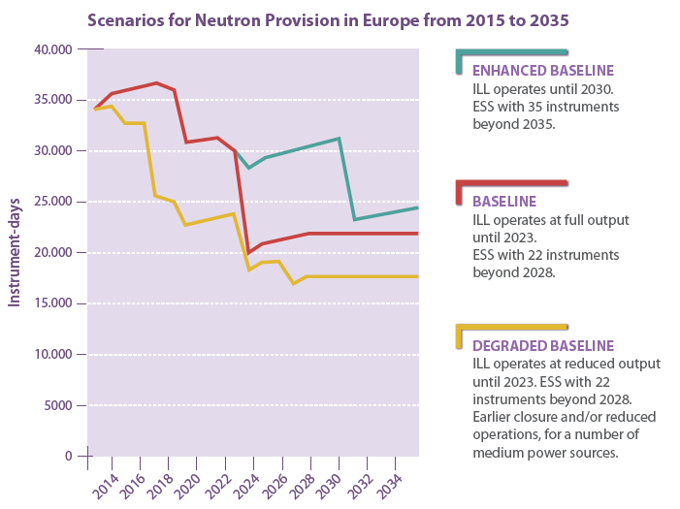
Neutron provision outlook
Adapted from ESFRI strategy report on research infrastructure
Notes:
Difficult to advocate involvement in a market that is relatively small and not seemingly growing
When I look at this chart I think:
-How can we build critical mass and create growth opportunities for both, industry and science
-How can we make neutron scattering more investible achieve a larger impact from the science produced within the neutron community.

Slide 17
Contents
Scintacor: overview & capabilities
Faxitron: overview & capabilities
Scintacor road map
Promoting industry participation

Slide 18
A Scintacor perspective
Let us know all the story from the beginning
Tell us if you know other applications
Encourage component-level standardization and design for manufacturing (DFM)
Capture user feed-back from previous generation detectors
Let us do what we do best (inventory, handling, processing)
If you see ways we can improve be sure to tell us
Let us be part of the team
Notes:
I will be a bit blunt and practical bring my own experience without attempting to give you a lecture in something which is not my subject.
Tell us on the first contact about the potential of the opportunity. Usually we ask questions to find out and it is in your interest to give us visibility.
Applications. We are always looking for this but if you help us.. We are in a niche and therefore it is really essential to exploit all possible market opportunities
Let’s work together to encourage component-level standardization and design for manufacturing
Let us do what we do best. Guys cutting up their scintillator sheets, or the glass might bring short term advantages. I know your budgets are tight, but when you cut the screens yourself you hurt the product and you do not save much money, fi this is something we can do efficiently.
You can let us know directly or I know that in some cases you need to talk to your technology transfer office. We are open to discuss licences but pls. keep in mind that if good ideas remain in the pile of paper sitting on a desk they do not make an impact. Assess whether publishing or protecting is the best route, but if not please consider dissemination a s means to achieving impact.
Mutual benefit for scientific community

Slide 19

Mutual benefit
Keep on buying what we’ve got
Come and talk to us when you have new ideas
Let us know all the story from the beginning
Let’s work together to stretch the boundaries of the neutron community and achieve even greater impact
Thank You !
Notes:
Of course come and talk to us, we are really keen on engaging with the scientific community and in particular with the neutron community and AST / Scintacor track record demonstrate our commitment to the cause.
We are at the beginning of a journey and the fact that we have been invited to the content is a great start and we are really keen on working together to innovate.
Let’s try to make the most form the high energy physics lesson and CERN, which despite being 10 times in size they still put a great emphasis in technology transfer and achieving impact beyond the boundaries of science
I have done my reading. It strikes me despite being 10 time larger community they still invest and the emphasis they put. Lesson from CERN

