Slide 1

Work Package 9 - Detectors
Task 4.3 - Silicon photomultipliers for muon spectroscopy
Lakshan Ram
Dan Pooley
Steve Cottrell
Luca Pollastri
Myron Huzan (NMI3)
STFC Rutherford Appleton Laboratory, UK
Wednesday 14-June-2016
PSI, Villigen

Slide 2
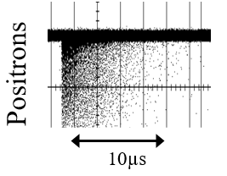
Beam Structure…
at a ‘pulsed’ source...
20ms
Proton beam
Two types of beam structures.
Continuous Source
  Measure 1 muon at a time.
Pulse width: 80ns
Time
Pulsed Source
  High Instantaneous rates.
Muon
Implant 1000s muons/pulse;
Measure 1000s muons simultaneously!
Notes:
Difference between pulsed and continuous muon source.
Pulsed source needs to handle high instantaneous rates.
Focus of this project and talk.

Slide 3
Why SiPMs?
Magnetically insensitive.
Commercially available (thanks to medical imaging sector).
Gain, quantum efficiency, noise discrimination comparable to a PMT.

Slide 4


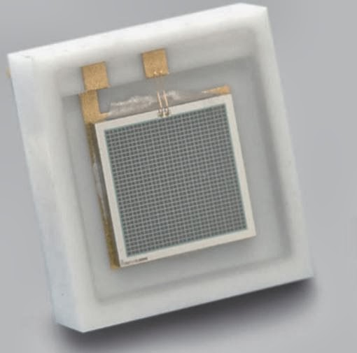
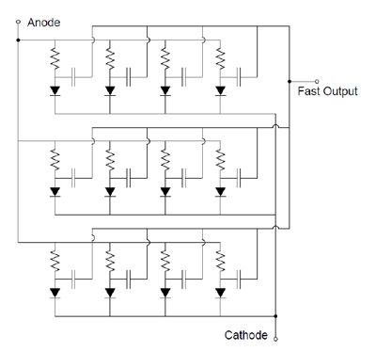
How do they work?
Notes:
Working Mechanism.
An array of photodiodes in reverse bias
High gain due to avalanche formation in the depletion zone.
Resistor is in series with each cell to quench the signal
SensL has Fast output inbuilt in its evaluation boards.

Slide 5
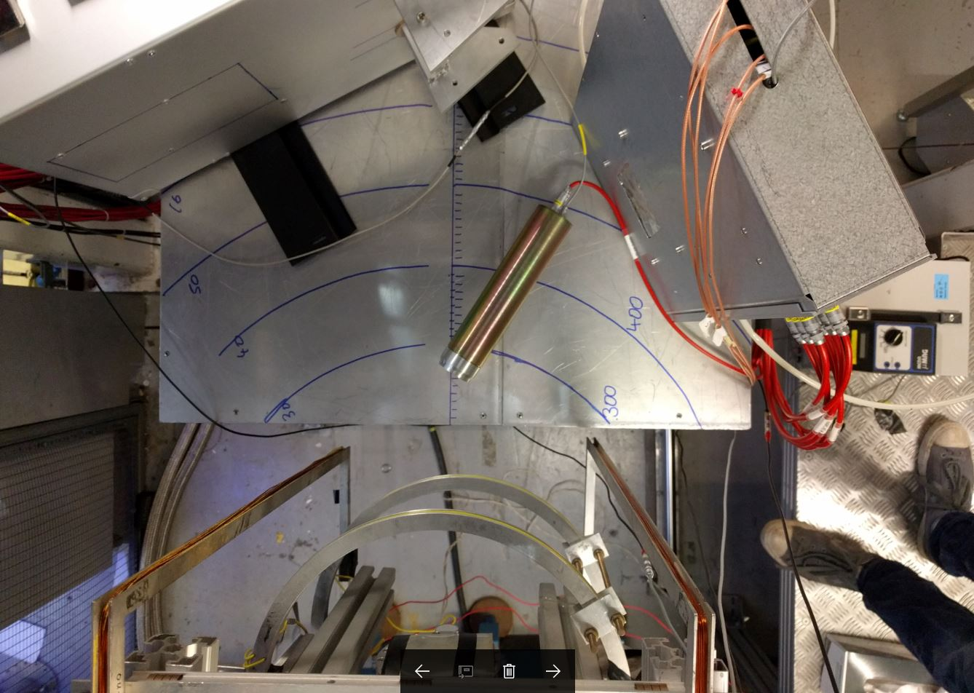
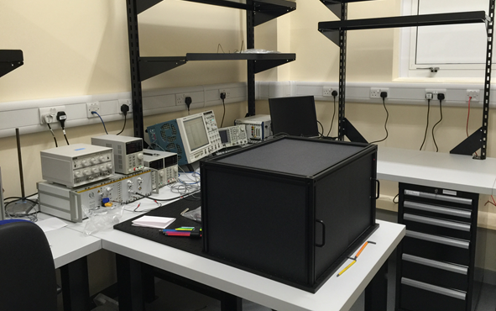
Experimental Threads
Monte-Carlo Simulation
Beam Line test
Laboratory test
Notes:
Different experiment methods
Model to simulate observed SiPM behaviour and find operational range of SiPM
Beamline test to find the rate capabilities of SiPM
Laboratory tests for controlled study

Slide 6
Monte-carlo Simulation

Slide 7
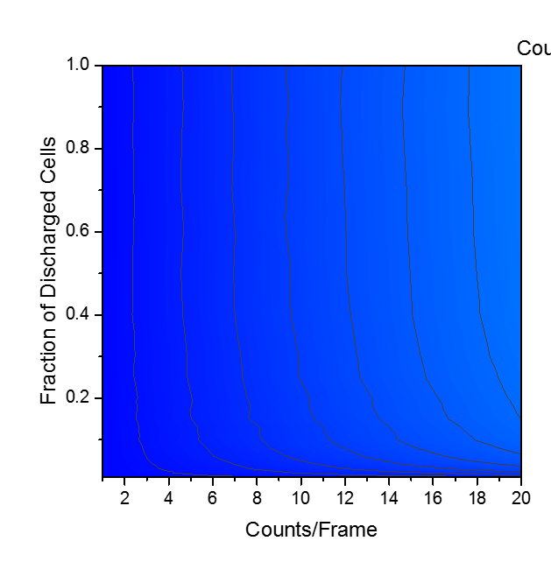
Monte-Carlo Simulation
SensL 50µm
SensL 50µm
Differentiated signal
Notes:
Successful model of SiPM behaviour at MuSR instrument
Able to find the usage range of an SiPM in a pulsed muon instrument.
Signal processing increases the count rate capabilities of the device.

Slide 8
Beam line tests

Slide 9
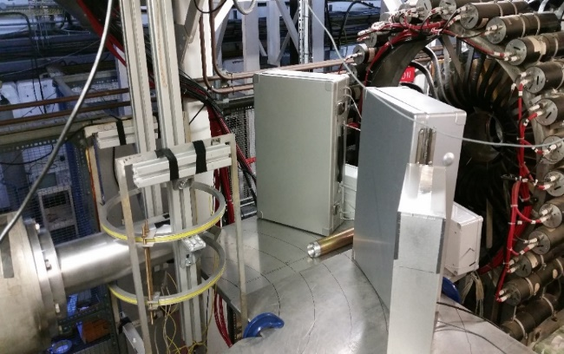
Beam line test
Full instrument control.
Availability 5-6 days per year.
Very limited time to collect data.
No information on the long term stability of a positron-SiPM detector set-up.
Cannot rely on cosmic to study high rate capabilities.
Solution: Mount the detector box on the instrument leave it for a few cycles.
Notes:
Limited time to take data
No long term stability information since very controlled measurements.
Solution: Mount the detector onto the instrument.

Slide 10
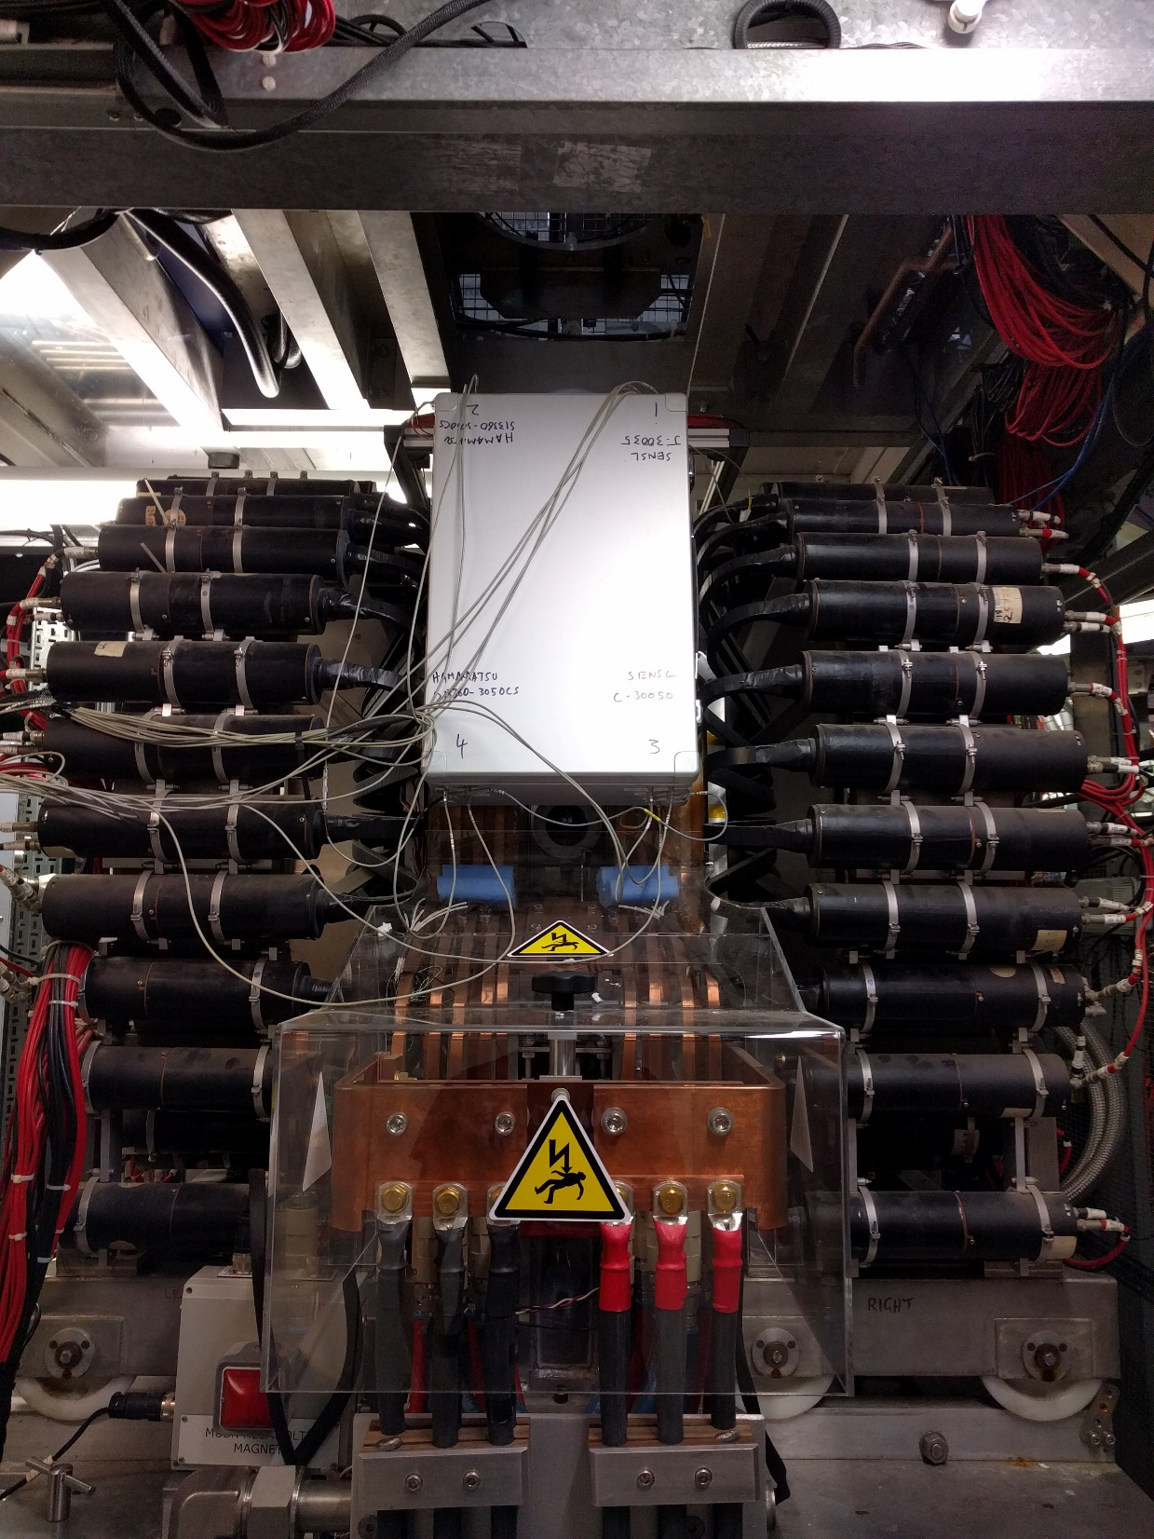
No control over the instrument.
  That is exactly what we want to test reliability of the device.
More time to collect data.
Notes:
Experiment set-up,
Mention direction of beam
Made sure that the test box does not interfere with the normal instrument usage
Box enables to collect data during user cycles.
Avoids time lost in setting up instrument every time.

Slide 11
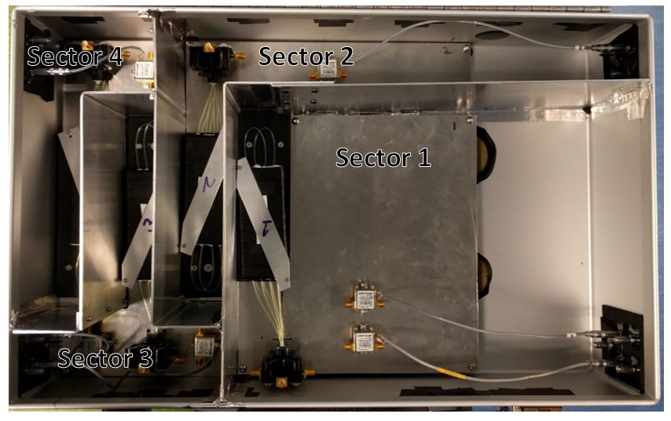
Choice of SiPMs
Channel No. | SiPM
1 | SensL J-series Fast
2 | SensL J-series Slow
3 | Hamamatsu 50µm(Sector-2)
4 | SensL C-series Slow
5 | SensL C-series Fast
6 | Hamamatsu 50µm(Sector-4)
Notes:
4 SiPMs, 2 identical and the other 2 same manufacturer but different series with signal processing.
2 identical SiPMs helps in understanding the reliability of the device and possibility to install pole-0 electronics in one of them.
Pushed to one side due to available beam window.

Slide 12
Dead-time Investigations

Slide 13
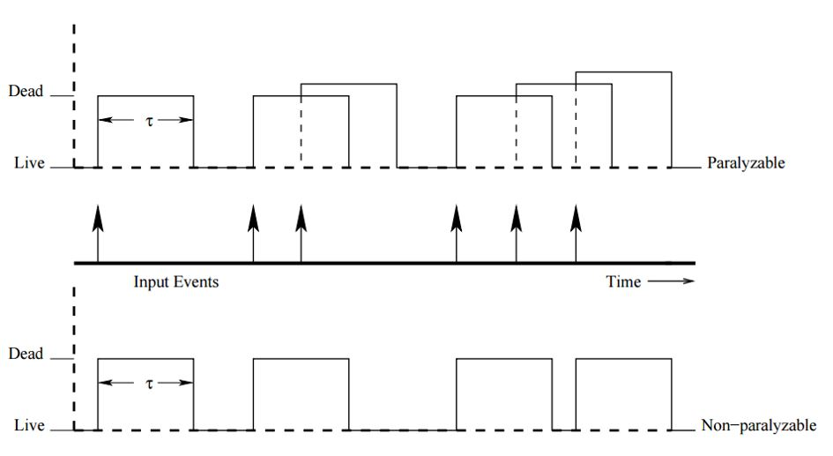
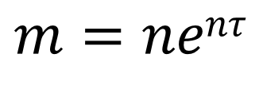
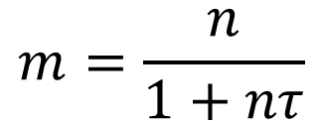

Dead-time models
n--- true rate
m--- measured rate
$τ$--- dead-time
$$m=\frac{n}{1+nτ}$$
Notes:
Explain both models
True counts is 6 but paralyzable detector measures 3 while non-paralyzable measures 4
Are described by the equation
Important to find which model followed by the SiPM to correct the data set.

Slide 14
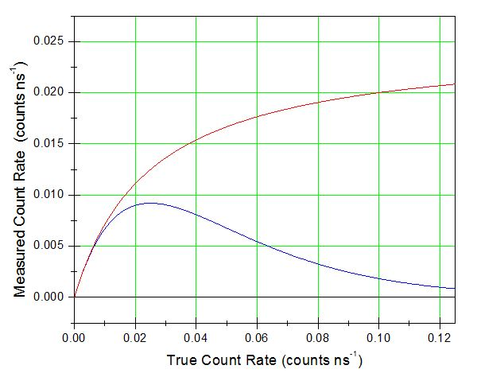
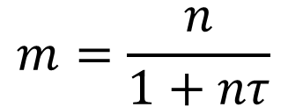

Measured rate as a function of true rate
Non-Paralyzable
$$m=\frac{n}{1+nτ}$$
$$τ=40ns$$
Paralyzable
Notes:
Plotting both the for various true count rates.
In the very low region cannot differentiate both models can be used to describe data set
Around 0.02 clear distinction between the models start to appear.
At very high rates both the models are very different.
Using the SiPM at high rates would help us find the model followed by it.

Slide 15
Contributions to dead-time in detector set-up
Fall time of signal.
Fraction of cells fired/ amplitude of signal.
Discriminator threshold value determined by signal to noise ratio.
Discriminator.
Fibre and scintillator.
Notes:
Mention the various contributions to dead-time.

Slide 16
Exponential-extrapolation
In the later part of the data set dead-time effects are assumed to be negligible.
This region is fitted with an exponent with fixed decay constant and extrapolated back to earlier times.
Each data point from the measured data set can be plotted against its counter part from the predicted data set.
Exponential
Notes:
Method to plot measured vs actual rate graph
Later times is near exponential with decay constant equal to the half-life of muons.
Can use it to find counts missed by extrapolating the data to high count region.
Plot each data point against it counter part to plot measured rate as a function of actual rate.

Slide 17
Counts time histogram
Notes:
Four trends identified
Low count rate is near ideal behaviour.
Unable to separate between paralyzable or non-paralyzable. .
Clear paralyzable behaviour.
Sharp rise due to the pulsed nature of beam.

Slide 18
Notes:
Two SiPMs compared with and with out signal processing
Data from the same muon flux
A clear increase in rate capabilities seen with signal processing

Slide 20
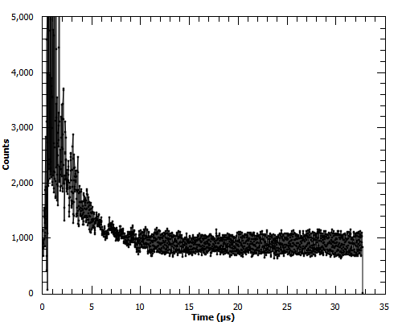
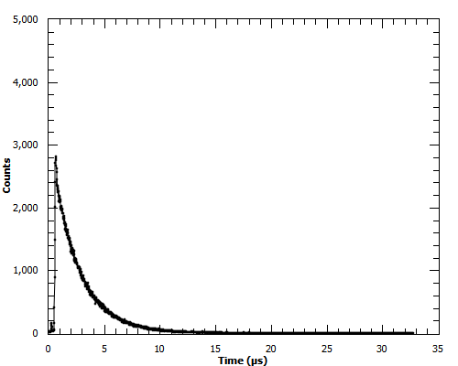
SensL Fast output
SensL MFJ-30035 Fast
SensL MFJ-30035 Slow
Total frames in run: 114254
Notes:
%%%Enter total frames in each run or remake graphs
Two problems with fast output, their Slow counterparts did not have this behaviour.
C fast- statistically insufficient data because of discriminator threshold being set high due to the observed signal to noise ration
J-fast- peaks in data set arising. Possibly due to a transformer in the circuit which picks up noise from magnets from another side of the facility.

Slide 21
Laboratory tests

Slide 22
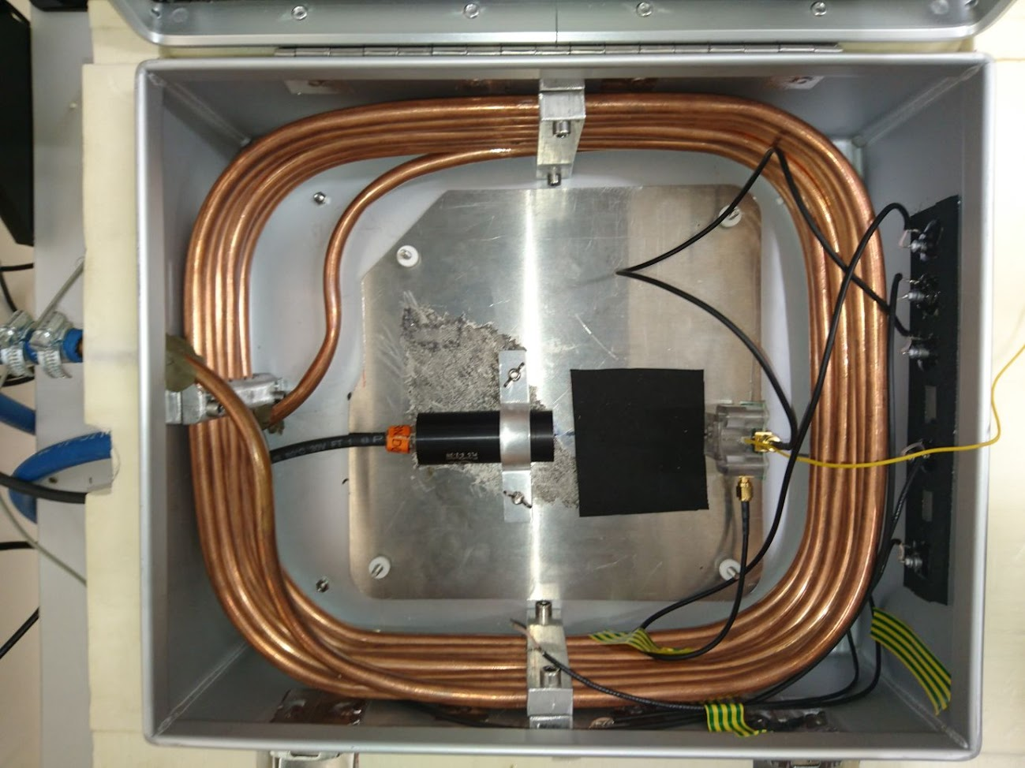
Future Investigations
Temperature Sensitivity tests

Slide 23
Conclusions
Proven that signal processing does increase count rate capabilities.
Prefer pole-0 since fast is sometime susceptible to external noise.
SiPM preference is determined by other factors such as temperature sensitivity

Slide 24
Thank You For Listening
Questions?

Slide 26
Back up Slides

Slide 27
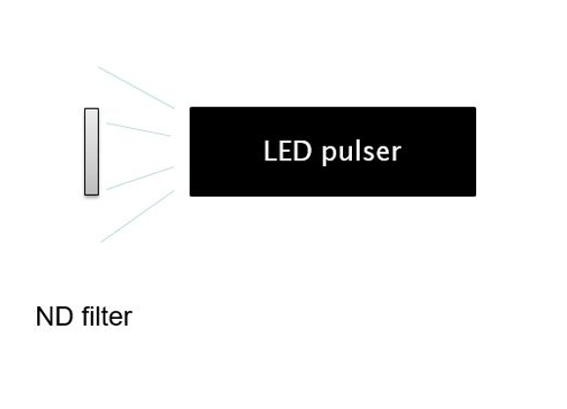
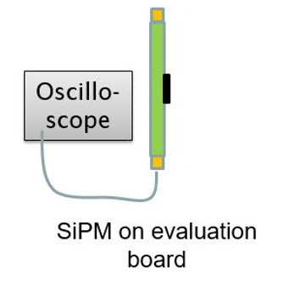
Proposed dead-time test
Minimum pulse separation of one pulser is 25 ns
Notes:
Use two pulsars to create pulse pairs separated by few nanoseconds.
Can recreate measured vs actual rate graphs.
Able to reach pulse rates higher that MuSR
Can calculate dead-time.
Reason two LED emitter needed is because the minimum pulse separation between pulses can only be 25ns

