Slide 1
WLS fibre detector
development at ISIS
    Jeff Sykora, Erik Schooneveld and
    Nigel Rhodes
SINE2020 Meeting
Industry day
13 June 2017

Slide 2
Overview
Scintillator + WLS fibre detectors
  Basic operation
  Individual major industrial components
ISIS contribution to SINE2020 WP9
Other scintillator detector development lines

Slide 3
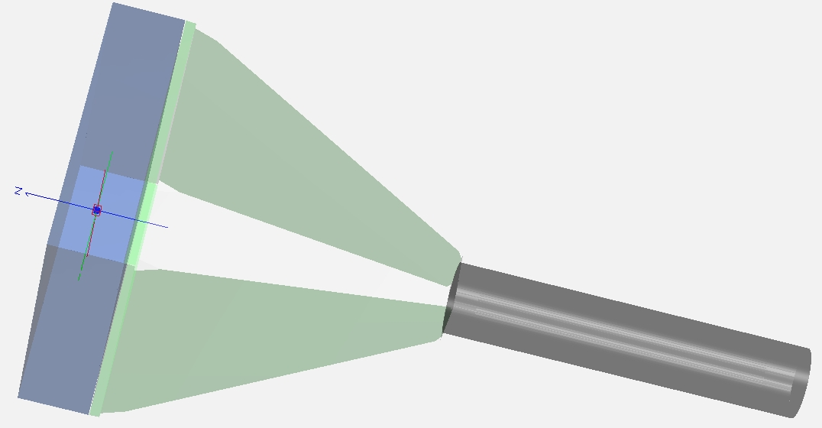
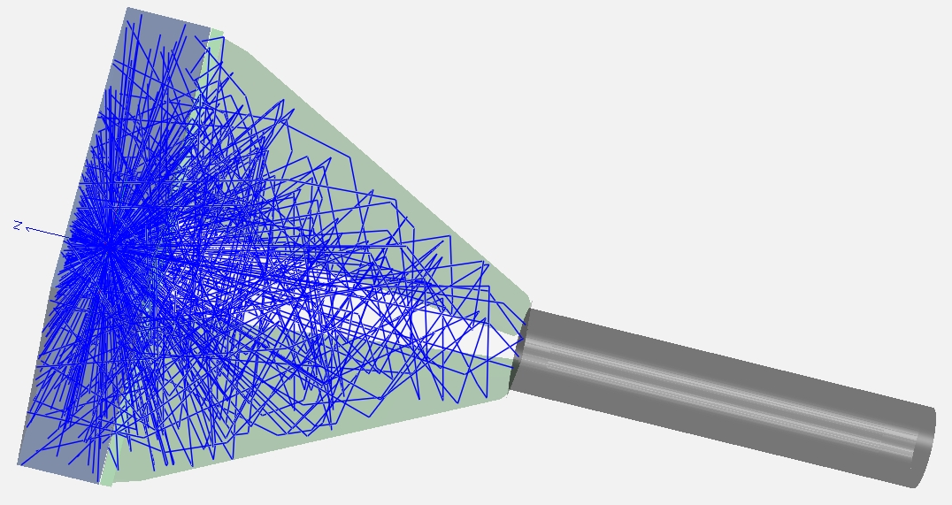
Scintillator detectors
Scintillator
Light transport
Light detector
(PMT, SiPM, etc.)
“Preamp”/Signal Shaping
Signal Processing
Discriminator
Display/Data Acquisition

Slide 4
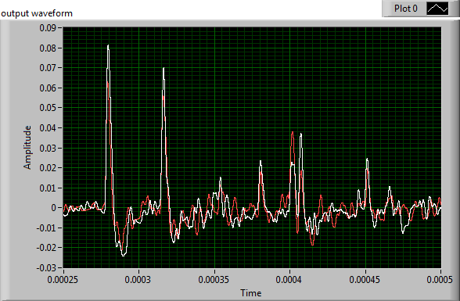
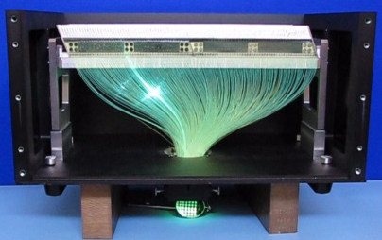
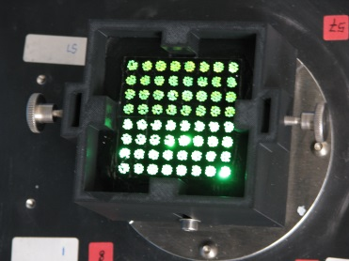
Scintillator + WLSF detectors
Activator type scintillation
³H
Conduction band
n⁰
α, T
⁴He
E_{g}
Valence band
ZnS:Ag
⁶LiF
Neutron
Scintillator
WLSF

Slide 5
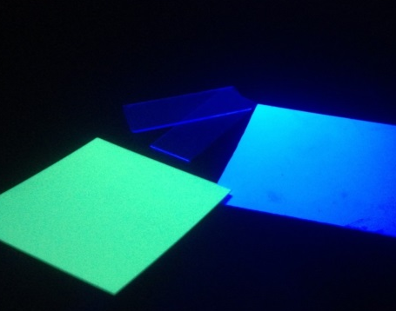
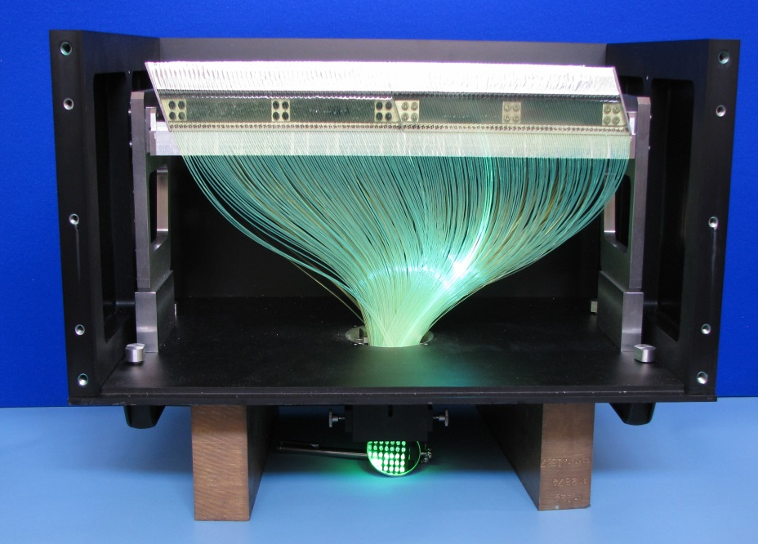
Major industrial components
Scintillator
  Development opportunities available/underway
  Already have a good working relationship with Scintacor

Slide 6
Major industrial components
Scintillator
  Development opportunities available/underway
  Already have a good working relationship with Scintacor
Fibres

Slide 7
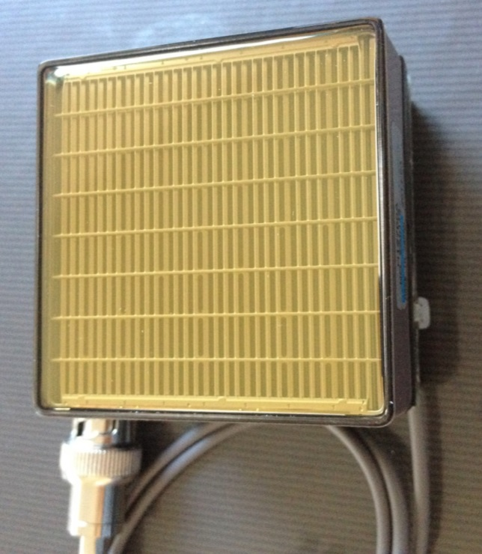
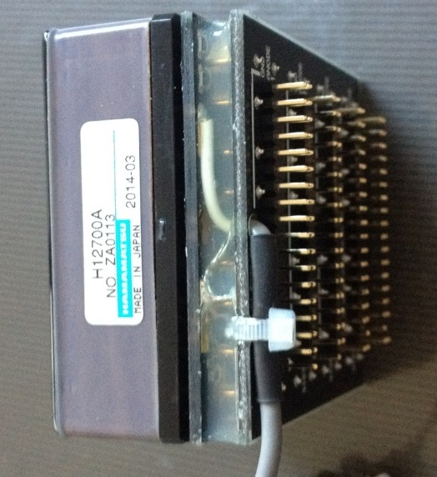
Major industrial components
Scintillator
  Development opportunities available/underway
  Already have a good working relationship with Scintacor
Fibres
PMTs
  Development opportunities available/underway

Slide 8
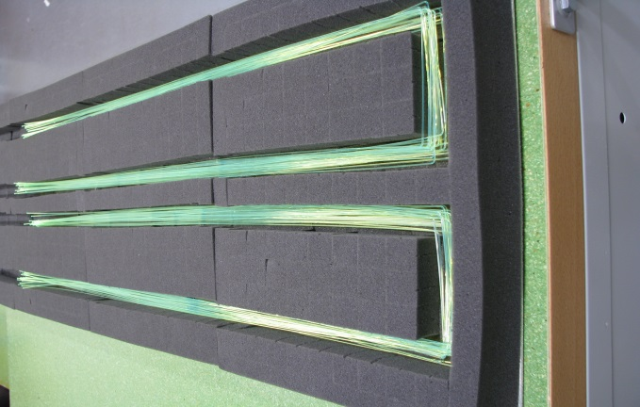
Major industrial components
Scintillator
  Development opportunities available/underway
  Already have a good working relationship with Scintacor
Fibres
PMTs
  Development opportunities available/underway
Scintillator/fibre prep

Slide 9
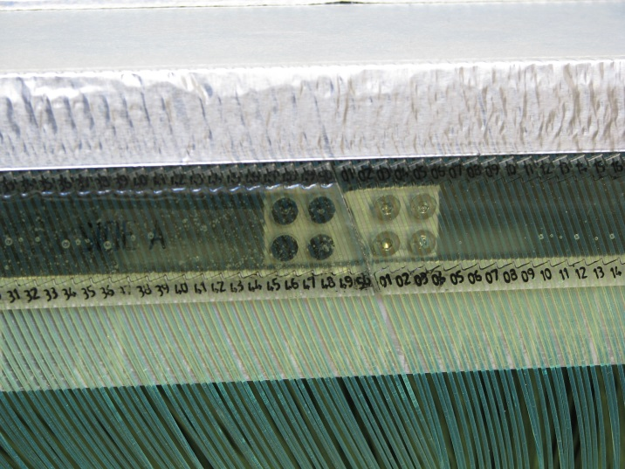
Major industrial components
Scintillator
  Development opportunities available/underway
  Already have a good working relationship with Scintacor
Fibres
PMTs
  Development opportunities available/underway
Scintillator/fibre prep
Detector mechanics
  3D printing
  Machining
  Shielding
    Magnetic screening
    Neutron shielding

Slide 10
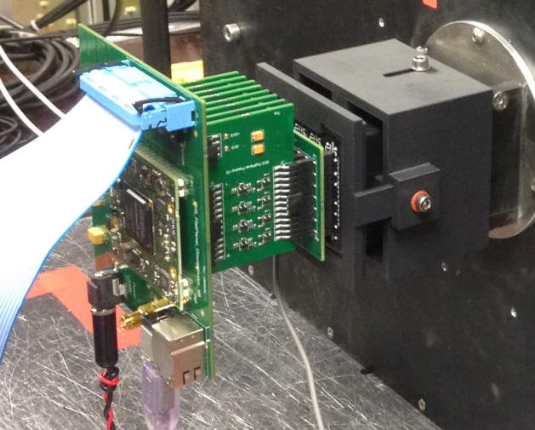
Major industrial components
Scintillator
  Development opportunities available/underway
  Already have a good working relationship with Scintacor
Fibres
PMTs
  Development opportunities available/underway
Scintillator/fibre prep
Detector mechanics
  3D printing
  Machining
  Shielding
    Magnetic screening
    Neutron shielding
Electronics

Slide 11
Major industrial components
Scintillator
  Development opportunities available/underway
  Already have a good working relationship with Scintacor
Fibres
PMTs
  Development opportunities available/underway
Scintillator/fibre prep
Detector mechanics
  3D printing
  Machining
  Shielding
    Magnetic screening
    Neutron shielding
Electronics
Assembly

Slide 12
Overview
Scintillator + WLS fibre detectors
  Basic operation
  Individual major industrial components
ISIS contribution to SINE2020 WP9
Other scintillator detector development lines

Slide 13
Work package 9.2.1
Development of a ZnS scintillation detector with WLS fibre readout for high rate reflectometry
  Detector hardware
  PMT readout hardware
  Initial report
  Final report

Slide 14
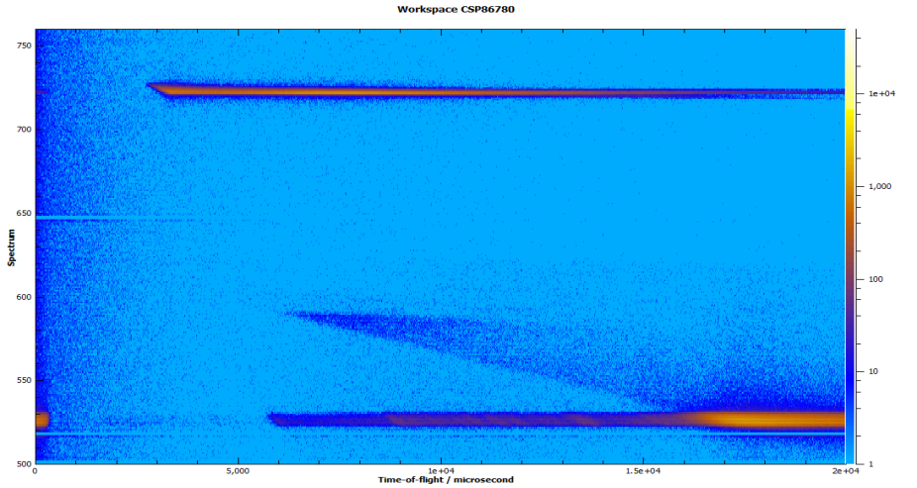
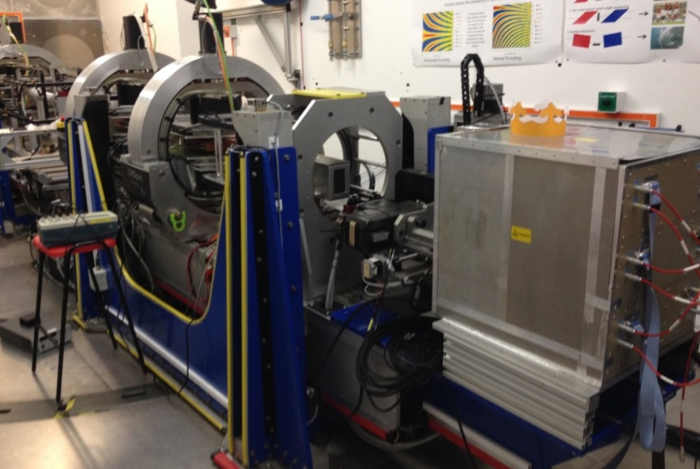
Reflectometer requirements on ISIS
2D PSD
  1 x 1mm² acceptable
  0.5 x 6mm² acceptable
  0.5 x 0.5mm² preferable
  500mm x 300mm total size
High efficiency
0.5 – 15 Å range
Good uniformity
Large dynamic range
High rate capability

Slide 15
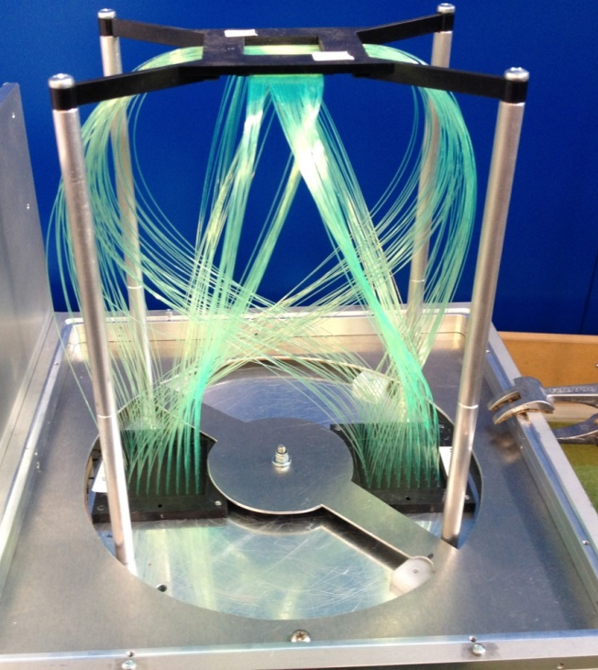
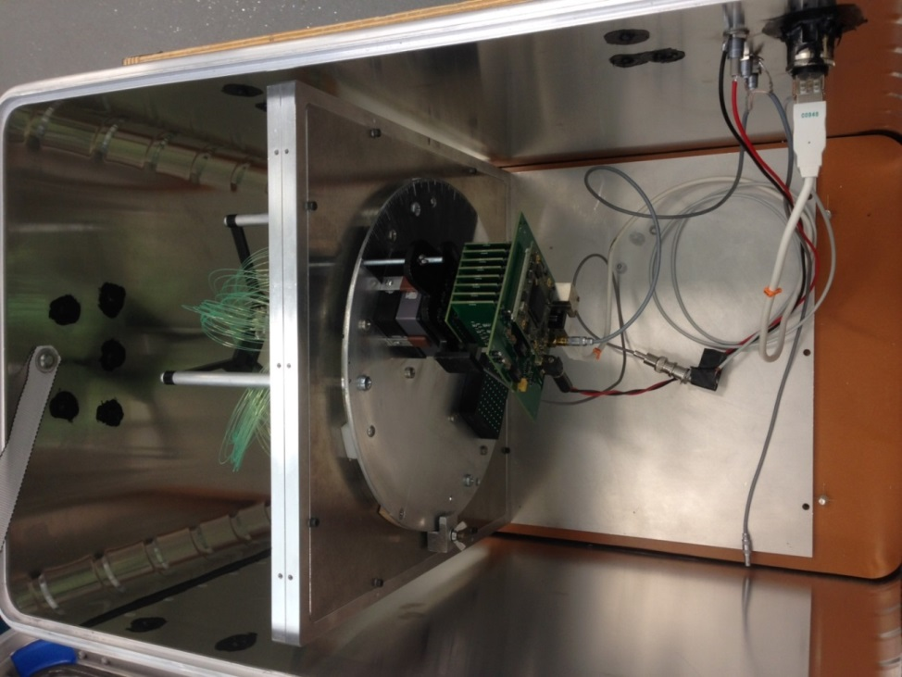
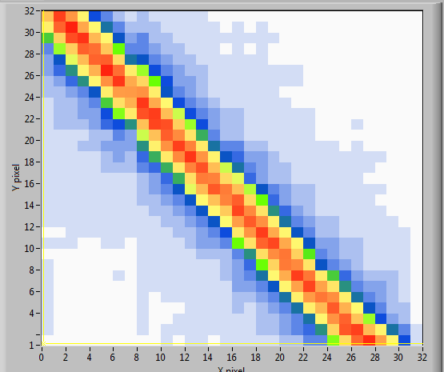
Work package 9.2.1
Solution
  ZnS:Ag coupled to FP PMTs with WLS fibre
  Distribute fibres over a large number of PMT channels (i.e. high pixilation)

Slide 16
Overview
Scintillator + WLS fibre detectors
  Basic operation
  Individual major industrial components
ISIS contribution to SINE2020 WP9
Other scintillator detector development lines

Slide 17
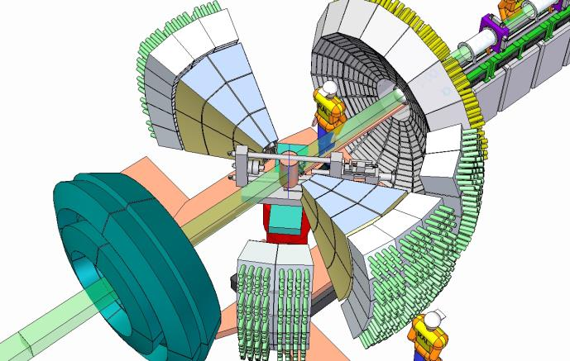
Powder diffraction
IMAT/HRPD/E-MAP
IMAT
  Diffraction detectors up to ~18m²
  4 mm x 100 mm resolution
  90 degree bank 2.5 m²
    40 FP PMTs
    8m² scintillator
    ~14,000 fibres
    Mechanics
HRPD
  Diffraction detectors up to ~14m²
  5 mm x 200 mm resolution

Slide 18
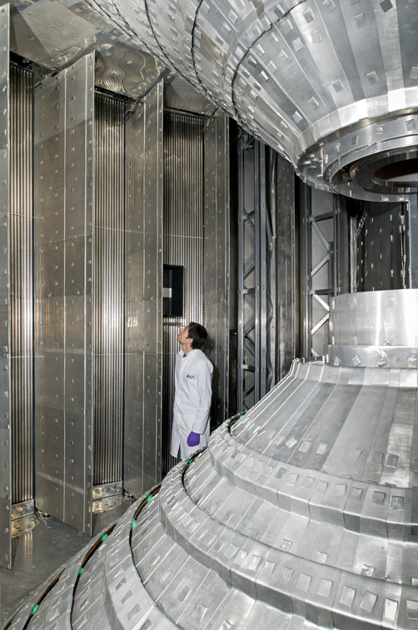
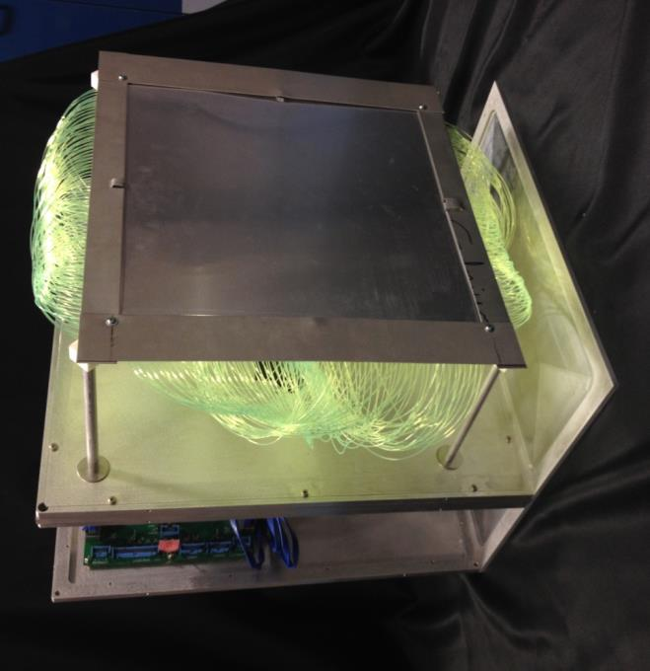
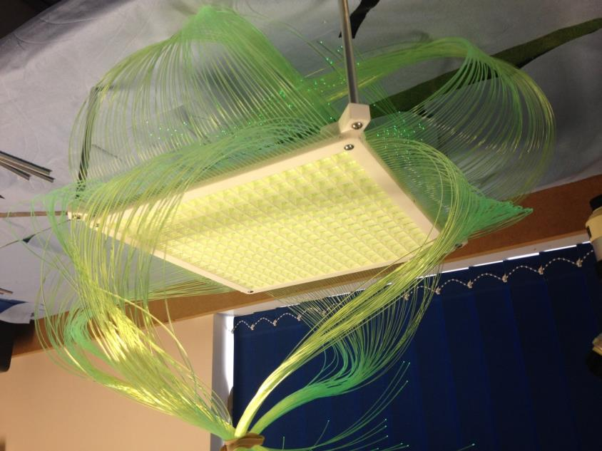
Inelastic Neutron Scattering
Large area – LET = 40m²
2D – 25 mm position resolution
Energy range 0 – 80 meV
Good uniformity
High efficiency
Low background
Current: Resistive Wire technology

Slide 19
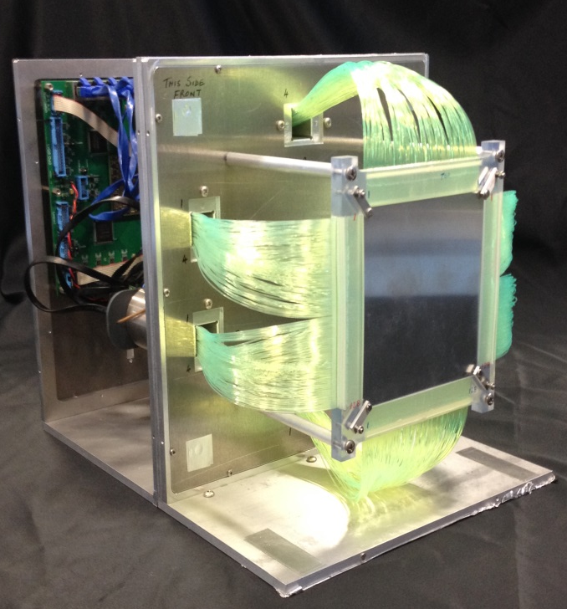
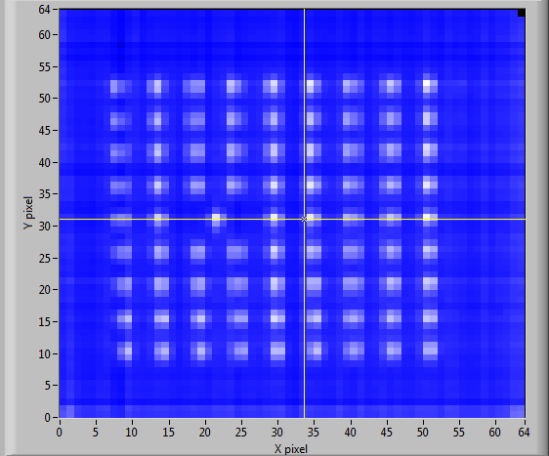

Single crystal diffraction
SXD/LMX
Varying areas/angular coverage
2D PSD
  1 x 1mm2 acceptable
  0.5 x 0.5mm2 preferable
Good uniformity
High efficiency
Low background

Slide 20
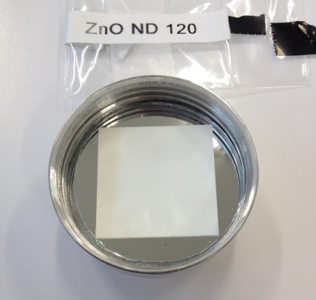


Investigating scintillators
Need detectors with high rate capabilities
ZnS:Ag is limited by afterglow
  Need alternatives
  Faster?
  Sufficient gamma rejection?
  Made in large quantities?
  Affordable?
Scintillator | Decay time (μs) | PL peak (nm) | PL range (nm) | Hygroscopic | Effective Fibre coupling | Gamma sensitivity
ZnO:Zn/LiF* | ~1.7 | 500 | 440-590 | No | Transparent Kuraray Green-Orange | <10⁻⁵
CLYC:Ce | 6.3,1.4 and 0.45*³ | 374 | 355–440 | Yes | Kuraray UV-Blue (1/2) | ~2*10⁻⁵
³H
n⁰
⁴He
2:1 ratio
ZnO:Zn 3.5 μm grains
⁶LiF

Slide 21
Summary
Advancing the rate capability for reflectometers is progressing under SINE2020
There has been a huge amount of R&D progress in scintillator detector technology
ISIS is developing several detector technologies for a wide range of neutron scattering applications
Industry involvement is critical to continuing progression

Slide 22

Thank you!

