Slide 1
WP 9: Items for Discussion
Photo
Deliverables
Poster for ICNS
Feedback on “industry day”
AOB

Slide 2
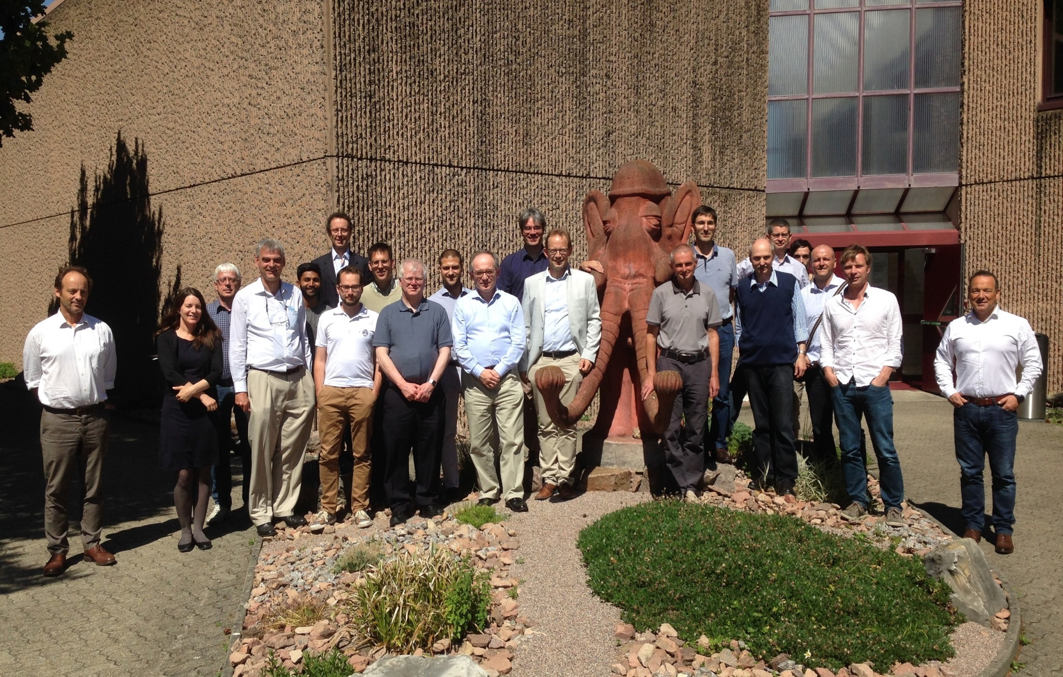
WP 9: Items for Discussion

Slide 3
WP 9: DELIVERABLES
No. | Deliverable Title | LEAD | TYPE | DOMAIN | DUE(M) | STATUS
9.1 | First extended RTD meeting | STFC | DEC | PU | 18 | +3
9.2 | Initial WLS fibre detector hardware | STFC | DEM | PU | 18 | Complete
9.3 | Initial direct PMT readout hardware | FZJ | DEM | PU | 24
9.4 | Interim report on scintillation detector development programme | STFC | R | PU | 24
9.5 | Novel MSGC detector hardware | ILL | DEM | PU | 24
9.6 | Interim report on MSGC detector development programme | ILL | R | PU | 24
9.7 | Interim report on Emergent Neutron Detector Technologies development programme | ESS | R | PU | 24
9.8 | Report discussing an evaluation of commercial SiPMs for µSR detector arrays | PSI | R | PU | 24
9.9 | Second extended RTD meeting | STFC | DEC | PU | 36
9.10 | Final report on scintillation detector development programme | STFC | R | PU | 48
9.11 | Final report on MSGC detector development programme | ILL | R | PU | 48
9.12 | Final report on Emergent Neutron Detector Technologies development programme | ESS | R | PU | 48
9.13 | Report discussing alternative detector technologies for μSR | PSI | R | PU | 48
9.14 | Website containing all presentations | STFC | DEC | PU | 48

Slide 4
WP 9: Actions
Is anyone going to ICNS in Korea?
SINE 2020 to display posters of RTD activities at ICND
I can make a poster and circulate it for comment based on our 18 m report
Anyone available to present it
Feedback on our industry day
Was it useful?
How shall we follow it up? Short report – ask industry partners to comment?
Shall we make yesterday’s SINE 2020 slides available to everyone?
Would we like to have access to the industrial slides?
Do we want to do it again?
Start earlier, invite more industrial partners
More partners? Does this mean a longer meeting
9.9 | Second extended RTD meeting | STFC | DEC | PU | 36

Slide 5
WP 9: Actions
Date and venue of next meeting??
5th WP meeting Nov/Dec 2018? VENUE?
6th WP meeting and GA meeting Apr/May 2018
Venue Poss Delft or Parma
7th WP meeting ~ Nov 2018 Venue?
8th WP meeting and GA meeting ~ Apr 2019
Project finish 30th Sept 2019

