Slide 1
Scintillator detectors with direct readout and MaPMTs
13. June 2017 | Ralf Engels

Slide 2
Outline
Scope of SKADI
Instrument detector requirements using SKADI instrument as target
Multi-Anode Photomultiplier (MaPMT)
Neutron Scintillator
Detector design & components
Conclusions

Slide 3
SKADI Detector Requirements
Count-rate rate capability of up to 20 MHz@10% dead time
Detection efficiency of 80% @ 5Å with a gamma suppression of 10⁻⁵
Position resolution of 6 mm², 3 mm², 1 µs time resolution for TOF
Operation in vacuum, adaptable shape
Use of 2 detectors at different distance from sample for coverage of large q-range:
active area of each detector 100 x 100 cm²
first detector with 20 x 20 cm² hole in the middle and small dead area around the hole

Slide 4
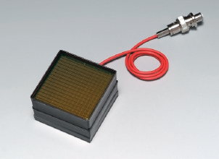
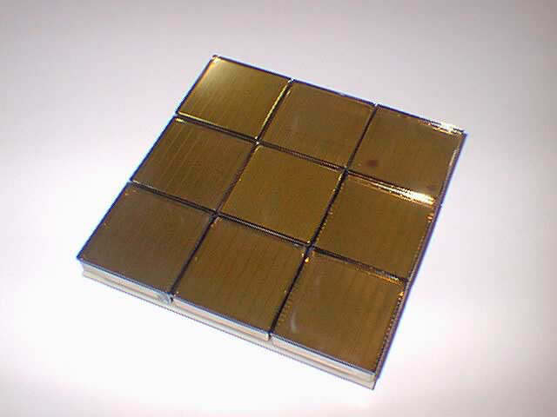
Multianode Photomultiplier (MaPMT)
Hamamatsu H8500 / H12700 :
dense array of PMT channels with small amount of dead space (~89 % active area)
possibility of modular and scalable design for large areas
High-Resolution Anger Mode
position resolution of ~0.6 - 0.7 mm
also: High-Rate Mode (SoNDe):
count rate capability theoretically up to max. 1 MHz per MaPMT
Figures from Hamamatsu

Slide 5
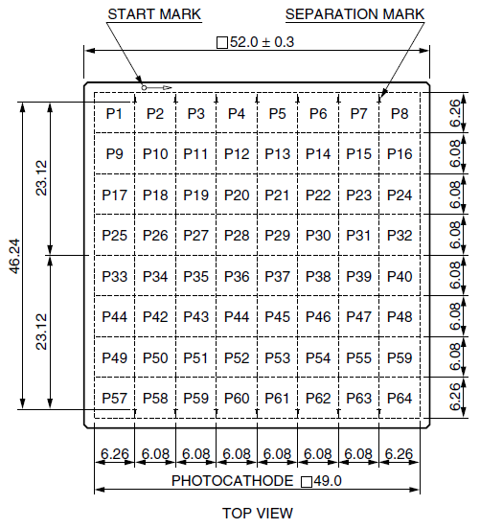
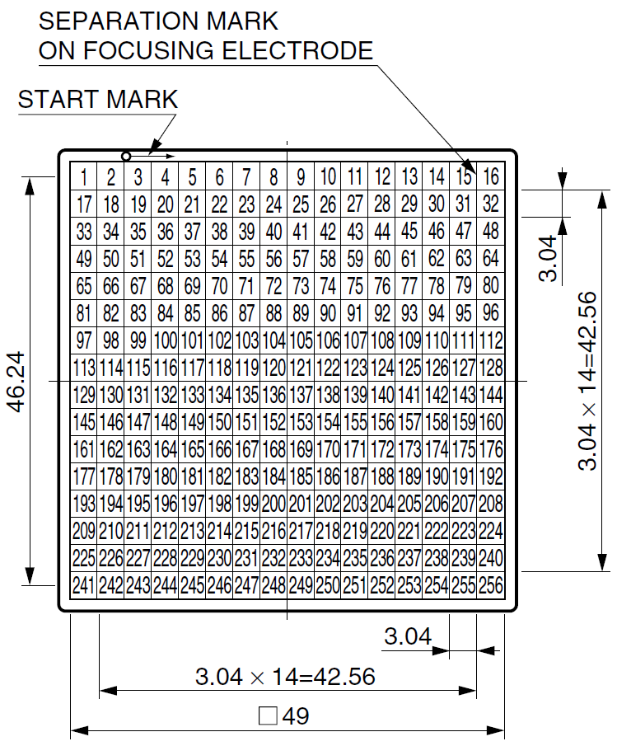
Hamamatsu H8500 / H9500 Flat-Panel MaPMT
H8500:
Array of 8x8 pixel
pitch 6.08 mm
3% crosstalk
H9500:
Array of 16x16 pixel
pitch 3.04 mm
5% crosstalk
Common Properties:
Outer dimension 52 mm, active area 49 mm, peak wavelength 400 nm
Gain ~ 10⁶, but inhomogeneous of factor 2-3 between different pixels
Maximum pulsed anode current >100 μA possible, but permanent current should be considerably lower for longer lifetime (~20 μA)
Figures from Hamamatsu

Slide 6
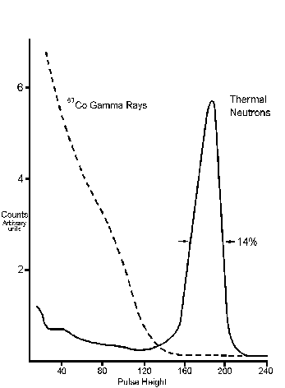
Standard Neutron Scintillator:
GS20-⁶Li-glass
Neutron capture reaction:
6.6 weight% Li, 95% ⁶Li-enriched
Emission peak at ~390 nm (Ce doped)
Light yield ~ 6000 photons/n (corresponds ~1.5 MeV gamma)
Neutronen Sensitivity
65% @ 1 Å
85% @ 2 Å
www.scintacor.com
Pulse height spectra
Scintillator with support glass

Slide 7
Readout Electronics Evaluation System
Required parameter for pulse processing: charge per neutron
dependent on number of photons hitting photocathode, quantum efficiency, gain of MaPMT
difficult to predict (reflective effects)
adjustable to some degree by MaPMT gain
Pictures of the ROSMAP
Readout System attached to a MaPMT

Slide 8
Readout Electronics Evaluation System
ROSMAP readout system for evaluation
digitization and counting mode available, but only digitization mode used for tests
2x VA32HDR14.3 ASICs for digitization of channels with 10:1 (changed to 3:1) charge splitter for measurement up to 200pC input charge
trigger derived from PMT dynode signal
14 bit ADC, data values are delivered with 8 bit resolution via ModBus interface
read out rate of ~50 Hz achieved for digitization mode (with python interface)
external high voltage supply for MaPMT

Slide 9
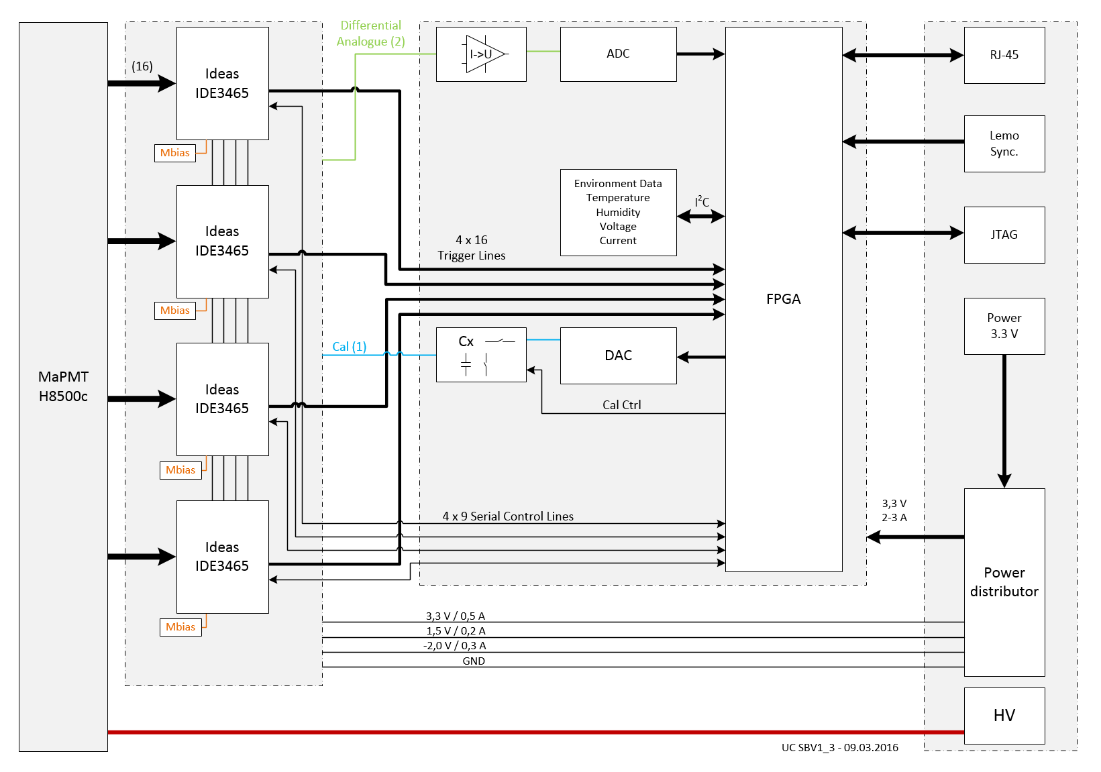
System Overview

Slide 10
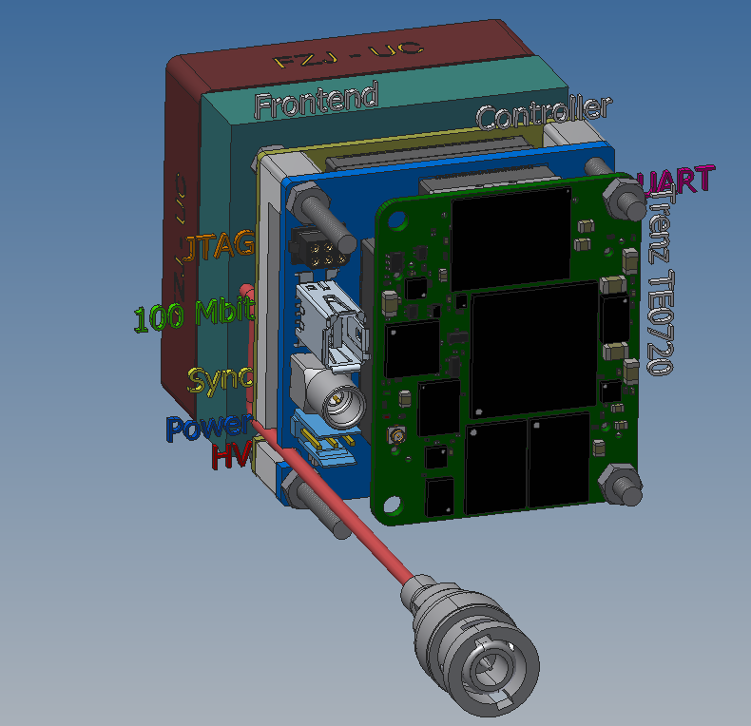
3D Model of one MaPMT Module and the Trenz-Lifter
ASIC Board with Aluminum housing
Controller / Backend Board
Trenz TE0720
Trenz – Lifter to remove safely the board from the ASIC board

Slide 11
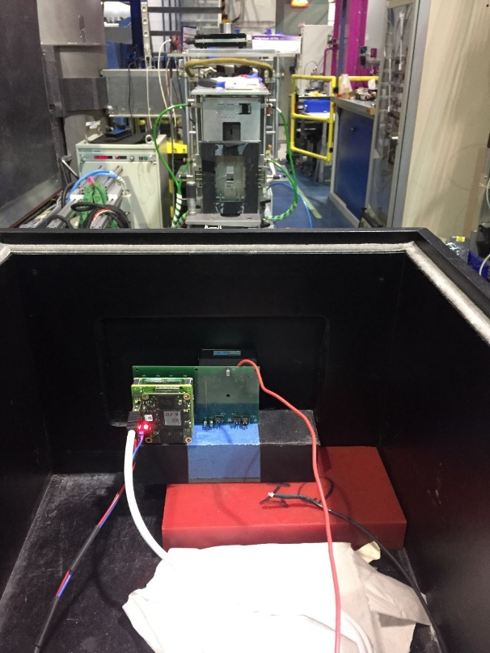
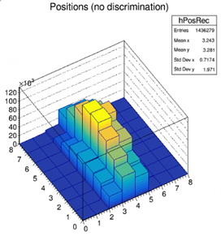
Test Setup @ TREFF
Picture of H8500 with the adapter
board and blue LED
View into the direction of the sample

Slide 12
Conclusion
Neutron Scintillation Detector based on H8500 MaPMT
Large active area → scalable design for larger detector size
Higher resolution due to smaller pitch size of neighboring light detectors (~ 6mm)
Higher count rate capability with smaller readout units (higher segmentation, smaller neutron occupancy)
First prototype for evaluation based on ROSMAP system
Images acquired with ROSMAP system look reasonable
Prototype measurements
Pixel n/γ –discrimination is possible, but need more test for optimisation
Backend Board was designed
Adaption to the ASIC board was successfully
Currently under commissioning

Slide 13
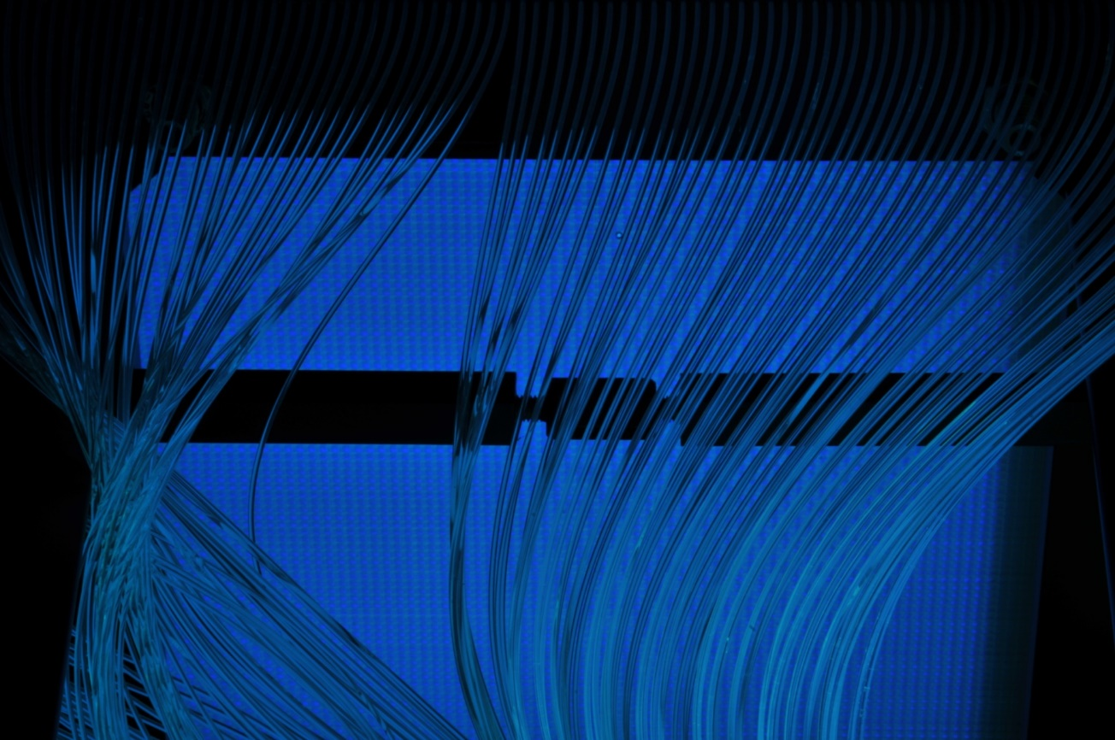
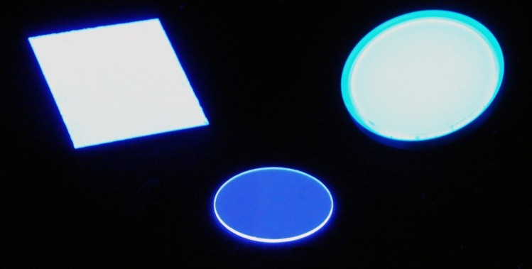
Thanks !

