Slide 1

WP 9.2.1 Development of a WSF detector at ISIS for reflectometry applications
Jeff Sykora, Erik Schooneveld, Nigel Rhodes, Martin Sharkey, Sarah Mann and Nick Ferguson
28 May 2019
Bilbao

Slide 2
Work Package 9.2.1
Objectives and Deliverables
Spatial resolution of 1-3mm, with a perspective of improvement into the sub-mm regime.
Time resolution better than 100μs.
Local instantaneous rate capability of several kHz/mm².
D1. Initial WLS fibre detector hardware
D2. Interim report on scintillation detector development programme
D3. Final report on scintillation detector development programme

Slide 3
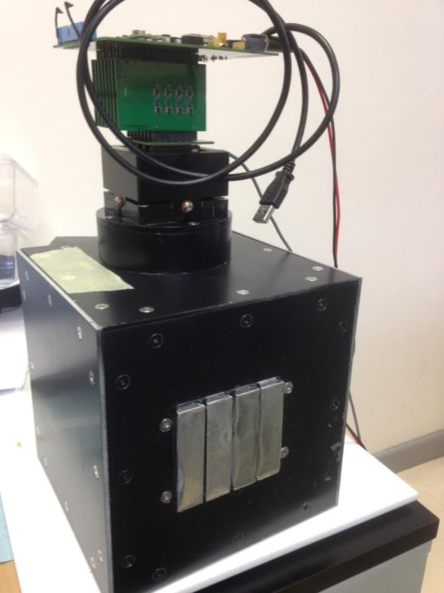
Overview
Recap
  SHARD2 successes
  SHARD2 problems
New WSF detector concepts
A solution for INTER

Slide 4
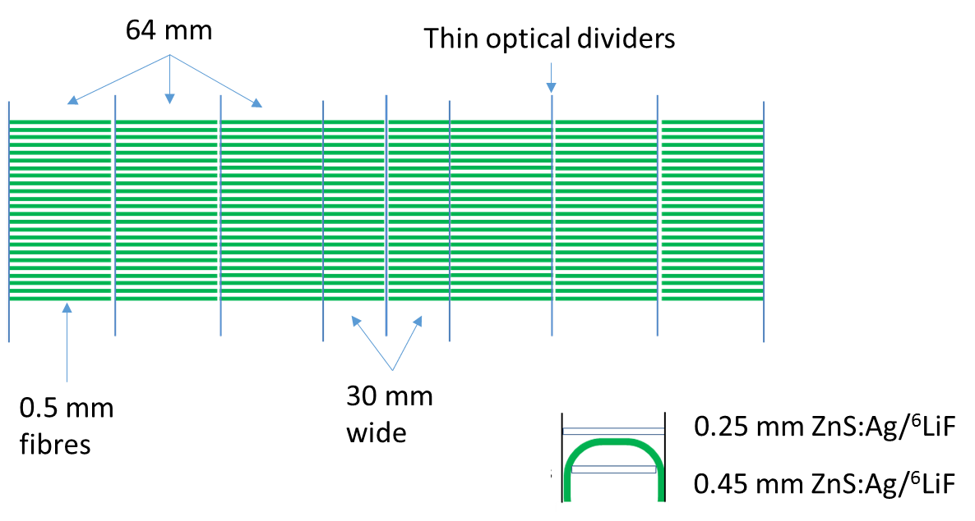
SHARD2
Configuration
1 mm fibres – 16 mm wide
Individual segments
  Optically divided
  Supports
    3D printed
  Strips of scintillator front and back
Single 64 ch FP-PMT per segment
Neutron beam

Slide 5
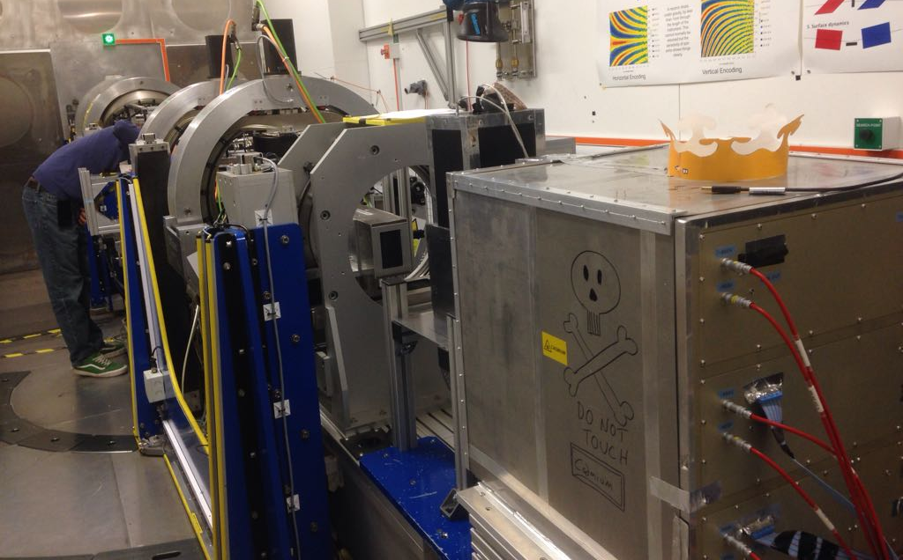
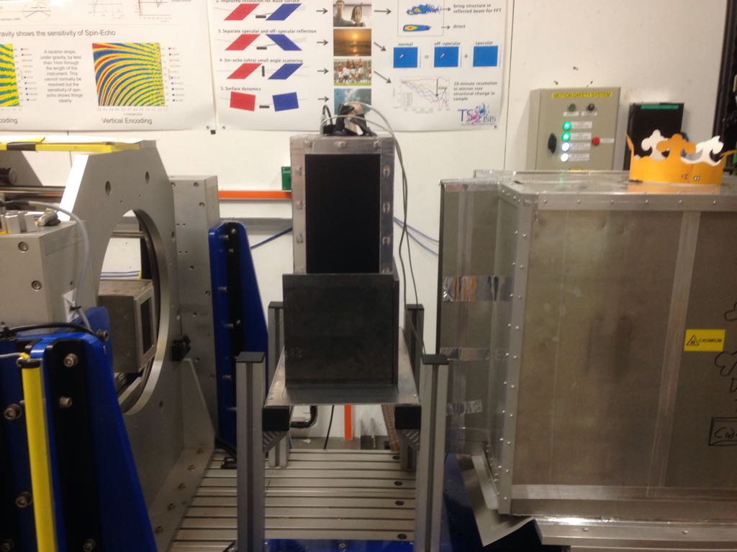
SHARD2
Testing
OffSpec reflectometer
  Efficiency
  Rate capability
  Ghosting

Slide 6
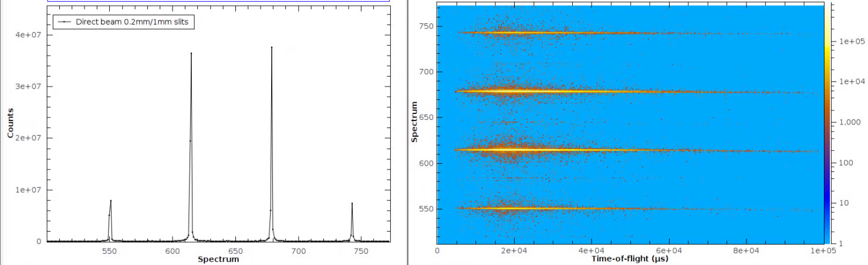
OffSpec
Results
80mm
Detector in direct beam
  Measure efficiency
  Global and local peak rates
65mm
16mm

Slide 7

SHARD2
Results
80mm
Detector in direct beam
  Measure efficiency
  Global and local peak rates
65mm
16mm
225 μm front scintillator + 450 μm back scintillator is ~90% efficient at 9 Å
450 μm front scintillator efficiency drops to 45% at 9 Å
“Local” (within beam area) instantaneous peak rates
  Linear until ~160 kcps
$${Local Rate limit= n}_{seg}×n_{PMTs}×16 kcps$$
$${Global Rate limit= n}_{seg}×80 kcps$$

Slide 8
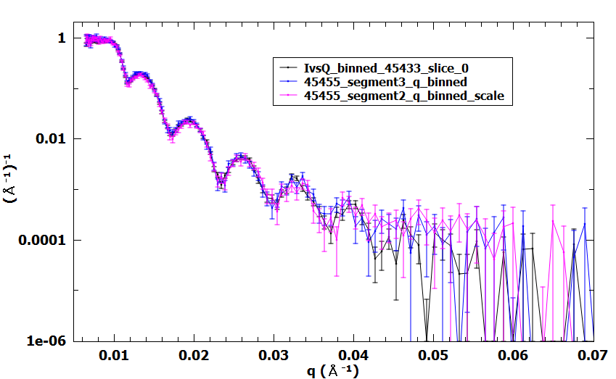
SHARD2
Reflectivity Results
Polymer on Si substrate
Exact match with similar error bars despite no shielding and less than ½ the active area!
³He point detector
SHARD inner 2 segments

Slide 9
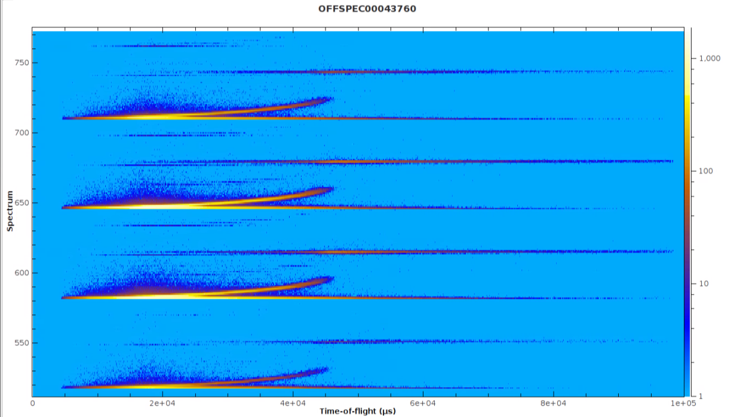

Ghosting
Si reflectivity
Reflected
Refracted
Transmitted

Slide 10

Ghosting
Ghosting is an issue with this coding scheme
  N.B. This was expected
Example:
Fibre no. | PMT 1 | PMT 2
1 | 1 | 9
2 | 1 | 10
3 | 2 | 10
4 | 2 | 11
5 | 3 | 11
6 | 3 | 12
7 | 4 | 12
8 | 4 | 13
9 | 5 | 13
10 | 5 | 14
11 | 6 | 14
12 | 6 | 15
13 | 7 | 15
14 | 7 | 16
15 | 8 | 16
16 | 8 | 9
17 | 3 | 9
18 | 3 | 10
19 | 4 | 10
20 | 4 | 11
21 | 5 | 11
22 | 5 | 12
23 | 6 | 12
24 | 6 | 13
25 | 7 | 13
26 | 7 | 14
27 | 8 | 14
28 | 8 | 15
29 | 1 | 15
30 | 1 | 16
31 | 2 | 16
32 | 2 | 9
  Ghosts caused by :
  Afterglow
  Coding
  Cross-talk
Direct beam
Location of ghosts

Slide 11
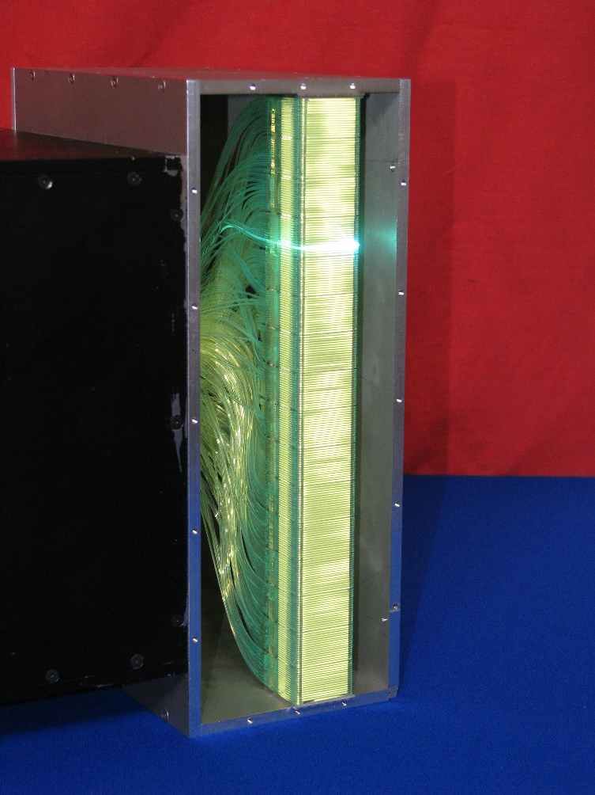
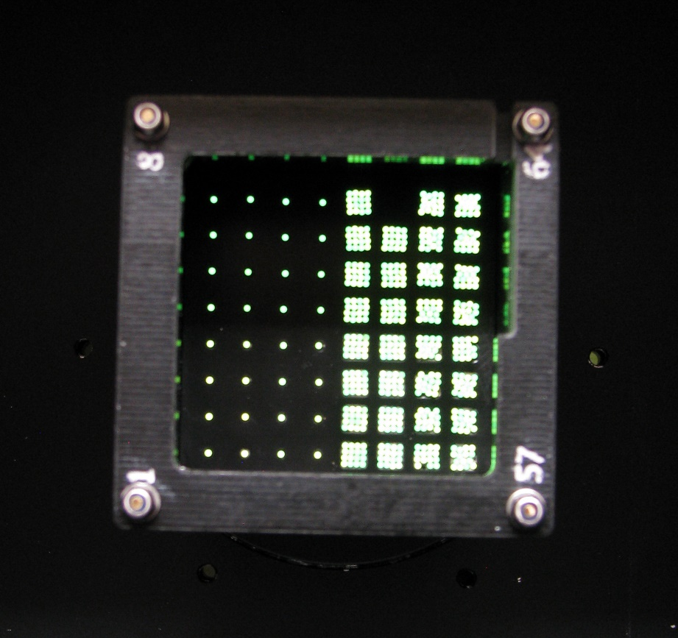
New geometry
Takes advantage of reflectometer operation
Optimise rate capability in one section
Eliminates ghosting
Remains cost-effective

Slide 12


Optimisation of rate capability and Ghost elimination
Uncoded fibres in detectors pixels seeing highest rate – specular reflection
  Off specular is very low rate
Optical dividers between fibres
θ₁
Incident
beam k_{i}
q_{z}
Reflected
beam k_{f}
q_{y}
q_{x}
Transmitted
beam

Slide 13
Reflectometer Operation
Full q reconstruction
  Time of flight
  Several angles to extend q range
Reflected beam on same detector pixels
θ₁
θ₂
Reflected
beam k_{f}
Incident
beam k_{i}
q_{z}
Reflected
beam k_{f}
q_{z}
q_{y}
Incident
beam k_{i}
q_{y}
Δz
q_{x}
q_{x}
Transmitted
beam
Transmitted
beam

Slide 14
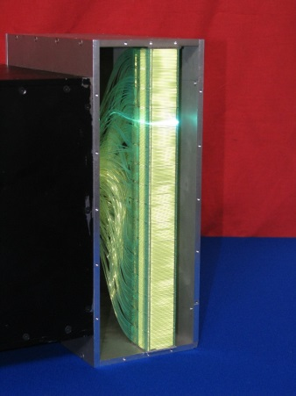
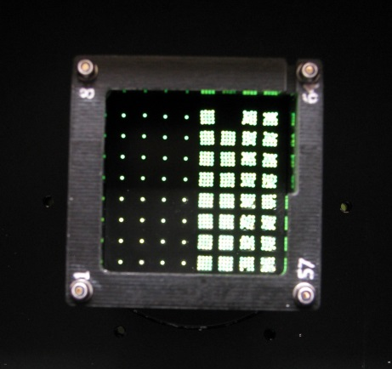
Layout of detector with dividers
0.25mm scintillator
Steel dividers
Foil reflector
Neutrons
Flat
B₄C backstop
Flat
w/dividers
0.45mm scintillator

Slide 15
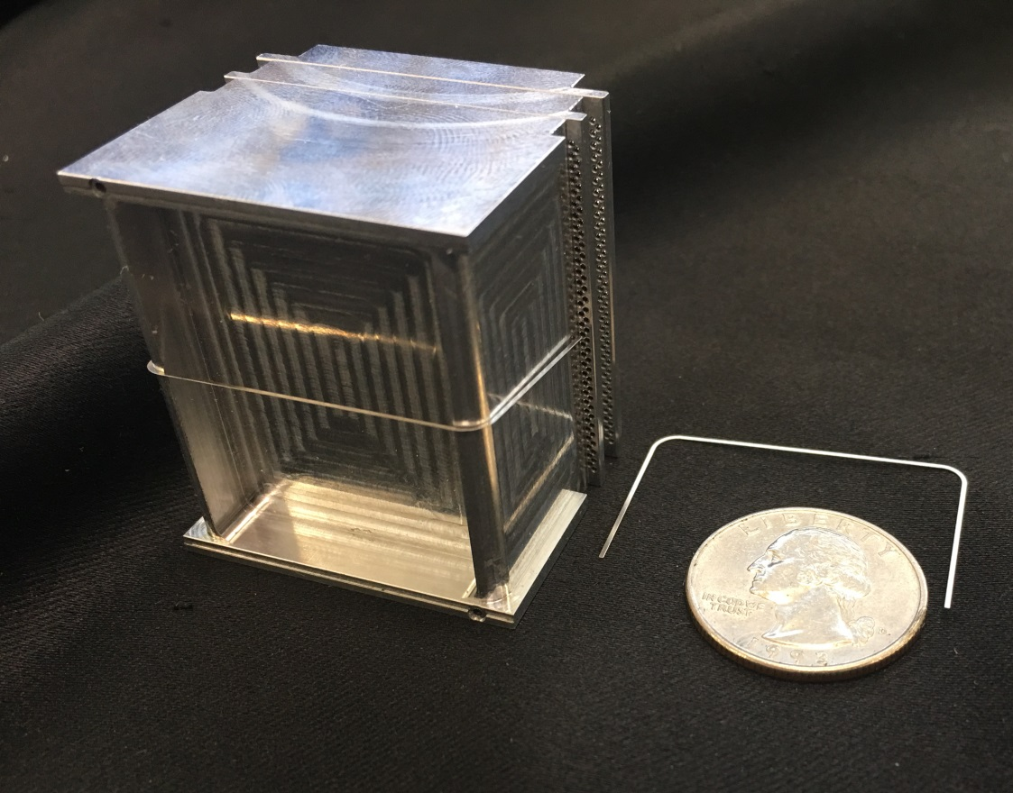
Fibre holder and dividers
Machined Al block
  Individual holes for fibres
  Pocket to contain B₄C and scintillator
Stainless steel dividers
  Sub-100 μm thickness
  Photo-fabricated
  Contains light spread

Slide 16
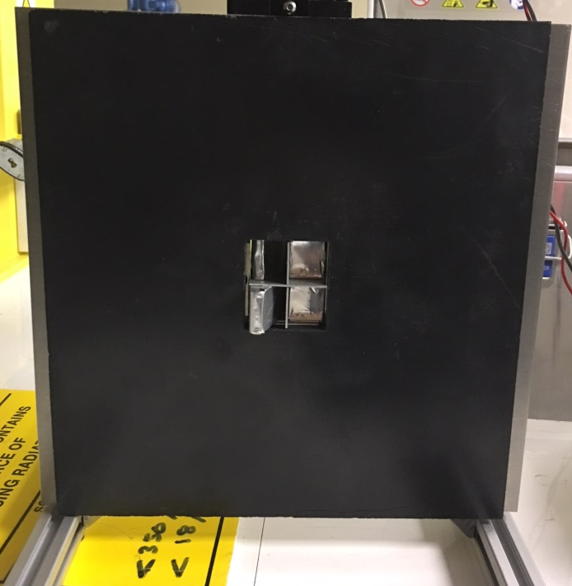
Effect of dividers
Efficiency
Flat
Flat
w/dividers
~5% gain in efficiency because of dividers
  Removes ambiguity in event determination

Slide 17
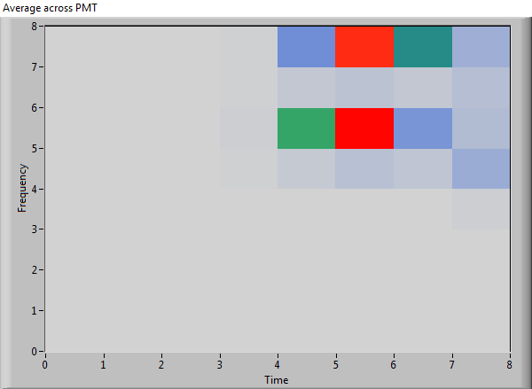
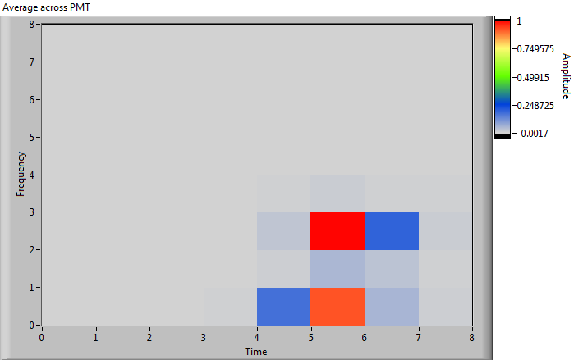
Light spread
Average intensity distribution across PMT
PMT 6
PMT 21
PMT 7
PMT 22
PMT 23
11%
34%
3%
38%
10%
Flat without dividers

Slide 18
Light spread
Average intensity distribution across PMT
PMT 46
PMT 61
PMT 47
PMT 62
PMT 63
11%
34%
Flat with dividers
3%
38%
10%
2%
18%
4%
Flat without dividers
17%
3%
Dividers reduce light spread by a factor 2

Slide 19
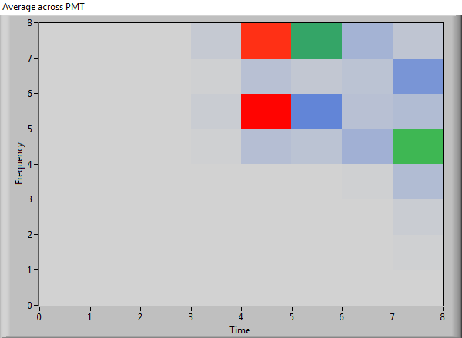
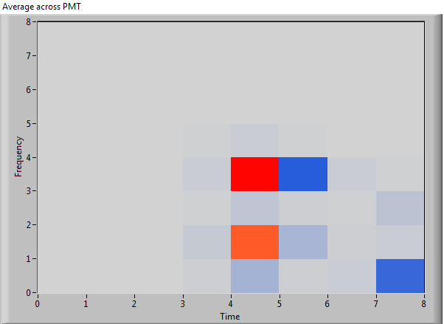
Light spread
Average intensity distribution across PMT
Dividers reduce light spread by a factor 2
  It is worth putting the dividers in unless it hinders ghost rejection
PMT 5
PMT 32
PMT 6
PMT 21
PMT 22
34%
Flat with dividers
3%
10%
12%
38%
20%
2%
5%
Flat without dividers
5%
17%

Slide 20
Light spread
Average intensity distribution across PMT
Dividers reduce light spread by a factor 2
  It is worth putting the dividers in unless it hinders ghost rejection
PMT 37
PMT 64
PMT 38
PMT 53
PMT 54
34%
Flat with dividers
3%
10%
12%
38%
20%
2%
5%
Flat without dividers
5%
17%

Slide 21
Optimisation of rate capability and Ghost elimination
Uncoded fibres in detectors pixels seeing highest rate – specular reflection
  Off specular is very low rate
Optical dividers between fibres
Tested on INTER
θ₁
Incident
beam k_{i}
q_{z}
Reflected
beam k_{f}
q_{y}
q_{x}
Transmitted
beam

Slide 22
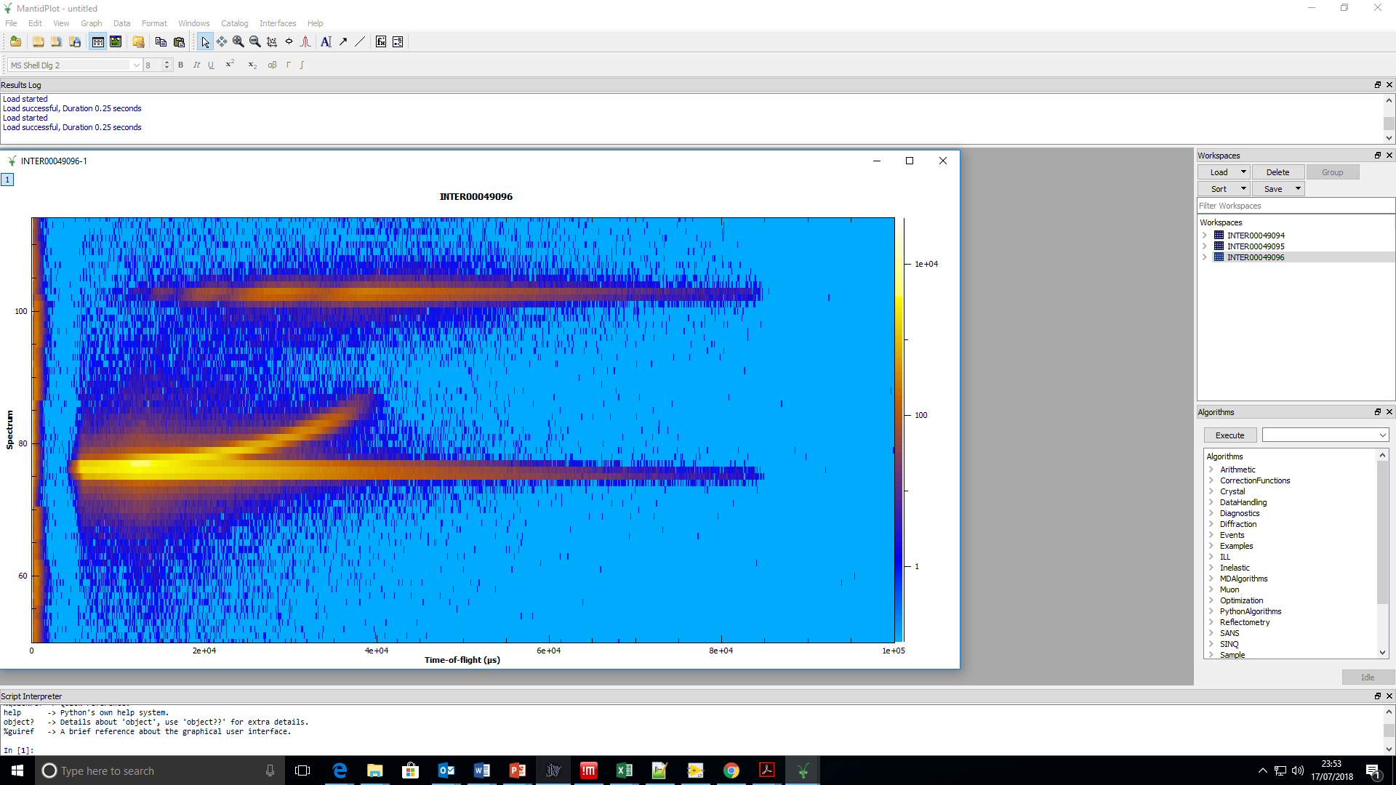

Ghost elimination
Success

Slide 23
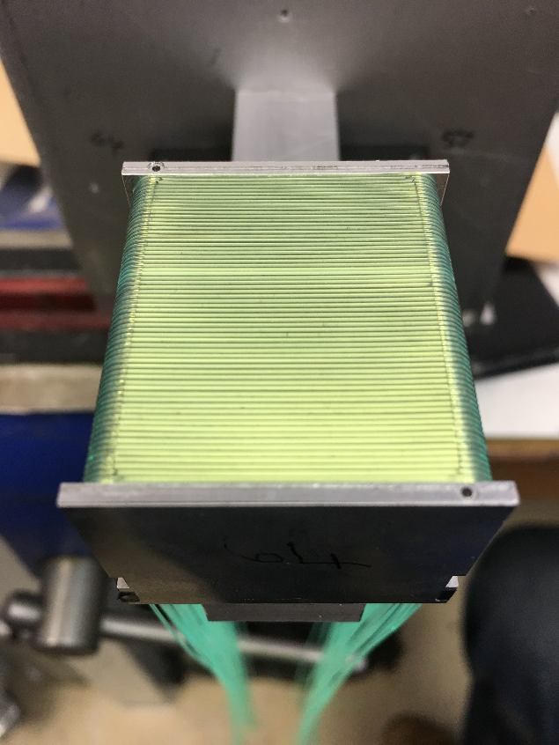
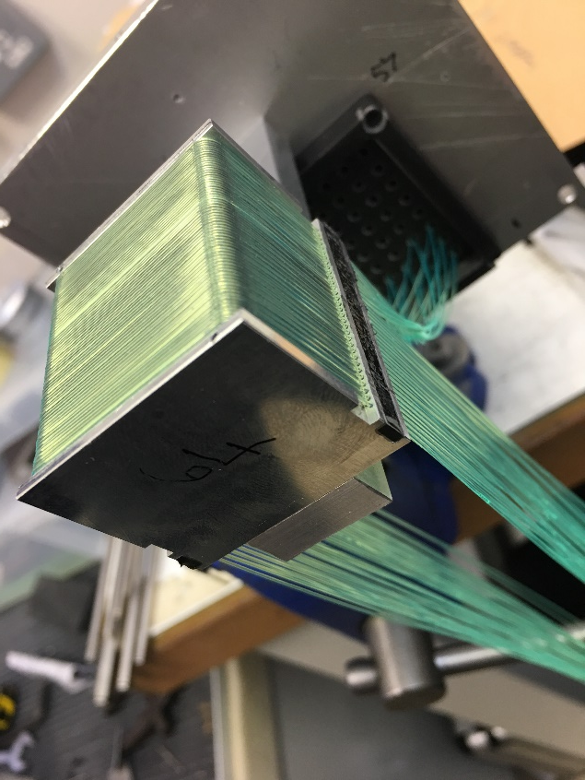
0.6 mm demonstrator
0.5mm fibres
0.1mm dividers
High rate walking coincidence (no repeated codes)

Slide 24
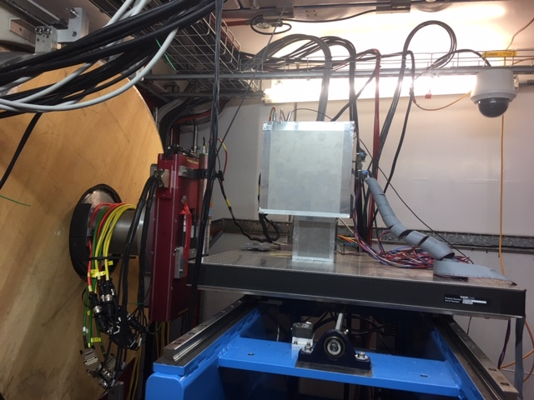
First characterisation of 0.6 mm
Verifying position resolution on EMMA

Slide 25
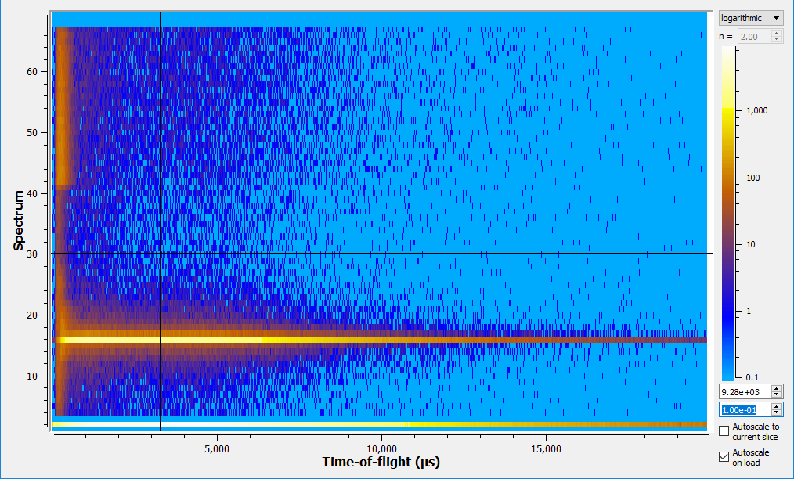
Verifying position resolution
EMMA
  Resolution
    0.2mm slit

Slide 26
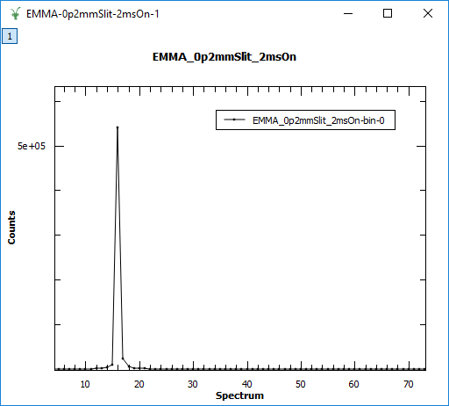
Verifying position resolution
Integrated in time of flight
Single pixel illumination
Resolution = 0.6 mm

Slide 27
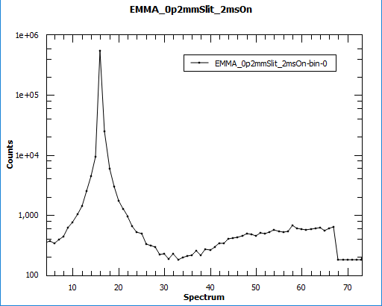
Verifying position resolution
Low scattering from fibres and B₄C behind scintillator
Beam spread dominated by divergence
No exact numbers yet
  Good enough for INTER

Slide 28
Detector spec summary
 | Requirements | SHARD2
Neutron Detection Efficiency | 40% at 1.8 A | 45% (0.25mm front scint) 60% (0.45mm front scint) at 1.8 Å
Gamma Sensitivity | 10⁻⁶ at 1MeV | 3 x 10⁻⁷ at 1MeV
Position Resolution | 1-3 mm | 0.6 mm
Timing Resolution | 100 μs | 10 μs
Rate Capability | (several) kcps/mm² | 1 kcps/mm²
Placement Accuracy | 99.99% | 99.99%
Requirements laid out in WP 9.2 have been satisfied
First application is the INTER beamline

Slide 29
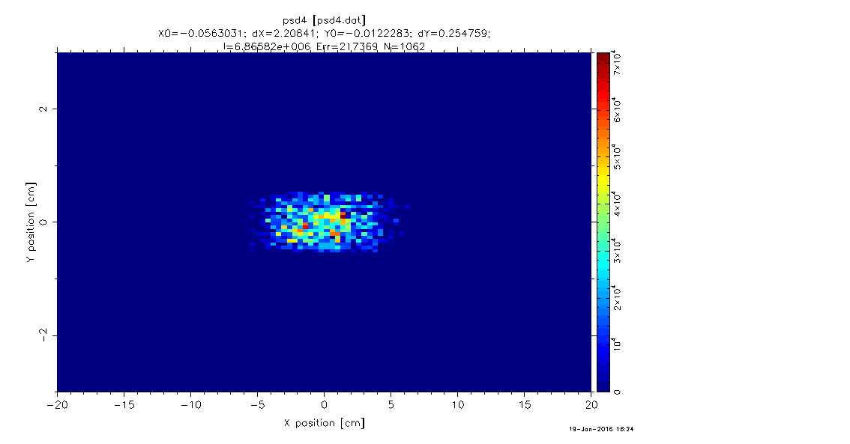
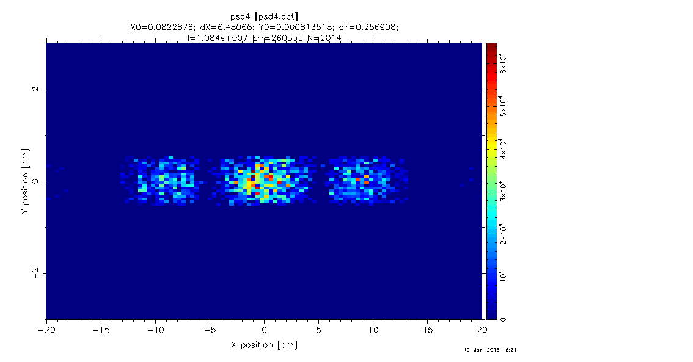
First Application:
INTER
Installing new guide
  Focussing guide
  Increase in flux spread out along the detector
Current
New guide

Slide 30
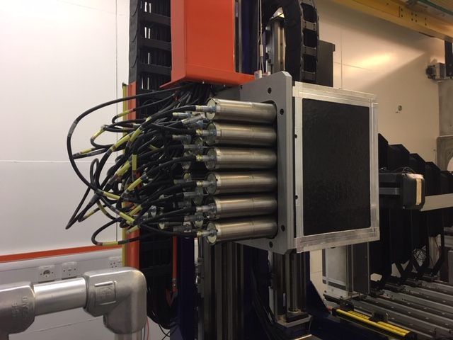
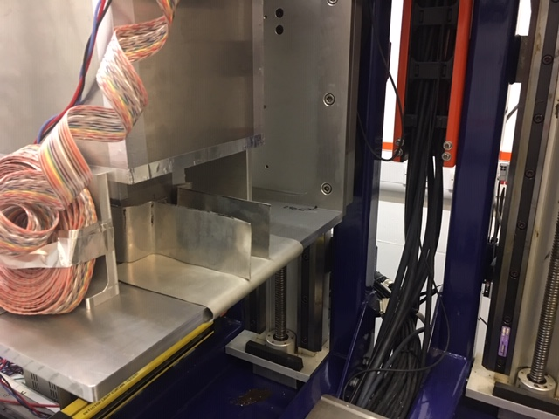
First Application:
INTER
Installing new guide
  Focussing guide
  Increase in flux spread out along the detector
Replace old linear detector
  New SHARD style to cover the area and match count rate requirements
  Temp replacement = 0.6mm segment

Slide 31
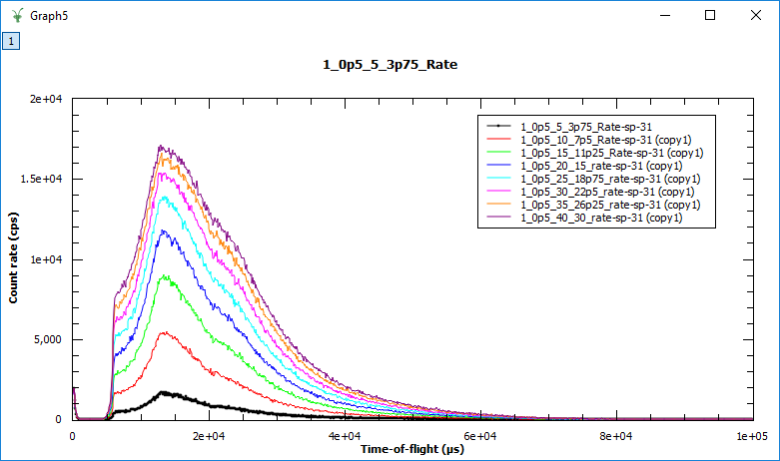
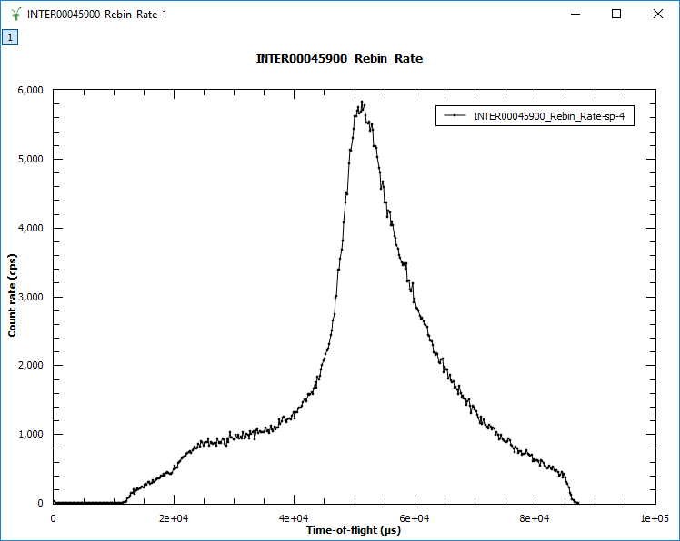
0.6mm segment on INTER
Rates
  16 kcps per 30mm² area
D₂O reflectivity at low angle
Divergent mode on ³He tube
40mm x 10mm slits

Slide 32
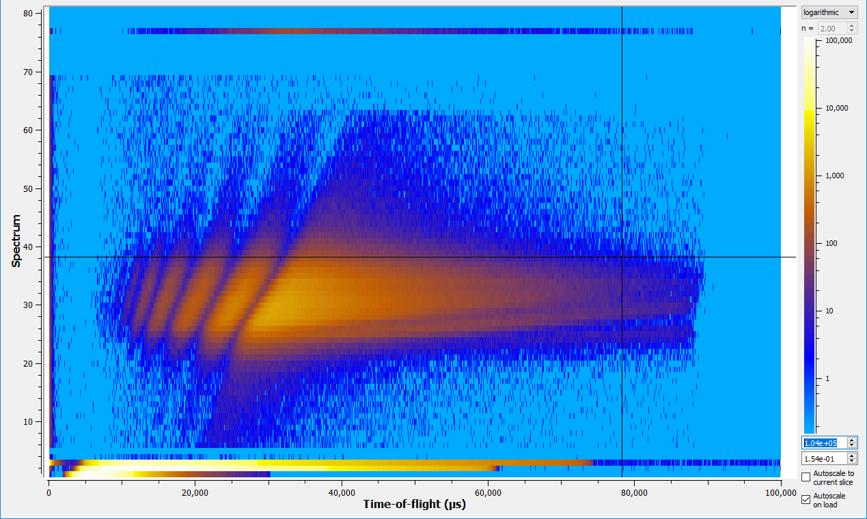
Early results on INTER
Detector covers full divergent mode in vertical plane
Resolution and uniformity showed existing guide defects
In operation this user cycle
Highly fringed sample in divergent mode

Slide 33
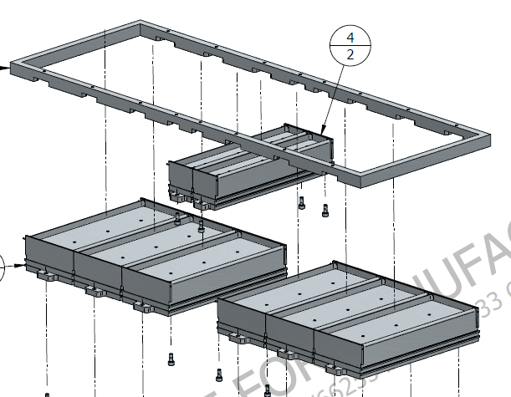
Mid-term detector design for INTER
8 Segments – 64 channel PMT per segment
150 μm gap between segments
2 different widths to match beam profile

Slide 34
Summary
A sub-mm position resolution detector has been developed for reflectometry
A new high rate section has been successfully implemented keeping the detector cost-efective
So far a detector capable of 1 kcps/mm²has been built
Ghosting has been eliminated
A new solution for the INTER reflectometer is now being implemented due to these developments.

Slide 35
Thank You!

Slide 36

Other issues?

Slide 37
Conclusions
PMT 1
PMT 3
PMT 2
PMT 4
PMT 1
PMT 3
PMT 2
PMT 4
PMT 5
Neutron counts are “missing” in the un-coded region
  Significant portion of events are unidentified
  Unidentified are in neighbouring fibres
    Most likely neutrons absorbed on the boundary between two fibres

Slide 38
Conclusions
PMT 1
PMT 3
PMT 2
PMT 4
PMT 1
PMT 3
PMT 2
PMT 4
PMT 5
Neutron counts are “missing” in the un-coded region
  Significant portion of events are unidentified
  Unidentified are in neighbouring fibres
    Most likely neutrons absorbed on the boundary between two fibres
No multi-counting in the coded areas

Slide 39
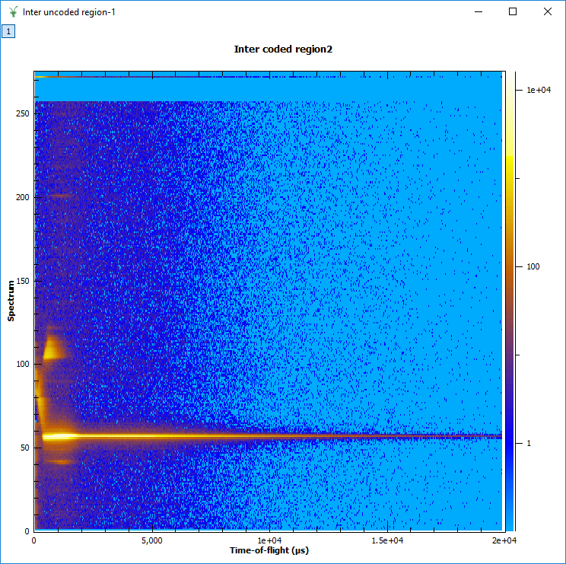
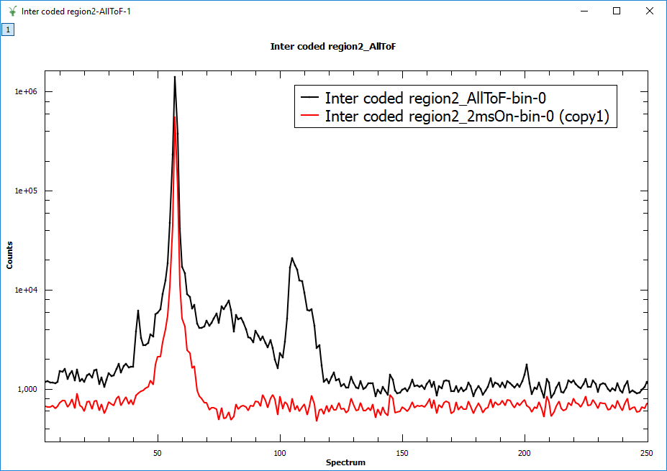
EMMA testing
Extra “bumps”

