Slide 1
WP 9: DELIVERABLES
No. | Deliverable Title | LEAD | TYPE | DOMAIN | DUE(M) | STATUS
9.1 | First extended RTD meeting | STFC | DEC | PU | 18 | +3 Complete
9.2 | Initial WLS fibre detector hardware | STFC | DEM | PU | 18 | Complete
9.3 | Initial direct PMT readout hardware | FZJ | DEM | PU | 24 | Complete
9.4 | Interim report on scintillation detector development programme | STFC | R | PU | 24 | Complete
9.5 | Novel MSGC detector hardware | ILL | DEM | PU | 24 | Complete
9.6 | Interim report on MSGC detector development programme | ILL | R | PU | 24 | Complete
9.7 | Interim report on Emergent Neutron Detector Technologies development programme | ESS | R | PU | 24 | Complete
9.8 | Report discussing an evaluation of commercial SiPMs for µSR detector arrays | STFC | R | PU | 24 | Complete
9.9 | Second extended RTD meeting | STFC | DEC | PU | 36
9.10 | Final report on scintillation detector development programme | STFC | R | PU | 48
9.11 | Final report on MSGC detector development programme | ILL | R | PU | 48
9.12 | Final report on Emergent Neutron Detector Technologies development programme | ESS | R | PU | 48
9.13 | Report discussing alternative detector technologies for μSR | STFC | R | PU | 48
9.14 | Website containing all presentations | STFC | DEC | PU | 48

Slide 2
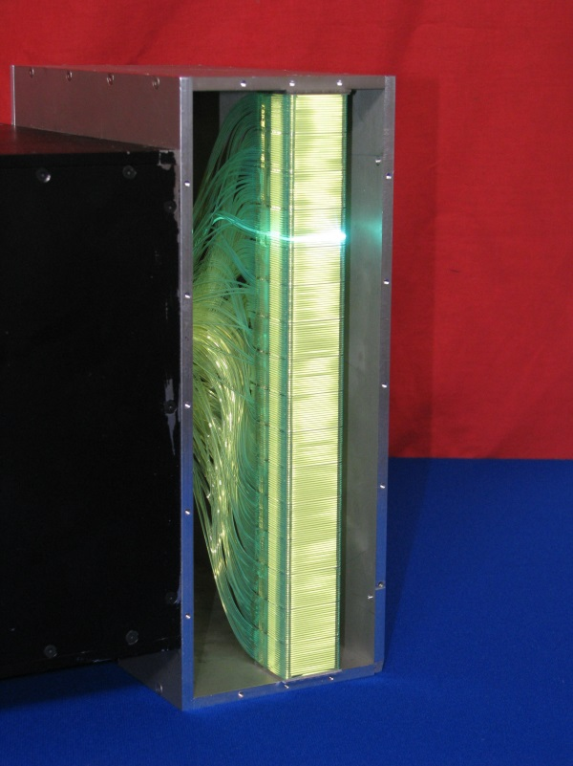
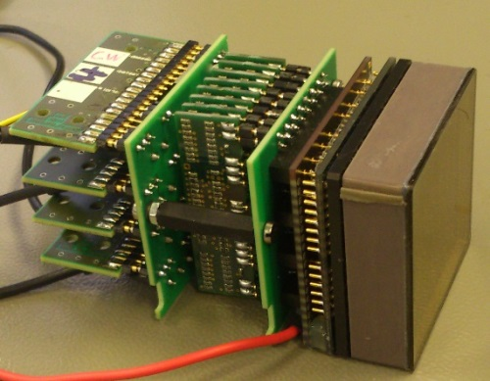
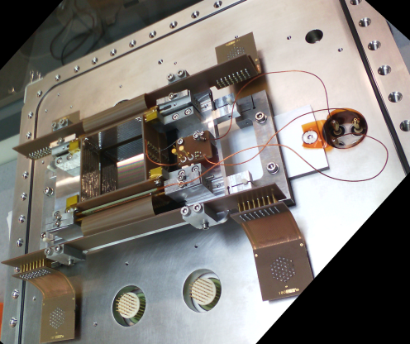
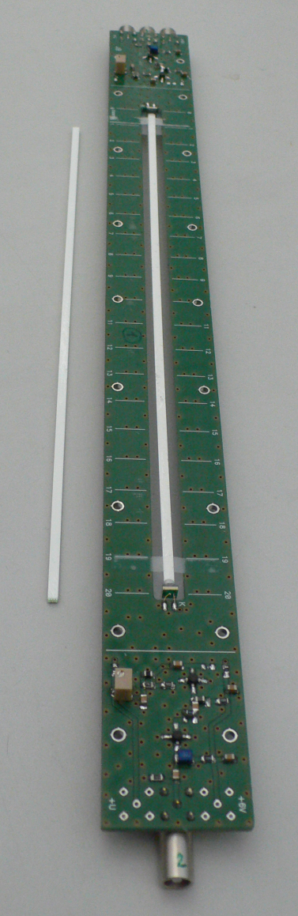
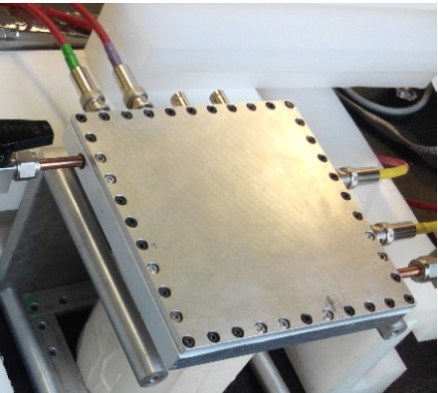
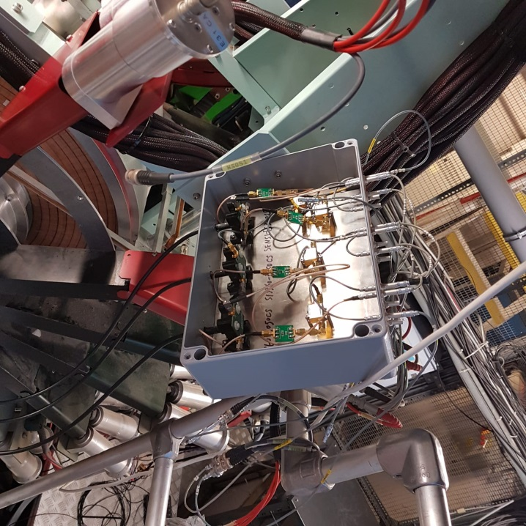
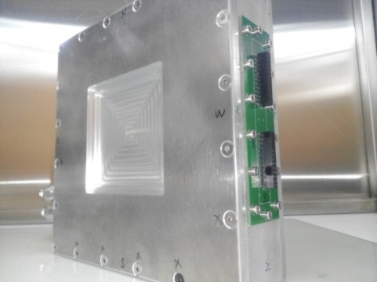
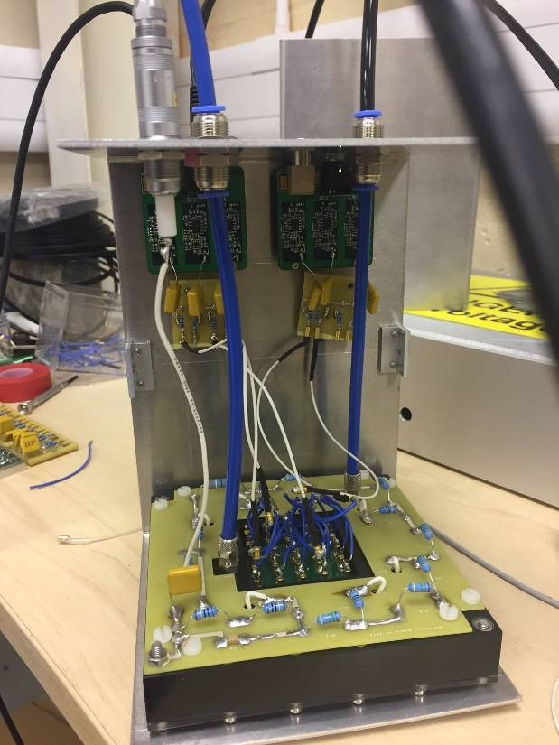
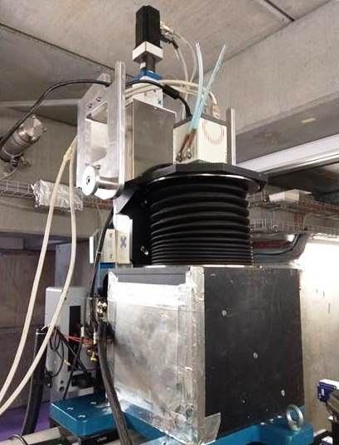
WP 9: DELIVERABLES
GS20 + MaPMT (Anger)
3He + 2D MSGC
Different detector technologies developed in SINE 2020 for neutron reflectometry and MuSR applications
ZnS +WLSF + MaPMT
ZnS +WLSF + SiPM
10B Micromegas
10B RPC
Plastic Scint + SiPM/MaPMT (µ)
GEM (µ)
ZnS + CMOS Camera

