Slide 1
WP 9 Instrumentation: Detectors
Nigel Rhodes, ISIS

Slide 2
WP 9: Aims
AIMS
Develop neutron detectors for reflectometry applications relevant to the ESS
Spatial resolution 1 – 3 mm
Time resolution better than 100 µs
Local instantaneous rate capability of several kHz/mm²
TASKS
Task 9.1: Involvement of industry and the wider European neutron and muon detector communities in detector development
Task 9.2: Development of scintillation detectors with high rate capability for reflectometery
Task 9.3: 3He based microstrip gas chamber with a novel 2D readout
Task 9.4: Emergent Detector Technologies for neutron scattering and muon spectroscopy

Slide 3
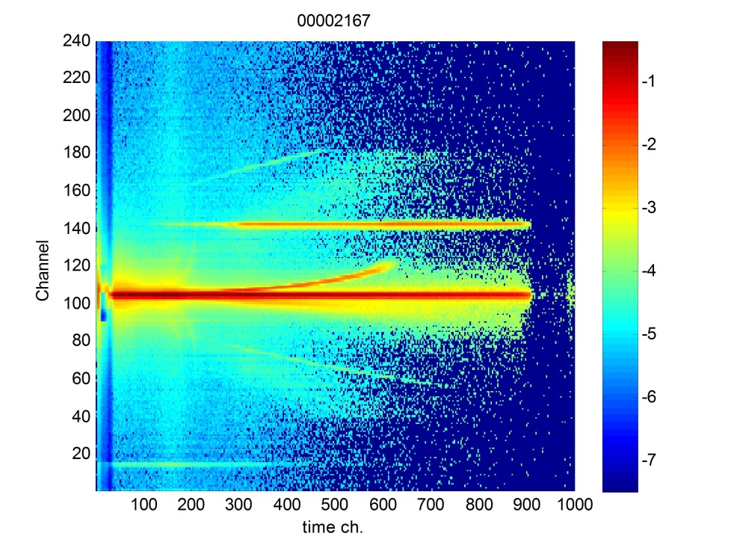
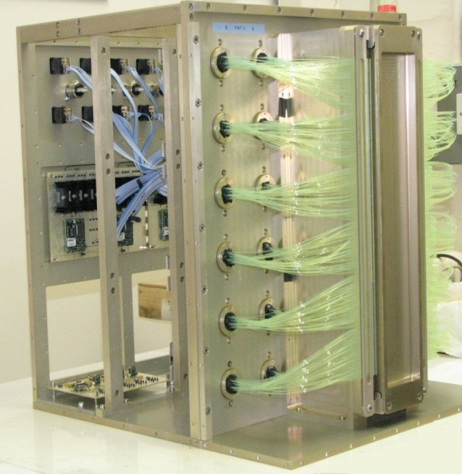
WP 9: Task 9.2.1
TASK 9.2:
Development of scintillation detectors with high rate capability for reflectometry
9.2.1 ZnS scintillation detector with WLS fibre readout
Distribute data high intensity data across all PMTs rather than just a few
Adjacent horizontal and vertical pixels deliberately coded to different PMTs

Slide 4
WP 9: Task 9.2.2
9.2.2 Scintillation detector with direct PMT readout
Use of Li glass scintillator and PMT for light collection
Use flat panel Ma PMTs
Dense aray of PMTs with small amount of dead space
Position resolution determined by pixel size of individual PMTs
Count rate capability probably limited bby maximum current of PMT
Energy resolution must be sufficient for n/γ discrimination
Deal with electrical an optical cross talk between channel

Slide 5
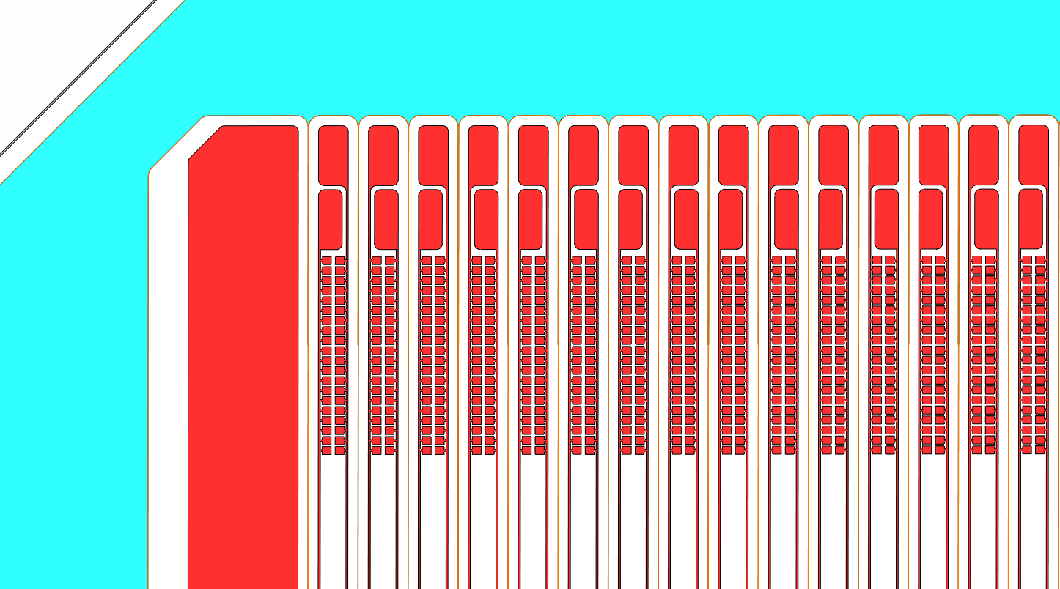
WP 9: Task 9.3
TASK 9.3:
Development of a 3He based microstrip gas with a novel 2D readout
The microstrip gas chamber is intrinsically a 1D position sensitive device
The proposal is to make it 2D position sensitive by laying down resistive cathodes
T9.3.1: Optimise the MSGC layout (in particular anode-cathode distance), and validate the mechanical mounting
T9.3.2: Mechanical study and fabrication of the detector vessel
T9.3.3: Fabrication of a 20 cm x 20 cm MSGC
T9.3.4: Test of the Bidim200-PCD (PCD=Parallel Charge division) detector on a beam line
The inter-anode gap is filled with 2 cathode strips; the left and right cathode strips surrounding each anode are connected together to make only one readout channel.
The resistance of the anode strip is controlled by tuning the width of the interconnection line

Slide 6
WP 9: Task 9.4
TASK 9.4:
Task 9.4: Emergent Detector Technologies for neutron scattering and muon spectroscopy
9.4.1 ¹⁰B₄C coated Resistive Plate Chambers for Position Sensitive Neutron Detectors
9.4.2 Silicon Photomultipliers for Neutron Scattering
9.4.3 Silicon Photomultipliers for Muon Spectroscopy
9.4.4 Micromegas detectors

Slide 7
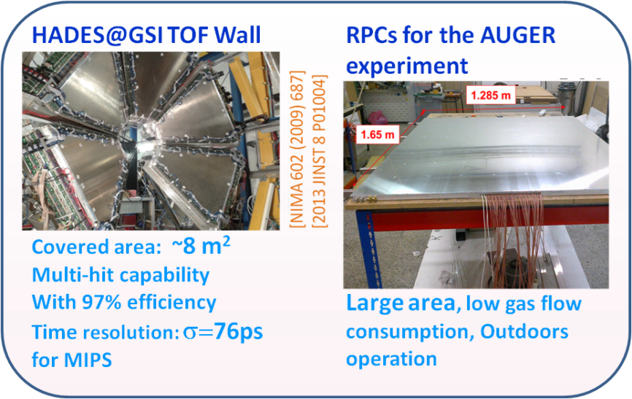
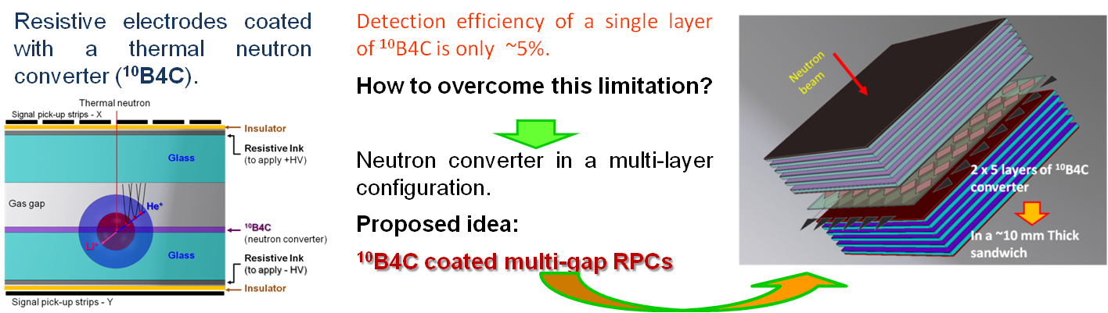
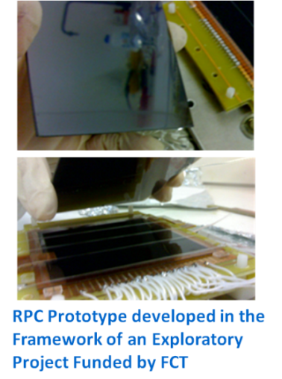
WP 9: Task 9.4.1
Task 9.4.1 ¹⁰B₄C coated Resistive Plate Chambers for Position Sensitive Neutron Detectors
RPCs used extensively in HEP for fast, large area detectors.
  Goals
  MC SIMULATION: GEANT4 and ANTS2 package
  PROTOTYPE: Design and assembly of ¹⁰B₄C coated RPCs; Explore the Multi-Gap RPC configuration.
  FEASIBILITY STUDIES: Efficiency; Position resolution; Count rate and Gamma Sensitivity.
  FUNDAMENTAL STUDIES: Investigate potential of PSD techniques for gammas and thermal neutrons
  2D POSITION RECONSTRUCTION: Statistical reconstructions" algorithms

Slide 8
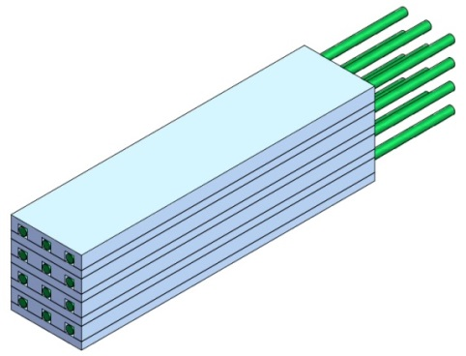
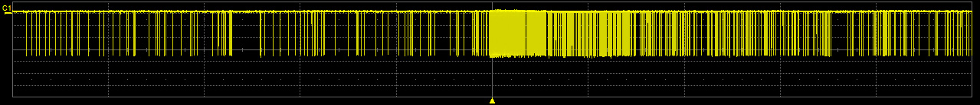
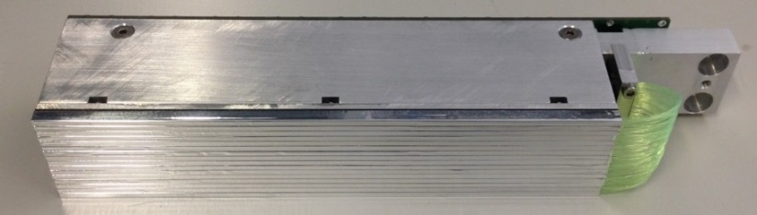
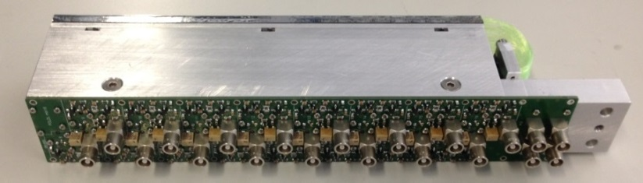
WP 9: Task 9.4.2
Task 9.4.2 Silicon Photomultipliers for Neutron scattering
1D WLS fibre detector with SiPM readout developed by PSI for POLDI
  16 channel module
  2.4 mm wide, 200 mm long
  layered machined scintillator, 2.8 mm thick
  neutron absorption probability 75% @ 1 Å
  12 embedded WLS fibers (0.25 mm diameter
  Each detection element coupled to single SiPM
  Signal processing extracts neutron event from SiPM dark counts
  SINE 2020
  2D, gapless, individual pixel readout
  pixel size down to ≈ (2.5 × 2.5) mm2
  → to do: design, construction, tools in view of
  large-scale production
  2D, gapless, individual long pixels with two-side readout
  2nd coordinate via pulse-amplitude analysis
  → to do: confirm feasibility of pulse-amplitude analysis, design, construction, tools
SD-signals, 20 µs/div

Slide 9
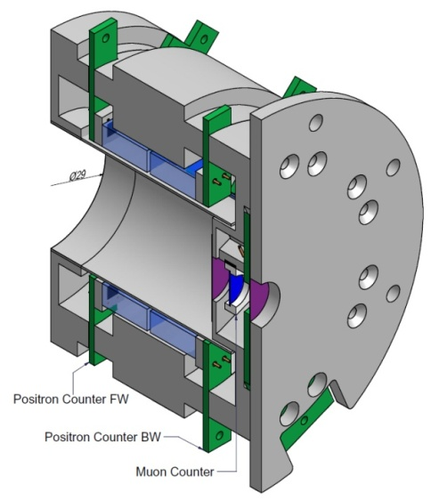
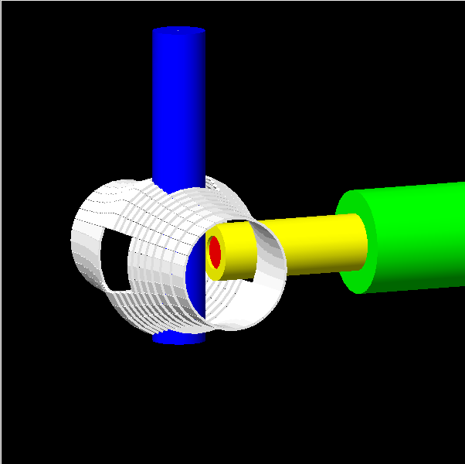
WP 9: Task 9.4.3
Task 9.4.3 Silicon Photomultipliers for μSR
SiPMs developed for μSR during FP 7
→ Key technology for improving timing
and magnetic field insensibility of µSR instruments
  New HAL-instrument at PSI requires 60 ps
  Upgrade of MuSR at ISIS requires high rate capability and ~ 1000 pixels
Aim of the Task 9.4.3
Further performance improvements particularly for fast timing
and operation temperature stability
  Systematic testing of emerging commercial SiPMs with
  continuous feedback to industry.
  Investigation of alternative technologies,
  such as the Micro Channel Plate (MCP)
  collaborative work between the facilities is essential (for example: study of dead-time for pulsed

Slide 10
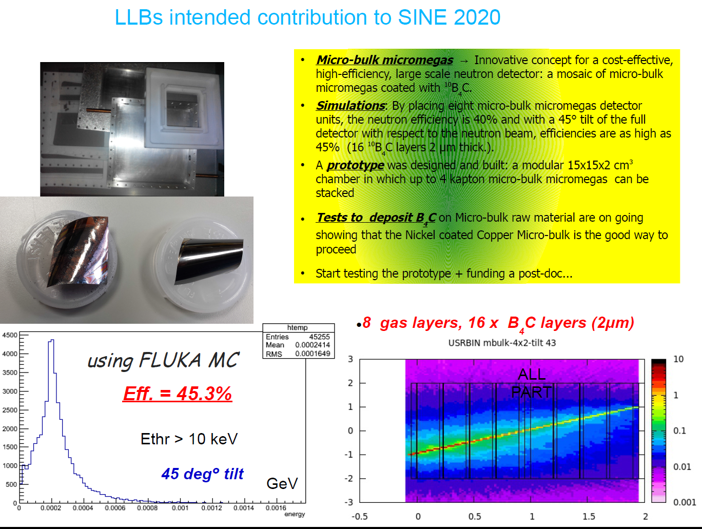
WP 9: Task 9.4.4
Task 9.4.4 Micromagas Detectors
Potential of technology shown in NMI3 2 using Bulk Micromagas Technology
Explore potential of Micro bulk technology and build appropriate demonstrator

Slide 11
WP 9: Task 9.4.4
A large high-efficiency multi-layers Micromegas thermal neutron detector
Cost estimation
➔A prototype 15x15x2 cm3 : Ni mesh ~ 500€ per mesh, mechanics ~2k€
●Linksoping < 2 k€/m2 for 10B4C deposition
fixed for a max of 100 k€/m2 of detector without electronics .
●In 2000, Euromip → 50x50 cm2 Nickel, 5 μm thick, meshes strectched on frame at cea with cost
~ 1.5 k€ per mesh, so 6 k€/m2 (in 2000) ! (x10 for 20 layers)
●For a multichannel powersupply system (CAEN or ISEG), a cost of 500 €/ HV channel is a mean
estimate (on shelf system with crate and 16 ch. modules, specifications for micromegas and
cathode supply)
●On the basis of a simple anode PCB with mm strips, a mean cost for a bulk-micromegas (including
connectors, woven mesh, anode PCB and integration of mesh) is of the order of 5 k€/m2 .
●CEA/Irfu ==> electronics: 120k channels ~ 450k€ → 4-10€/channel (development, chip design,
prototypes, production, etc...) <<< ~ 1.2k€/channel (128 ch. with a cost of ~ 150k€ ILL +/- HV
suplies+elec.??)

