Slide 1
WP x
WP Title
SINE2020 Mid-term Review
Brussels, 4 July 2017
WP leader Name, Institution

Slide 2
Explanations of the work carried out
The ppt follows the structure of the Periodic Report
Objectives
Work carried out so far
Expected impact
Deviations / Problems encountered
this slide will be discussed during our private meeting the day before the MTR (Monday afternoon of July 3rd)

Slide 3
1. Objectives
Develop in few lines the main objectives, evtl link them to the tasks/ deliverables
...

Slide 4
2. Work carried out
Structure per task and linked deliverables, mention KPIs (see pdf attached)
Task x.1...
  Subtask x.1.1
...

Slide 5
3. Impact
What is the current situation and where could your current development help to sort problems? Is there an application beyond the neutron community?
It may also be your contribution to training recruits who will then work in other fields... etc
...
...

Slide 6
4. Deviations / Problems encountered
Mention delays and their reasons, does it impact the other tasks and deliverables? Any problems? How did you cope with the problem?
...
...

Slide 7
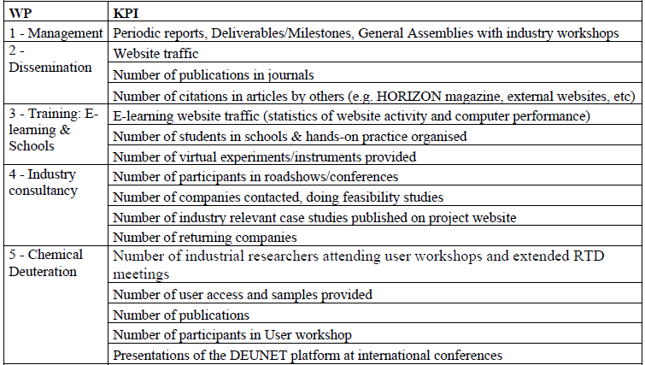
KPI (1)

Slide 8
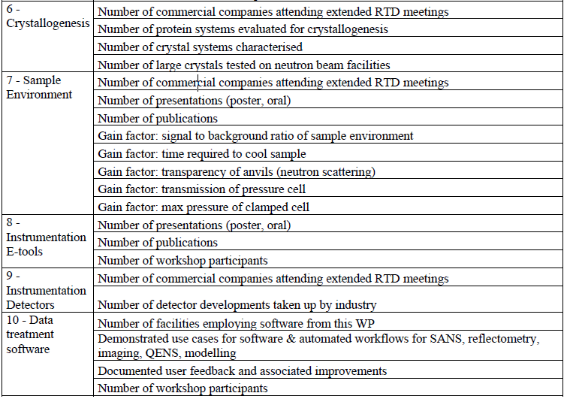
KPI (2)

